Slide 1
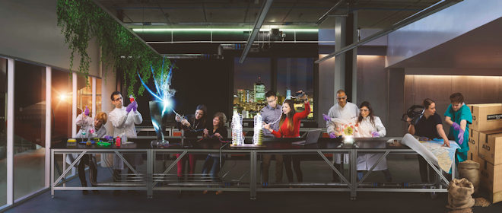
Research Culture and Environment: Lightning Talk
Dr Cathal Rogers,
Research Culture and Assessment Manager

Slide 2
Outline
What is research culture?
Why does it matter?
What does this mean at UoM?
I have an idea; can I apply for funding for this?

Slide 3
What is Research Culture?
“[Research culture] is the way that we collaborate, communicate, and interact with each other;
the behaviours, attitudes, and values that shape how our research is developed, conducted, and used;
and the mechanisms by which we support research and recognise and reward that work.”
A focus on how we do research, not just the outcomes

Slide 4
Why does it matter? What’s the issue?
61% have witnessed bullying or harassment, and 43% have experienced it themselves. Just one in three (37%) feel comfortable speaking up, with many doubting appropriate action will be taken.
84% of researchers are proud to work in the research community, but only 29% feel secure pursuing a research career.
One in five junior researchers and students (23%) have felt pressured by their supervisor to produce a particular result.
43% believe that their workplace puts more value on metrics than on research quality.
32% agree that their workplace values speed of results over quality.
78% of researchers think that high levels of competition have created unkind and aggressive conditions.
53% have sought, or have wanted to seek, professional help for depression or anxiety.

Slide 5
Research Culture and Environment Framework
Research culture and environment Hub

Slide 7
Open funding call
To fund projects that develop and test potential solutions, or increase the scale of already proven practices, to known research culture challenges.
£50,000-£80,000 for projects which align to one of the University’s four research culture themes
Open to individuals or teams. Can be led by research staff, academic staff, technical or professional services colleagues.
Deadline: 14 May 2025
More info: Open funding call for projects to enhance our research culture | StaffNet | The University of Manchester

Slide 8
Further information/ useful links
Research culture and environment Hub
Melissa Westwood: Impactful research and – importantly – how we get there (Viewpoint blog)
Open funding call for projects to enhance our research culture
Email: cathal.rogers@manchester.ac.uk

