Slide 1
Approaches to Pedagogy
Dr. Alistair Dickins
Cheadle Hulme High School (Laurus Trust)

Slide 2
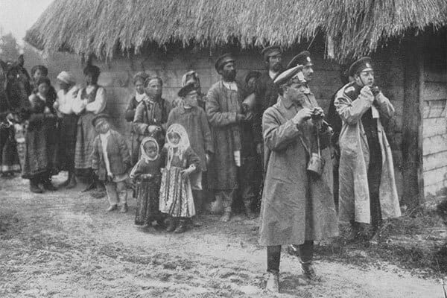
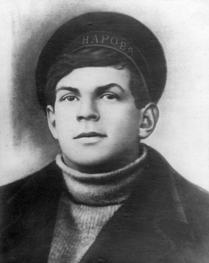
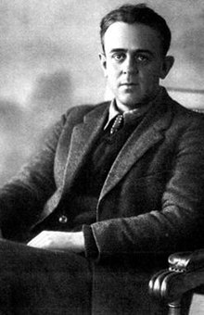
Aims
To introduce a range of pedagogical approaches
To demonstrate possibilities for teaching research-informed lessons
To illustrate a range of potential re(sources) available to teachers

Slide 3
1. Unpicking ‘Ordinary People’
2. Narratives of Polarisation
3. ‘Feeling’ a Revolution?

Slide 4
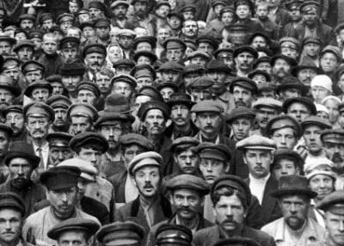
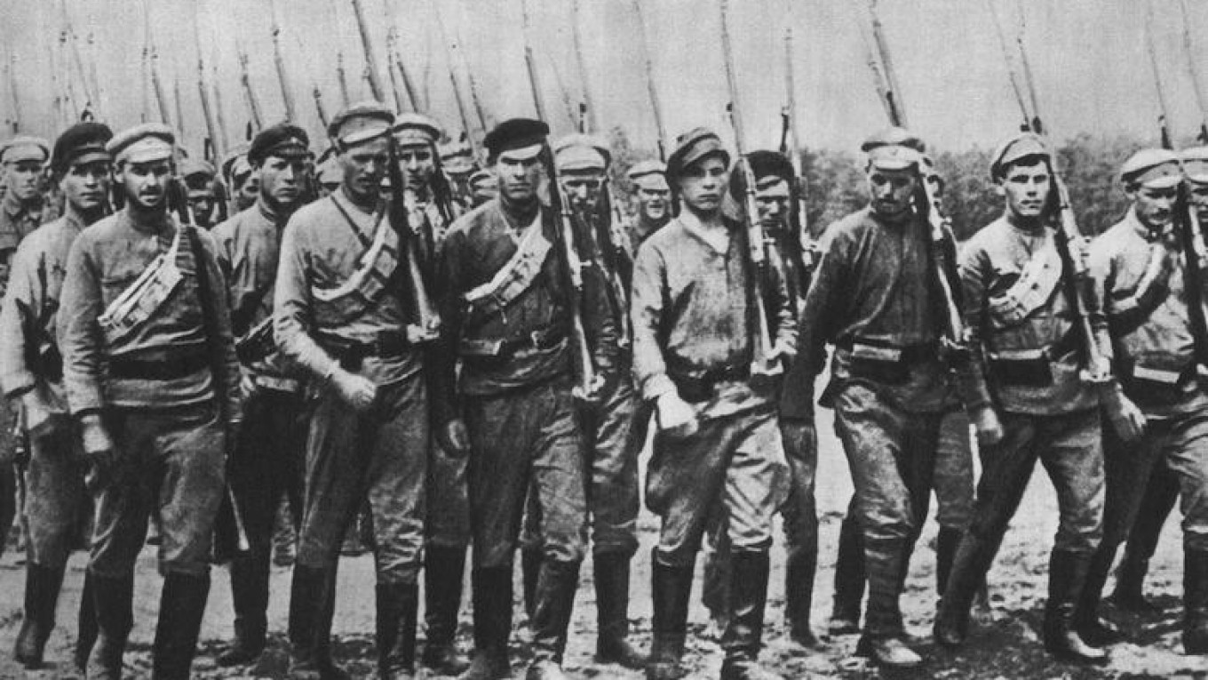
‘Ordinary People’
Historians have typically focused on three social groups in the Revolution.
Workers
Soldiers
Peasants
But who are these, exactly?

Slide 5
Beyond ‘Ordinary’
“The issue [of ‘ordinary people’] becomes ticklish as soon as one thinks about it – and one should – because ‘ordinary’ is neither historical nor precise. Saddled with the concept of ordinary, we risk losing sight of the category’s usefulness: to show that the people we term ordinary are in fact extraordinary when viewed through the right lens and with creative imagination on the part of the historian.”
Historian, Yanni Kotsonis, writing in 2011

Slide 6
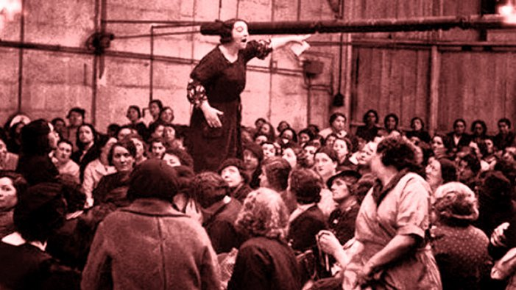
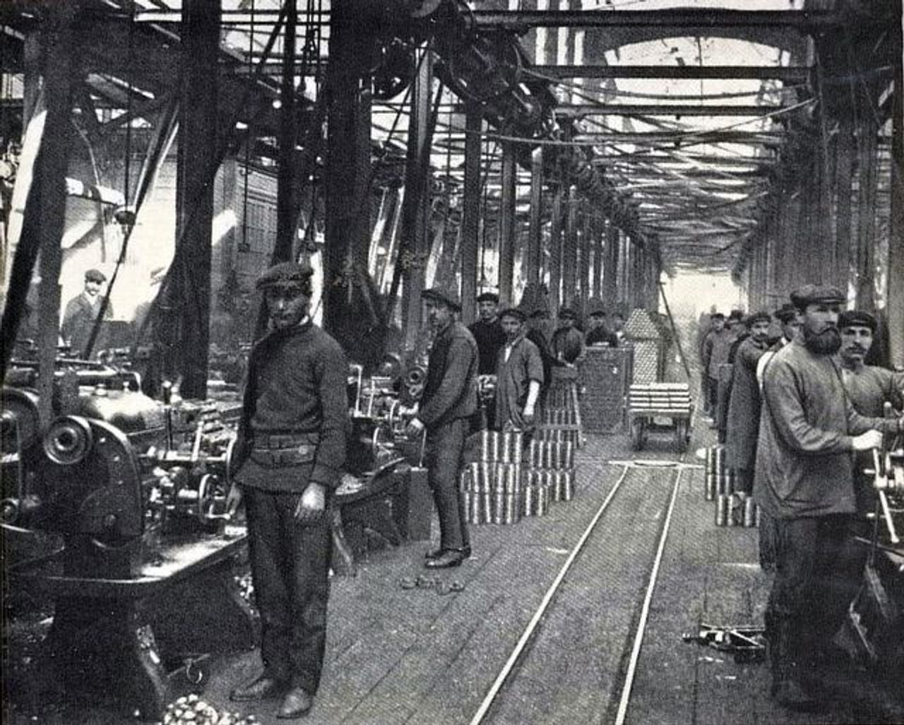
Who were ‘ordinary’ people?
Look at the pictures on the cards in front of you.
Can you sort these people into groups, based on who they appear to be?
Workers?
Soldiers?
Peasants?
Others?

Slide 7
What does the revolution mean to me?
Turn over your cards.
Take a few minutes to read the information about each group.
Do different groups have anything in common?
Aims
Actions
Enemies
Sort them into categories.

Slide 8
‘Ordinary People’
What do you notice about the ‘ordinary people’ of Russia’s revolution?
Why are many historians questioning the old categories of peasants, workers, soldiers?
Why might it have been difficult for Russian society to unite behind a political programme in 1917?

Slide 9
Political Polarisation
Advantages of biography:
Relatability (and novelty) of personal experiences
Interconnectivity with wider context
Narrative structure
Anatoly Zhelezniakov, anarchist

Slide 10
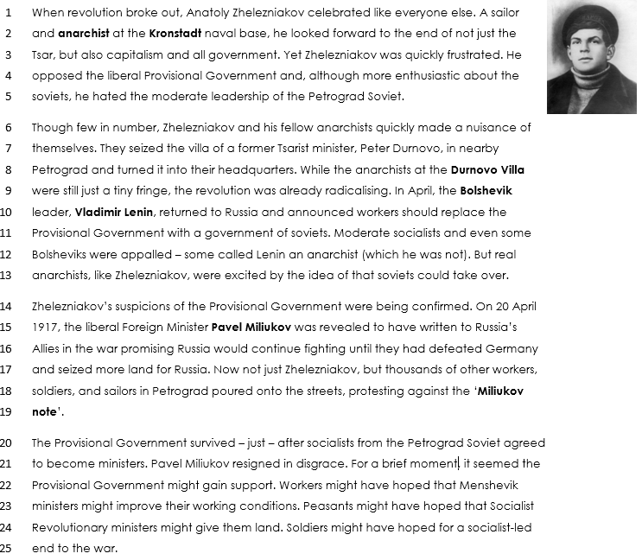
Anatoly and the Anarchists: A Revolutionary Love Story
Identify any causes of polarisation you can find.
What are the most important moments of polarisation?
Who are the main groups/people driving polarisation?

Slide 11
What can Zhelezniakov’s story tell us about polarisation?
Bolsheviks
Localities
Fringe radicals
War
Liberal mistakes
Labour
“Dual power”
Counter-Revolution

Slide 12
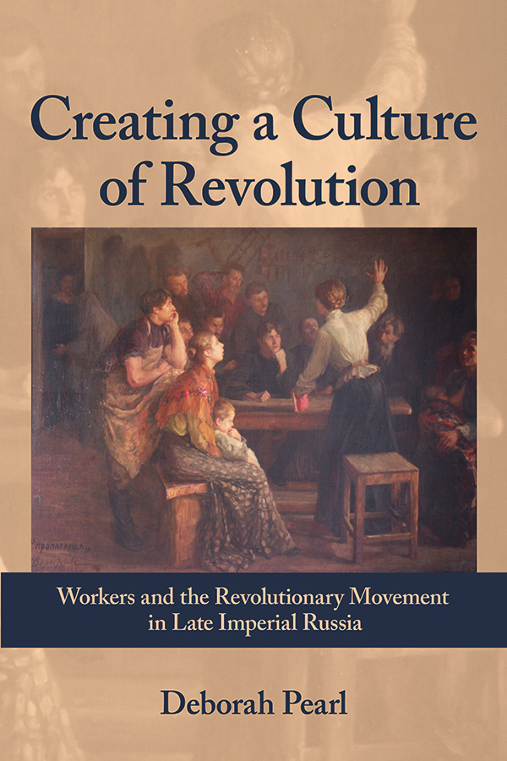
Song and Emotion
Advantages and hazards of emotions:
revolutions are emotional
emotions are difficult to capture
empathy is (im)possible?
Importance of appropriate source base (e.g participant memoirs and their sources of inspiration).

Slide 13
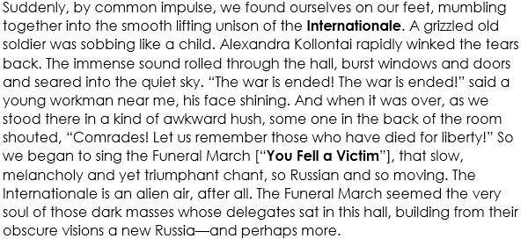
John Reed, Ten Days that Shook the World (1919)

Slide 14
Which song?
Listen to the two songs.
Which is “The Internationale”? Which “You Fell a Victim”?
Now read the lyrics in English. What messages do the songs try to convey? How does their music help them do this?
Notes:
Internationale: https://www.marxists.org/history/ussr/sounds/mp3/international.mp3
You fell a victim: https://www.marxists.org/history/ussr/sounds/mp3/proletariat-01/Vy-shertvoju-pali.mp3

