Slide 1
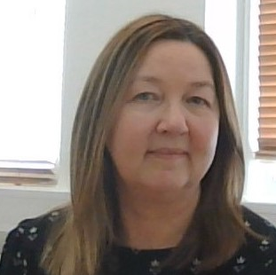
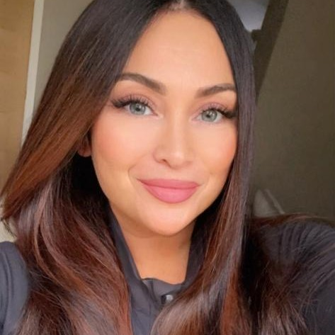
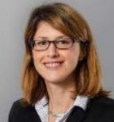
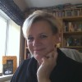
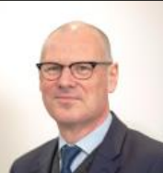
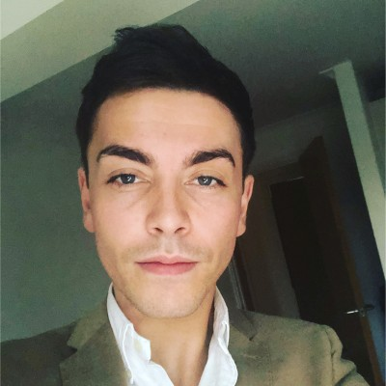
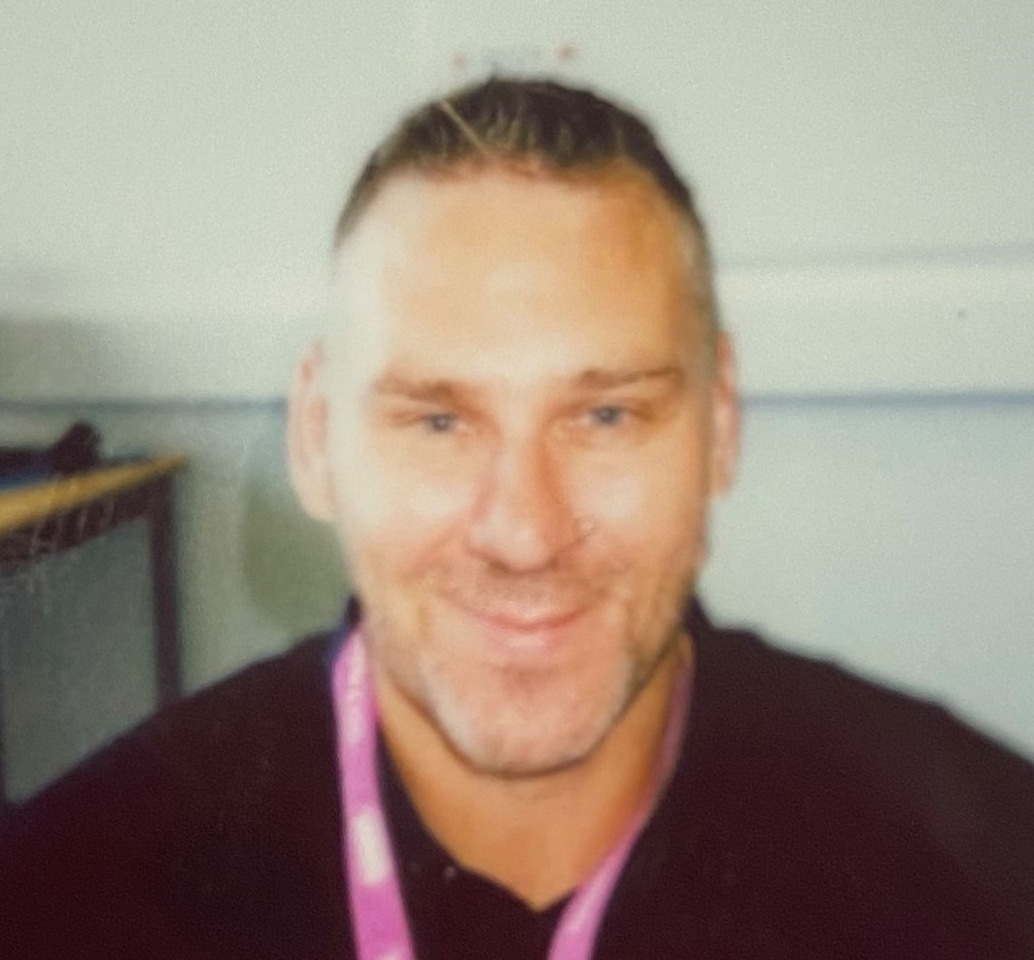
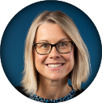
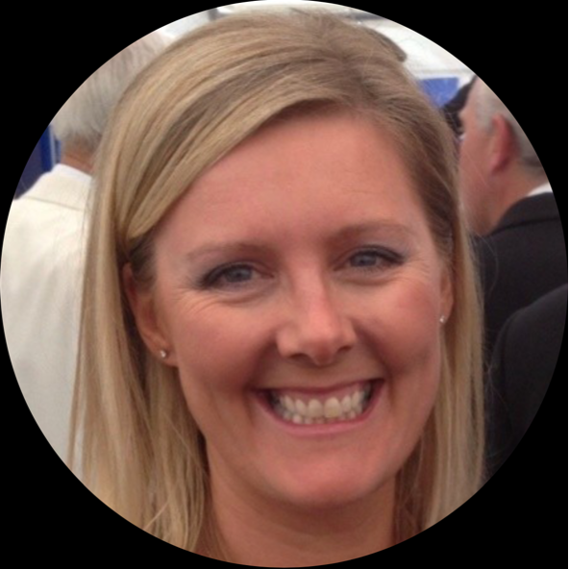
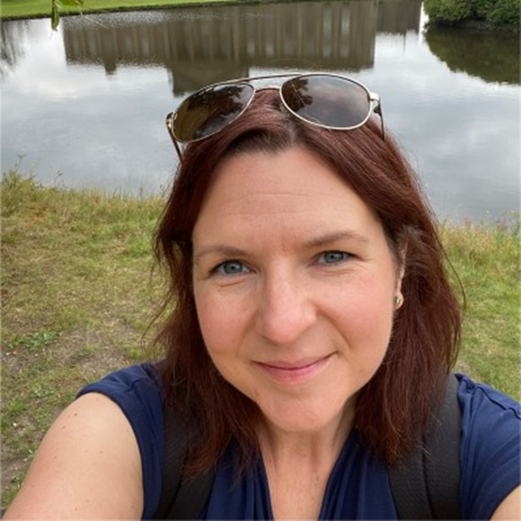
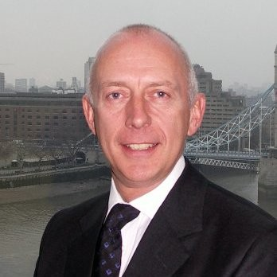
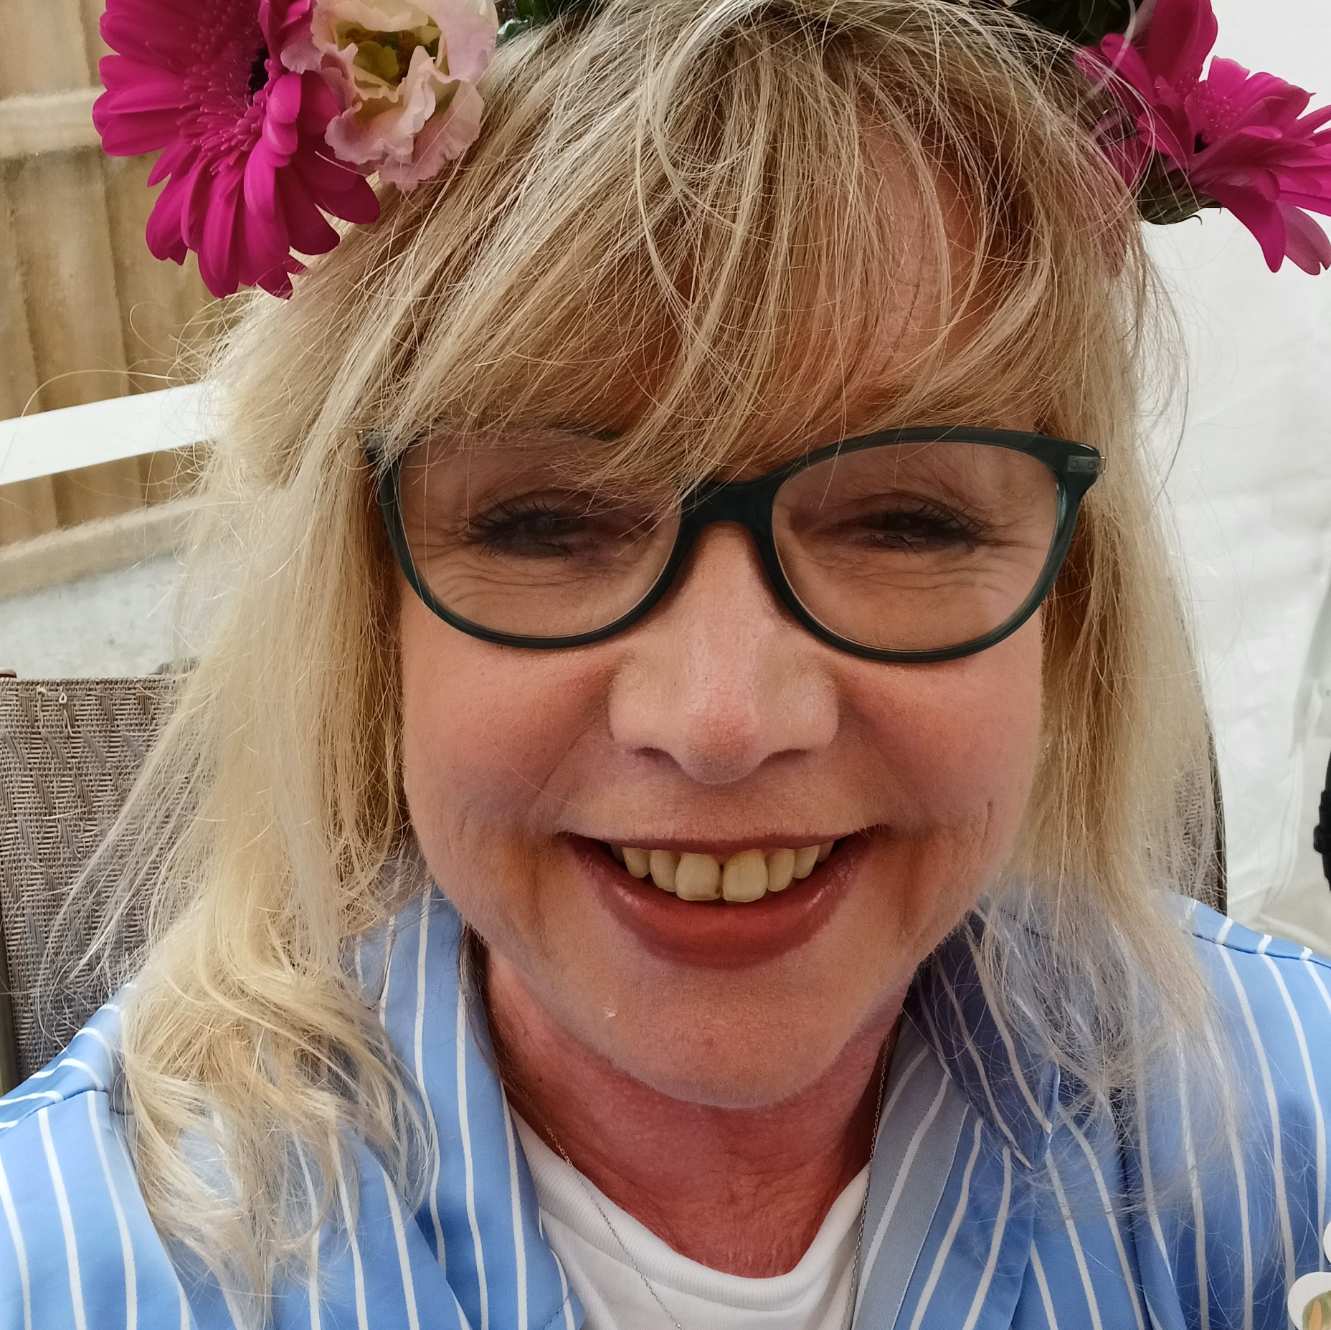
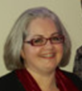
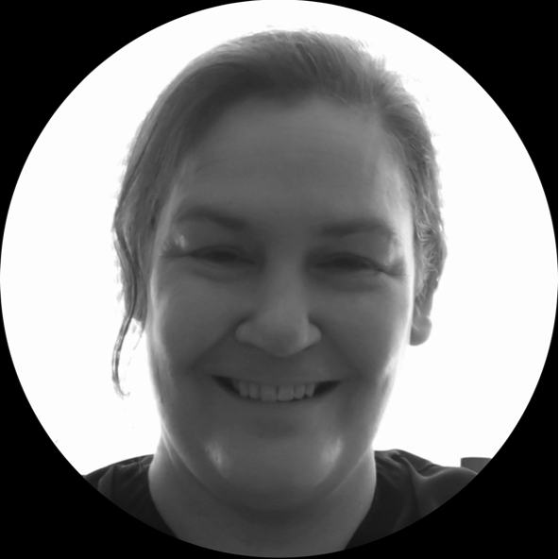
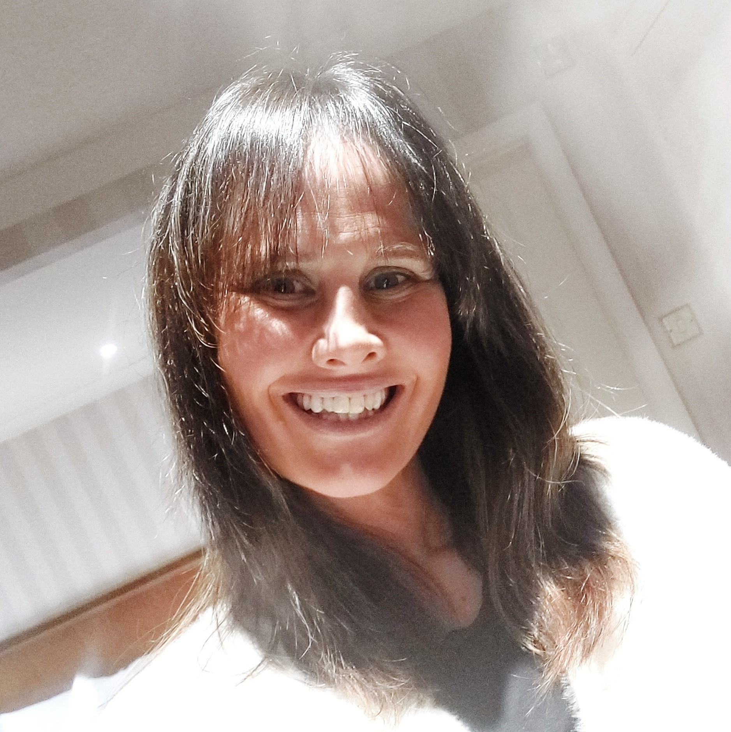
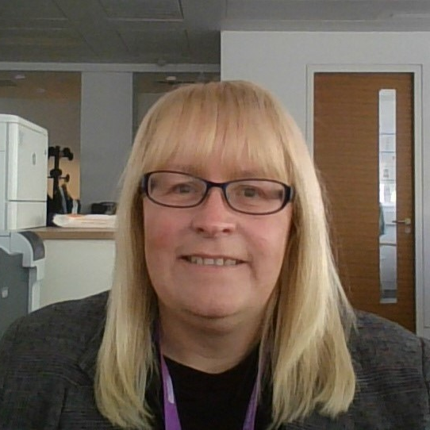
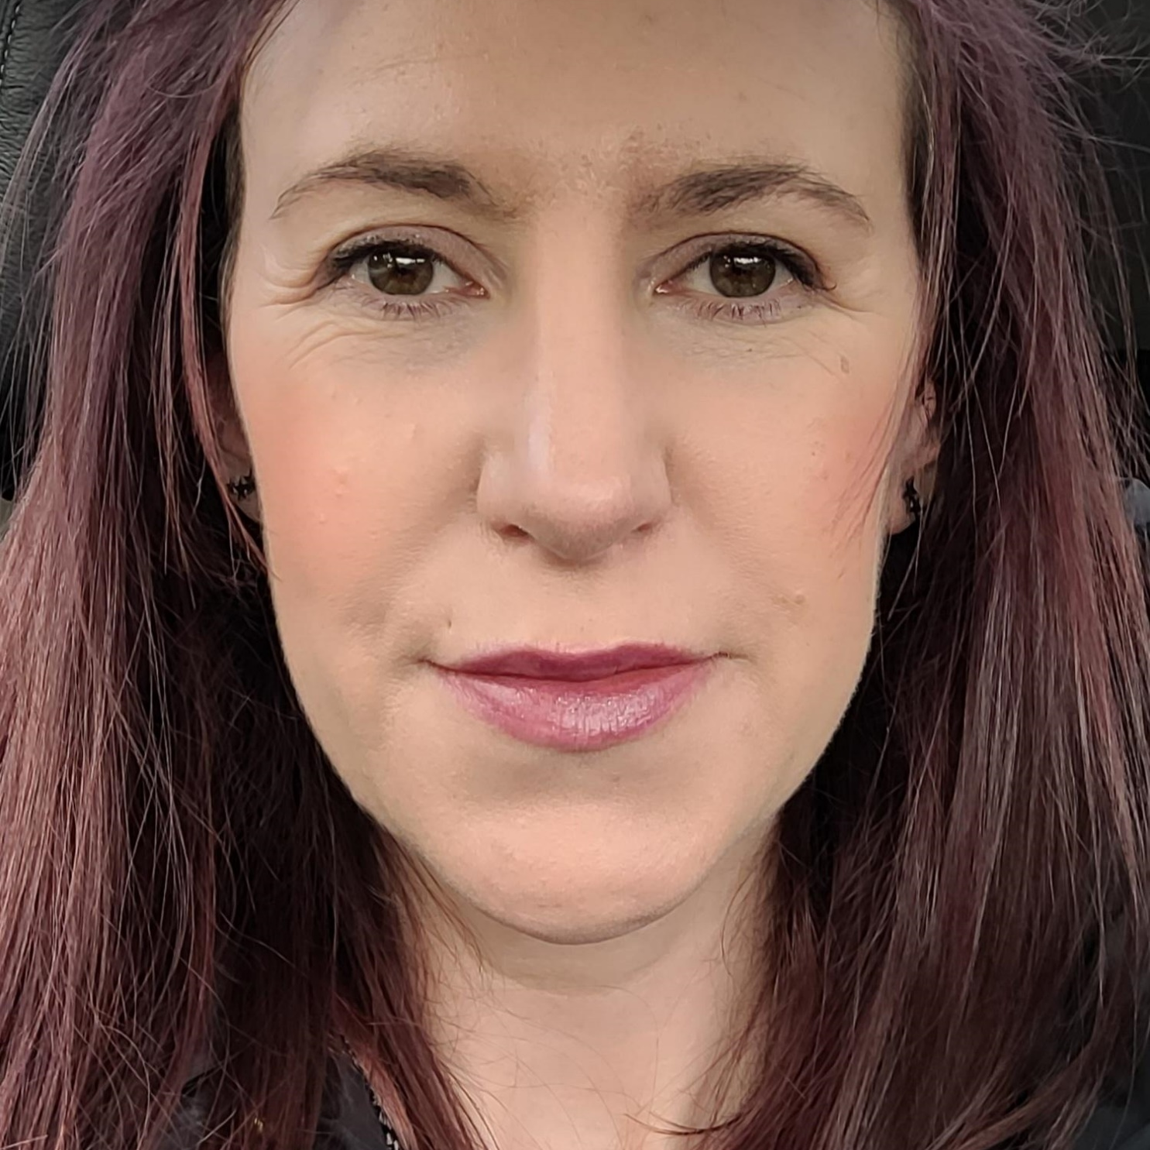
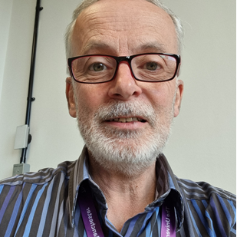
P&OD Leadership Team Direct Reports
Jo Taylor
Katie Grouse
Personal Assistant to the Director of People & OD
Interim Programme Manager
People & OD Transformation
Adèle Mackinlay
Nicola Somers
Sara Sawicki
Executive Officer to the Director of People & OD
Director of People &
Organisational Development
Employment Solicitor
Hazel
Tritschler
Tracy
Pinner
Andrew
Mullen
Helen
Ashley
Deputy Director
of People & OD
Head of People & OD Operations & Reward
Programme Director
People & OD Transformation
Director of Organisational Development
Maxine Bate
Michael Platt
Danielle Birchenough
Ash Field
Anthony Wilkinson
Rachael McGraw
Global Mobility Manager
Talent Acquisition Manager
Business Lead, Strategic Infrastructure
Transformation Programme
Head of Pensions
Head of Colleague Experience
Head of People & OD Partnering Professional Services and Cultural Institutions (Mat Cover)
Shelly Coates
Nicola Evans
Jane Burrows
Helen Brewis
Emma Curson
Neal Chamberlain
Core Systems Manager
Directorate Support Manager
People & OD Transformation Manager
Head of Wellbeing
Head of People & OD Partnering Biology, Medicine and Health
Lead Learning & Org Development Partner
Clare Heinitz
Bushra Salmaan
Fiona Coll
John Malley
Carol Platts
Angela Cotter
Reward Manager
Employment Services Manager
Lead People & OD Partner
Head of People &OD Partnering Science and Engineering
Head of Employee
Relations
Lead Learning & Org Development Partner
Jane McNeill
Andrea Place
Fiona Keenan
Brooke Foulger
Jac Dennington
Workforce Information Manager
Business Lead, Strategic Infrastructure
Transformation Programme
Head of People &OD Partnering Humanities
People & OD
Policy Manager
Head of Workforce
Planning and Talent
Lindsay Monaghan
Caroline Fellowes
Colin Baines
Payroll Manager
People & OD
Policy Manager
Head of Technical Apprenticeships

