Slide 1
Module 3:Bridging the Memory Gap
Evidence from a Randomised Controlled Trial of memory aids and guidance by Dementia Support Practitioners for people with early-stage dementia and their carers

Slide 2
Bridging the Memory Gap
In this module we provide evidence from a Randomised Controlled Trial of the use of memory aids, and guidance in their use, for people with early-stage dementia and their carers living at home.
Why a Randomised Controlled Trial (RCT)? An RCT is the ‘gold standard’ of research design. Because participants are placed into either an ‘intervention group’ receiving the service and a ‘control group’ receiving usual care completely at random, this makes sure that the effects of any differences between participants (age, gender, receiving help etc.) is minimised. Therefore, the results can be trusted more than other research designs.
This study, the Dementia Early Stage Cognitive Aids New Trial (DESCANT) recruited 468 people with dementia and their carers across 10 NHS Trust memory services in England and Wales. The findings are presented below.

Slide 3
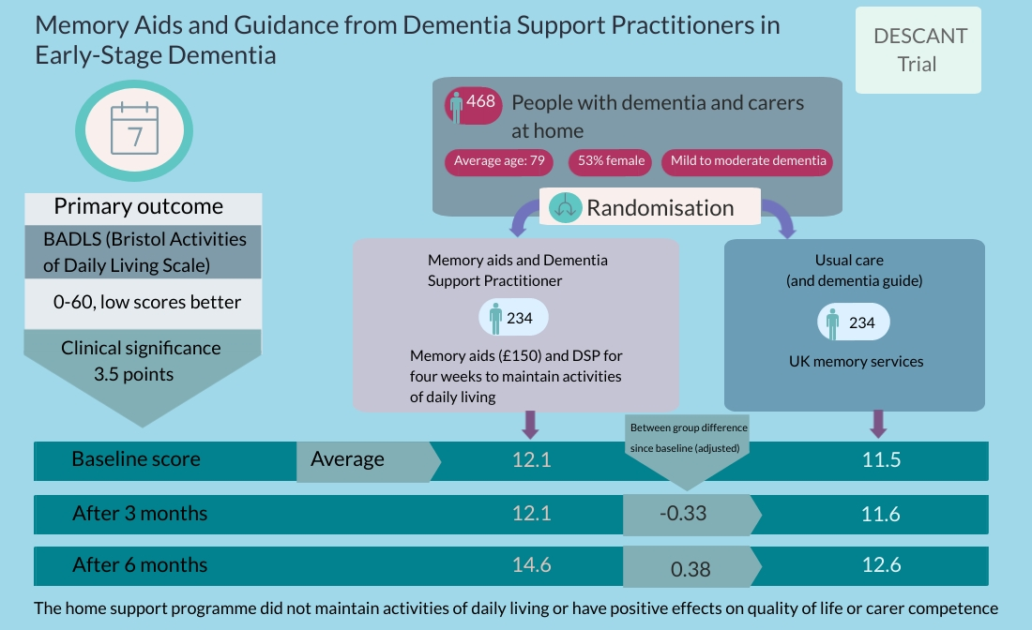

Slide 4
Evidence from the trial – main findings
Our findings from the trial show no effect of the Dementia Support Practitioner in offering guidance and memory aids on people with dementia’s activities of daily living. There was only a slight difference over 6 months in people’s abilities to undertake activities of daily living and this was slightly less impaired in the comparator group - but not significantly.
There were similarly no effects of the intervention on other outcomes. These included: more complex daily living activities (e.g. using the telephone); Control, Autonomy, Self-realisation and Pleasure; memory; carers’ psychological health or their sense of competence in dealing with problems.
The approach was well received. The Dementia Support Practitioners were trained and operated the approach as intended and participants liked it. The following evidence adds weight to this.

Slide 5
Evidence from the trial - processes
We interviewed the Dementia Support Practitioners taking part in the trial and reviewed their records. The following adds more information as to what people thought of the approach and their perceptions of it.
There were high levels of engagement amongst both people with dementia and carers. Most reported use of the memory aids and over half of DSPs considered them to be integrated into their routines. DSPs reported positive benefits for both people with dementia and carers.
Positive feedback was received regarding the memory aids issued, particularly the orientation clock, whiteboards and calendars. They were considered to have a significant impact on participant’s daily living, encouraging independence and reducing reliance on their carer.
Unintended effects were often unforeseen benefits. Examples included the recognition of undiagnosed memory issues in a family member and dual use of memory aids by other carers/family members to help better coordinate care.

Slide 6
Evidence – perceptions of benefit
Some quotations from people with dementia and carers receiving the approach and DSPs implementing it:
“[The aids] gave him a voice; [they] have become part of our daily lives” (carer talking about how the approach had helped her husband).
“I mean it's good because it's a manualised intervention, but also that we do have some flexibility within that…That we are able to make things individual for the individual and make it fit their needs “ (DSP)

Slide 7
Evidence – perceptions of benefit
“I’ve found it’s fitted really, really well, really seamless, certainly looking at what people have challenges with, in respect of their memory, their day to day functioning, how it’s impacted. It’s very similar to the core skills of OT….And so, I’ve found it quite easy to transfer those skills across” (DSP)
“Last week, a carer said it was really helpful that I’d said to them, rather than you tell them the time, you say, go and look at your clock mum, go and do this mum….So they said, they found that really useful, that practical hands on tip….. So, although you’re doing the aids, there’s a lot of strategy work that goes in it, like advising about approaches” (DSP)

