Slide 1
Postgraduate Research Admissions
Humanities Doctoral Academy
Interim Evaluation Process and Guidance
October 2024
Notes:
[Tas welcome]
Hi, welcome to the session detailing the Postgraduate Research Admissions Interim Evaluation process for 2024 entry. I’m Zoe, the PGR Recruitment Administrator for the Humanities Doctoral Academy. Contact details for the Admissions team are given at the end of this presentation.
The purpose of this presentation is to give you some insight to the evaluation process as potential supervisors. While PGRA is not available, we again are operating using an interim process for this cycle. Please be aware that for future cycles, the process should follow the same stages, but will be administered through a separate system.

Slide 2
Timeline of Admissions
Managed through SharePoint and Email
Pre-application
Formal application submitted
Initial Review (PS Administrators and Departmental)
Supervisor Decision
PS Review
Departmental Approval
Formal Offer
Interview
Notes:
Here is a rough timeline of the admissions process. In this presentation, I will go through this process from start to finish, with a particular focus (click) on the ‘Supervisor Decision’ stage.
(click) As was the case for the 2024 cycle, initial review through to Departmental Approval will be managed via SharePoint and Email.

Slide 3
Pre-Application
Pre-application
Formal Programme Application
Initial Review
Prospective applicants may reach out to you directly to discuss whether you are interested in supporting their proposal.
You may correspond with the prospective applicant and go through a process of informally redrafting the proposal until it is suitable.
As you review research proposal drafts, please consider Ethics.
While we encourage prospective applicants to reach out to potential supervisors in advance of submitting their programme application, some may not do this.
Eligibility will only be checked at the point of formal application – admission is not granted on the basis of supervisor approval alone.
Supervisor Decision
PS Review
Department
Approval
School Approval
Formal Offer
Notes:
The pre-application stage you might be most familiar with.
At this point, prospective applicants may reach out to you directly to discuss whether you are interested in supporting their proposal, and you may correspond directly with them, informally redrafting the proposal until it is suitable. Whilst working with app on the proposal, please bear in mind ethical considerations as this has been key for the University and Faculty. Guidance provided by MDC is available via the link in this slide. Applicants have been advised to discuss ethics with their proposed supervisor ahead of submitting their application.
Also although you might be talking to a potential applicant, it’s important to be aware of academic qualifications and eligibility. Eligibility will only be checked at the point of formal application.

Slide 4
Formal Programme Application
Pre-application
Formal Programme Application
Initial Review
Applicants submit a formal programme application via a system called ‘Online Application Form’ (OAA)
All required documents must be provided. Most programmes require at minimum:
1500 word research proposal
Academic transcripts and certificates for both undergraduate and postgraduate degrees. Wherein a Master’s degree is pending, we require an interim transcript
Academic CV
Details of two academic referees
Where applicable, English Language evidence
Name of potential supervisor
Section 9 of the application asks for funding intentions. We ask applicants to detail all competitions they intend to enter.
Supervisor Decision
PS Review
Department
Approval
School Approval
Formal Offer
Notes:
Applicants submit a formal programme application via a system called ‘Online Application Form’ (OAA)
The application form will ask for all relevant required documents. Required documents for each programme are given on the course profile pages, so applicants are aware before this point. For most programmes, this includes:
A 1,500 word PhD research proposal, stating the word count on page 1
Bachelor’s degree academic transcript and certificate.
Master's academic transcript and certificate. Where a Master’s degree is pending, we require an interim transcript
If the applicant has completed more than one Bachelor's or Master's degree, they should submit evidence for each. If any transcripts are in a language other than English, the applicant must provide an official English translation. Likewise, if a weighted average mark or GPA is not included on these documents, applicants should also include an official document from their university verifying this information.
An academic CV. MDC recommends that the CV summarises the applicant’s academic record, employment history, publications and highlight experience demonstrating their research potential.
The names of two academic referees, including one from the most recent institution.
Where applicable, a certificate or evidence demonstrating English language ability and proficiency. Applications can be considered without this evidence but any offer would be conditional on meeting minimum requirements.
To let you know how references work, the system automatically contacts the referees once the formal application is submitted. The email they receive gives a link to the referee portal, where referees can complete a sort-of questionnaire about the applicant, or upload a letter of reference (or do both). We do check throughout our process that references have been received – I’ll go into this shortly.
The application form also asks applicants whether they have identified a potential supervisor.
Section 9 of the application asks for funding intentions. We ask applicants to detail all competitions they intend to enter.

Slide 5
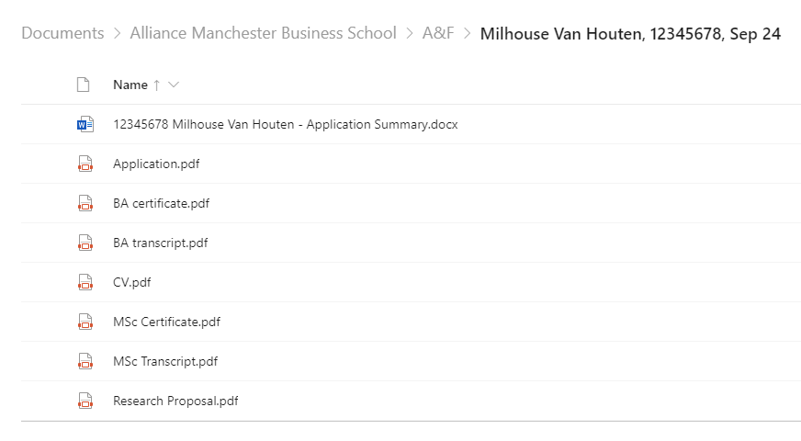
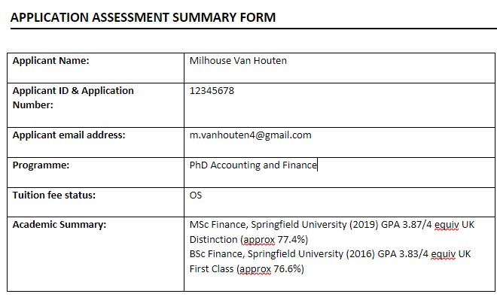
Initial Review PS Administrator
Pre-application
Formal Programme Application
Initial Review
After applicants have submitted their formal programme application, Admissions administrators will:
Request outstanding documents
Assess transcripts to confirm whether the applicant meets standard entry requirements.
Await references (where applicable)
Write an application summary:
Supervisor Decision
PS Review
25
Department
Approval
School Approval
Formal Offer
Notes:
After formal programme applications come in, admissions administrators will do a couple of things:
(click) First, we will check that all required documents have been provided, and send a request to the applicant for any which have been omitted.
(click) Once all documents have been received, we will assess the transcripts to confirm that the applicant meets standard entry requirements.
Depending on particular school and department agreements, we will reject applications that fall clearly below entry requirements. For SEED, this is not applicable.
In scenarios where an application is to be considered despite academic qualifications falling below requirements, an additional justification statement is needed from the supervisor (detailing reasons such as strength of proposal or relevant professional experience). I’ll come back to this shortly.
(click) Depending on particular school agreements, we will circulate applications while we are still awaiting referees to provide references. As soon as we receive the references, they will be added to the applicant’s documents for your review. If the agreement is to await references, we will wait until 1 or both references have been submitted via the referee portal before the applications can be circulated.
(click) We will write an application summary detailing formal qualifications, and for international degrees, the UK equivalent grade and approximate percentage. For interim Master’s degrees, we will also include the current average percentage, to reflect what applicants are on target to achieve. The academic summary will also state how the applicant meets English language requirements, whether funding has been declared, and whether a potential supervisor has been identified on their application form.
(click) This application summary will be housed in a document titled with the applicant’s ID number, name, and application summary. This document also contains some guidance for the admissions process, including ethical considerations, export control and ATAS. This application summary document will be placed in a SharePoint folder, along with all of the applicant’s supporting documents, and a pdf of the application form.
New screenshot of summary form

Slide 6
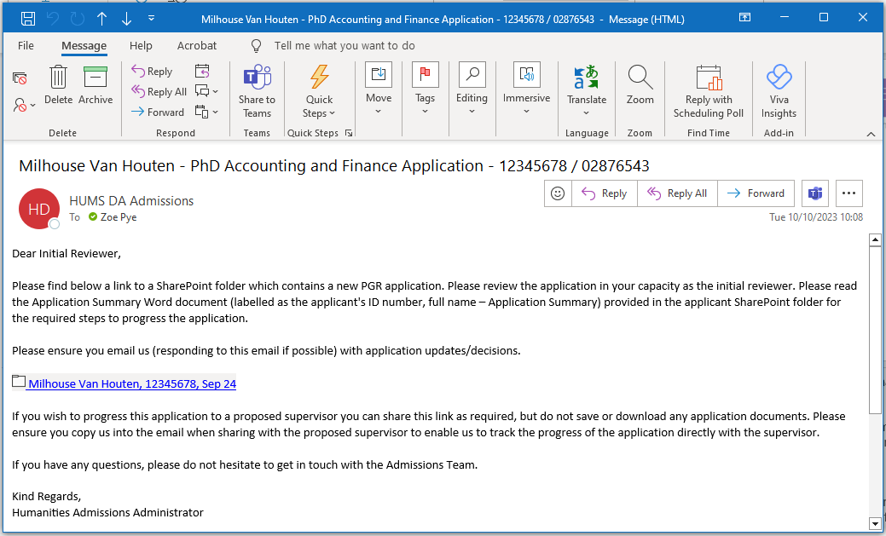
Initial Review Departmental
Pre-application
Formal Programme Application
Initial Review
Supervisor Decision
PS Review
Department
Approval
School Approval
25
Formal Offer
Notes:
After admissions administrators have made their initial assessment, the application is then forwarded for academic consideration. Like last year, applications will be shared via email for this cycle.
The first stage of academic consideration is Initial Review. All eligible applications are forwarded to the respective DCO, Admissions Tutor or PGR Director. They will receive an email such as the one shown here, prompting them to review the application.
The email will contain a link to the SharePoint folder, providing access to all relevant documents, including the application assessment summary, application form, and research proposal.
If the application is unsuitable, the initial reviewer will reply to the admissions team via email, and the admissions administrator will process a reject decision.
If the application is suitable, the initial reviewer will reply to the email and add potential supervisor(s) to the thread. This enables us to track the progress of the application directly with the supervisor. Please note that initial reviewers may determine that the most appropriate supervisory team is different from those listed on the application form.

Slide 7
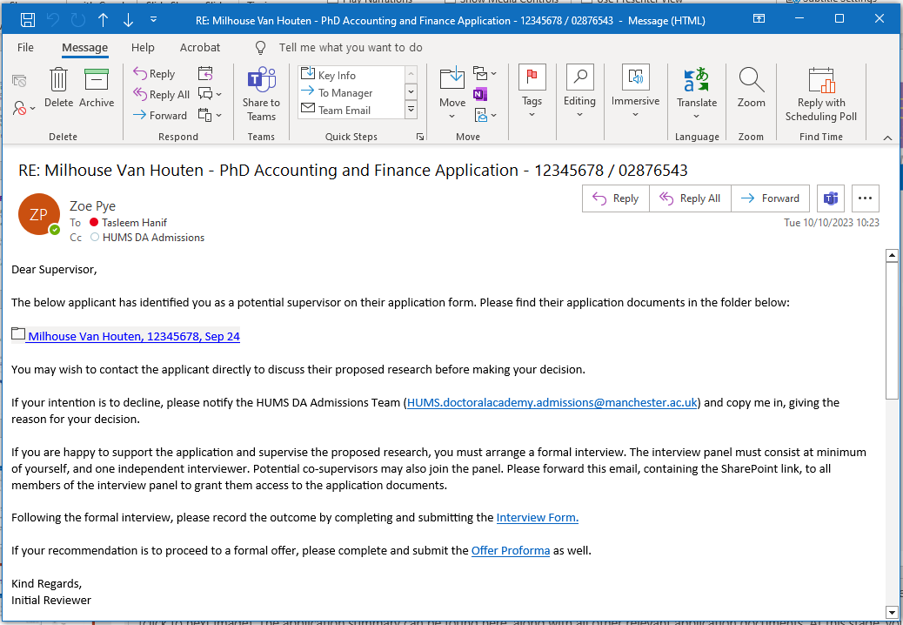
Supervisor Decision
Pre-application
Formal Programme Application
Initial Review
Supervisor Decision
PS Review
Department
Approval
25
School Approval
Formal Offer
Notes:
At this stage, you will receive an email from the initial reviewer notifying you that there is an application for your review. In this email, there will be a (click) link to the SharePoint folder, containing all of the application documents.
The application summary can be found here, along with all other relevant application documents. At this stage, you should review the documents and determine if you are interested in supervising the proposed research. You may wish at this stage to reach out to the candidate to discuss the research, or even informally prompt a redrafting process. Please be aware that the final version of proposal should be emailed to the Doctoral Academy Admissions Team so that the application can be up to date (bearing in mind this will be used for funding apps, where applicable).
In the application summary document, guidance is given on the steps required from you. In the next few slides, I will go into this in more detail.
If your intention is to decline supervising the application, please notify the HUMS Admissions Team and copy in the relevant DCO / Admissions Tutor / PGR Director, giving the reason for your decision. You can decline before or after interview – just let us know why.

Slide 8
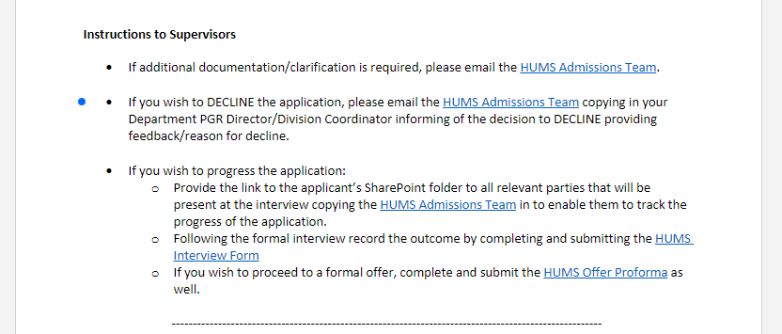
Pre-application
Supervisor Decision Interview Form / Offer Proforma
Formal Programme Application
Initial Review
Supervisor Decision
PS Review
Department
Approval
Interview Form: https://forms.office.com/r/ZYmUaANf2A
School Approval
Offer Proforma: https://forms.office.com/r/WgDu8eJENg
Formal Offer
Notes:
If you are interested in supervising the proposed research, you must formally interview the candidate as per university policy. The interview panel must at minimum consist of yourself as potential supervisor and an independent interviewer.
The Humanities PGR Applicant Interview Form must be completed by the proposed main supervisor. This form must be submitted for all applicants interviewed (whether successful or not). A link to this form is provided in the admissions summary document, under ‘Instructions to Supervisors’, and at the bottom of this slide.
[open browser with interview form]
This interview form covers all bases expected in a formal interview, and contains suggested questions - you can include additional questions as you feel are appropriate to the research topic. This form is used as part of funding applications, and has been cited as being helpful in making applications competitive as Pathway Leads are able to utilise the information given in the interview form when completing nomination forms. As such, we really appreciate if you complete it with all appropriate detail.
As a reminder, there is a question in the interview form to address whether Ethics have been considered within the research proposal, and if there are any concerns regarding the project gaining UREC approval in a timely manner. If there are any ethical concerns, you must refer the application upwards to School PGR Director and Research Director, and evidence of School PGR Director and Research Director approval must be provided before the application will progress further.
Following interview, if you are happy to supervise the applicant and their proposed research, please complete and submit the Humanities PGR Offer Proforma. A link to this form is provided in the admissions summary document, under ‘Instructions to Supervisors’, and at the bottom of the interview form.
[open Print version (no branching) in browser]
This information captured in this form (such as supervisory team and supervision percentage) is used by the admissions team to populate the programme offer, and will be reviewed at departmental level.
-The form also asks whether the applicant meets standard entry requirements for the programme. You will already have the applicant’s grades in the application summary document, but if you would like to check the programme entry requirements, a link is given here in the form. If you wish to progress an application where the applicant does not meet the programme requirements, we have added a field where you can enter the justification for admission. This will be reviewed during the remainder of the evaluation process.

Slide 9
Approval Process
Pre-application
Formal Programme Application
Initial Review
PS Admissions Administrators check that all relevant forms are received, and acceptable.
We will add both the interview form and offer proforma to the SharePoint folder containing the applicant’s documents.
At this stage we also double check that both references have been submitted.
We will email the folder to the relevant Departmental Reviewer, and indicate the proposed offer and any other relevant details (ie Full Time Sept 2025 Offer, Conditional on MA, no funding declared).
Supervisor Decision
PS Review
PS Review
Department
Approval
Department
Approval
Departmental reviewers will check all submitted documentation, and confirm if they approve the proposed offer, taking into account supervisory capacity in the department.
School Approval
School Approval
Formal Offer
Depending on the School, School PGR Directors will serve as final reviewer and confirm whether they approve the proposed offer.
Formal Offer
Notes:
After you submit the interview form and offer proforma, the evaluation proceeds through 3 stages of approval.
The first of these is PS review. At this stage we check that all relevant forms are received, and acceptable. We will add both the interview form and offer proforma to the SharePoint folder containing the applicant’s documents. At this point, we also double check that both references have been submitted. We will email the folder to the relevant Departmental Reviewer and indicate the proposed offer (ie Full Time Sept 2025 Offer, Conditional on MA). If there are any discrepancies, you are likely to receive an email from us.
(click)
At Departmental Approval, Department Co-ordinator, PGR director or Admissions Tutor (dependent on individual department agreement) will check all submitted documentation and comment whether they approve the proposed offer, taking into account supervisory capacity in the department.
(click)​
The final stage is School Approval – depending on individual school agreements, the PGR Director or Head of Division will serve as final reviewer and comment whether they approve the proposed offer.
All approval must be given to allow an offer to be extended to an applicant. Supervisor approval and successful interview are not sufficient until PS, Departmental and School reviewers have given the go-ahead. Once we have received this, we will (click) generate the programme offer to your new supervisee.

Slide 10
Funding
Pre-application
Formal Programme Application
Initial Review
To apply for internal funding competitions, applicants must indicate in section 9 of their programme application which competitions they would like to enter.
Please be aware that ESRC NWSSDTP and AHRC NWCDTP applications have a strict 1500 word count on research proposals. If you have an applicant applying for research council funding, the funding application version of the proposal must be provided with their funding application.
For specific information on funding competition eligibility and processes, please see the pages on the Recruitment and Admissions > Funding area of StaffNet.
Supervisor Decision
PS Review
Department
Approval
School Approval
Formal Offer
Formal Offer
Notes:
Applicants should already know their funding intentions before the point of application, as in order to enter internal funding competitions, we ask that the name of the competition is included in section 9 of the application form. Hopefully, you will be aware of any potential supervisee’s intentions prior to the point of their formal offer through discussions throughout the admissions process. As you may already know, it is likely you will be required to support the PGR and their funding applications.
If you have any potential supervisees seeking to apply for ESRC NWSSDTP or AHRC NWCDTP funding, please liaise with them to produce a 1500 word version of their research proposal, and make sure the revised version of the proposal is forwarded to the Doctoral Academy Admissions team by relevant deadline. Pathway leads also utilise the content of the interview form in their nominations, so please complete this form with as much detail as possible following the admissions interview to ensure a strong application.
For more detailed information about funding, we will be holding a funding session on the 9th of October which provides a more detailed overview of funding allocation processes, and how to navigate these pages in StaffNet.

Slide 11
PGR Admissions
Questions?
Humanities Doctoral Academy Recruitment & Admissions Team
https://www.staffnet.manchester.ac.uk/humanities/research/postgraduate-research/doctoral-academy/
hums.doctoralacademy.admissions@manchester.ac.uk
Telephone: +44 (0)161 275 1200 – Select Option 1
This presentation, and further resources will be housed in the Recruitment and Admissions section of Humanities PGR on StaffNet: https://www.staffnet.manchester.ac.uk/humanities/research/postgraduate-research/recruitment-and-admissions/
Notes:
We’ll shortly have a Q and A for any questions you have now, but if you have any questions at any point in the cycle, please send us an email at hums.doctoralacademy.admissions@manchester.ac.uk.
A recording of this presentation will be housed in the recruitment and admissions section of Humanities PGR on staffnet, alongside further resources.
https://www.staffnet.manchester.ac.uk/humanities/research/postgraduate-research/recruitment-and-admissions/.
We have collated all of the questions from the sessions in the previous cycle, and we’ve popped them in the FAQ page on StaffNet. We will do the same for any questions you may have now- if there is anything you’d like to ask, please go ahead.
------------------
A recording of this presentation is be housed in the recruitment and admissions section of Humanities PGR on staffnet, alongside further resources.
We have collated all of the questions from the live sessions, and we’ve popped them in the FAQ page on StaffNet. but if you have any questions at any point in the cycle, please send us an email at hums.doctoralacademy.admissions@manchester.ac.uk.

