Slide 1
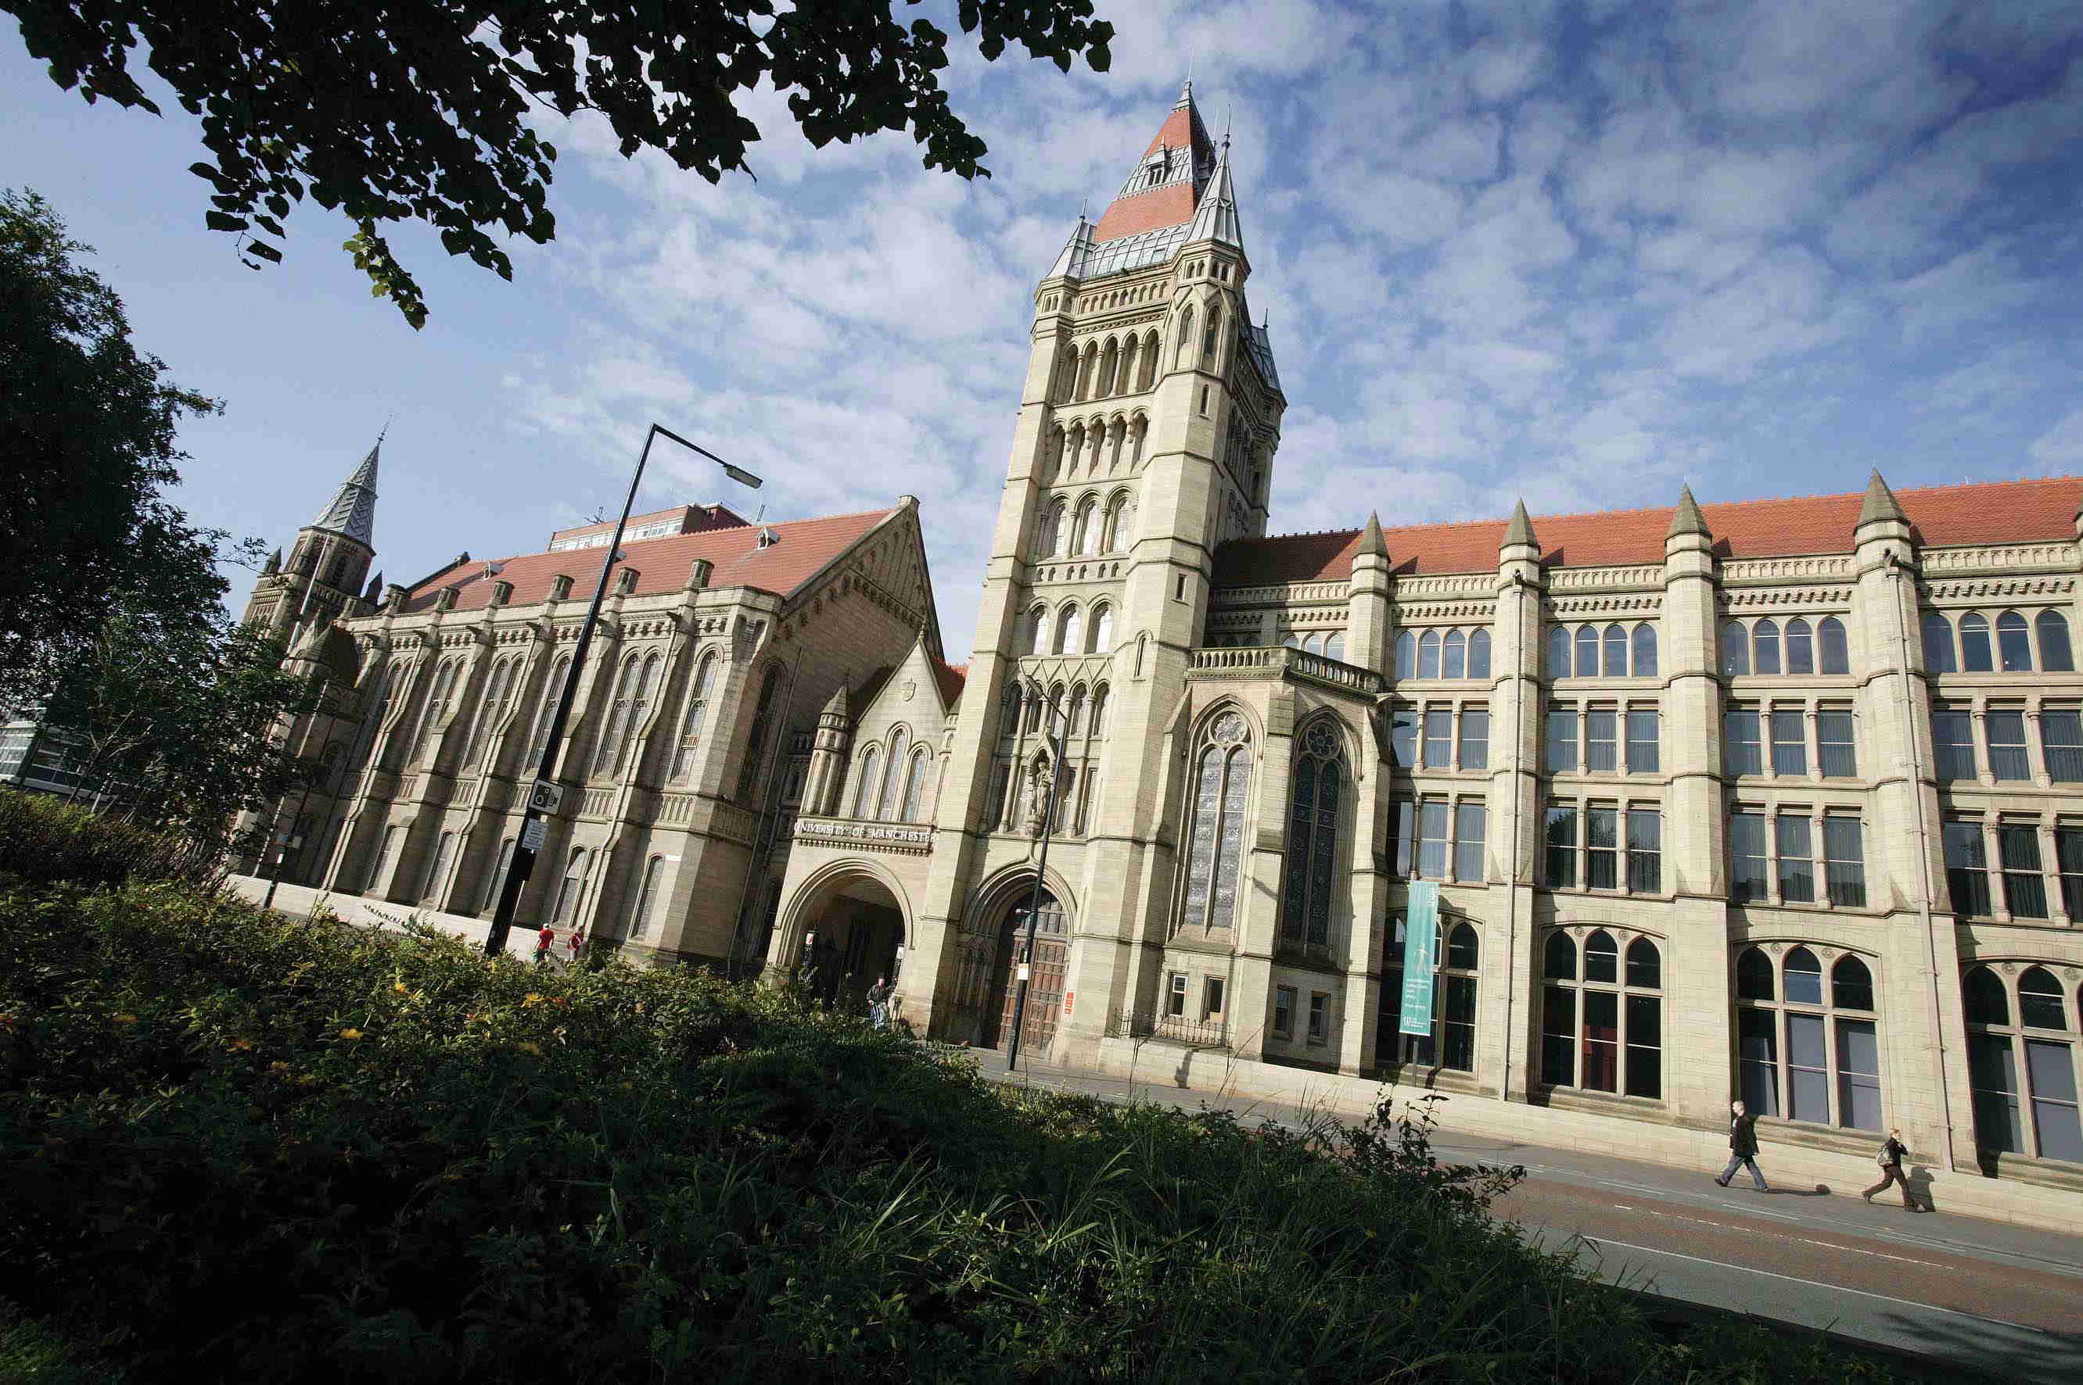
Student Visa Application: Applying from Overseas
Student Immigration Team
Student Services Centre
visa@manchester.ac.uk

Slide 2
Student Immigration Team
Student Services Centre
visa@manchester.ac.uk
Contents
Visa for Short-term study
Differentiation Countries
Visa Application costs
Visa Application Process
Supporting Documents
Credibility Interviews
BRP Card
Dependants
Visa Refusals
Arriving in the UK

Slide 3
Short-term Study – Standard Visitor Visa
As of 1st December 2020, applicants can apply for a Standard Visitor visa/enter the UK as a Visitor to study a short course which is less than 6 months in length
The Short-term study route is now only for students coming to the UK to study an English language course between six and 11 months long
Standard Visitor application fee is currently £95 in local currency
No work permitted and you cannot extend this visa from within UK
Non-visa nationals and EEA/Swiss nationals can enter the UK as a Visitor either via the passport eGates or by seeing an immigration officer on arrival
You must check whether you are required to apply for a visa before you travel (visa national) or if you are a non-visa national: https://www.gov.uk/check-uk-visa
Even if you are eligible to obtain Visitor status on arrival, it is still advisable to carry your offer letter and evidence you can support yourself in your hand luggage
If you use the airport eGates, you must retain evidence of your arrival date so that you know the exact duration of your six month stay
Your course may still require ATAS clearance so check with your school/department as it can take up to 4 weeks to obtain this clearance so applying early is important

Slide 4
Low Risk Nationals:
Students from some countries are part of UKVI differentiation agreement
Check if your nationality is included by looking at the Differential Evidence Requirement section in Appendix ST of the Immigration Rules: https://www.gov.uk/guidance/immigration-rules/appendix-st-student
You do not have to submit financial documents or qualification documents as part of your visa application
However, UKVI can still ask you to provide this evidence later so you must ensure you still obtain the evidence of your qualifications and your money, even though you may not need to send them

Slide 5
Visa Application costs
1

Slide 6
Visa Application cost
A standard Student visa application costs £348 (in local currency)
Each applicant has to pay e.g. each dependant pays the same fee and makes a separate application
This is the standard application cost. There may be other premium services available depending on the country you are applying from
Please check with your local visa centre for priority services:
https://www.gov.uk/find-a-visa-application-centre

Slide 7
Immigration Healthcare Surcharge
Compulsory charge which entitles applicants to free hospital treatment whilst in the UK. You cannot submit your application without paying this.
Only affects students who will be issued with visa for 6 months or more.
Charge is currently £470 per year and £235 for part of year (less than 6 months).
Calculated on length of visa, not length of course:
Length of course + 1 month before start of course + 4 months after end of course
Cost should work out as follows:
£705 for a 12 month Masters course
£1645 for a 3 year Undergraduate course

Slide 8
Visa Application process
2

Slide 9
When and where to apply for Student visa
When to apply
You can only apply for your Student visa online once you have received your CAS statement from the University
You should only apply online once you have all the required documents and have checked these meet requirements
Where to apply
You can apply for a Student visa in the country you are ordinarily resident in
This may be your home country or the country you are residing in e.g. for work or studies
You cannot apply in a country if you are only visiting e.g. if you have a visitor or tourist visa

Slide 10
How to apply for a Student visa
Wait for your admissions team to create your CAS
Read the information on our website including our guide to the Student application form and our financial guide: www.studentsupport.manchester.ac.uk/immigration-and-visas/visas-and-applications/
Complete the online Student application form through the GOV.UK website:
https://www.gov.uk/student-visa/apply
Pay the application fee and Immigration Health Surcharge online
Book appointment at a local Visa Application Centre
3. Attend appointment a Visa Application Centre
Submit original documents which should be scanned and returned to you
Enrol biometrics
Attend credibility interview if asked to
4. Await decision

Slide 11
Complete the online visa application
Pay the visa and IHS fee
Book an appointment at local VAC
Passport returned with entry visa vignette
BRP collection letter included
CAS is sent
Wait for decision
1
2
3
4
Official date of application
Travel to UK within your entry visa period
Attend appointment at VAC
Enrol biometrics
Scan documents
Attend video interview (if required)
Prepare for application using our website guidance

Slide 12
Documents
3

Slide 13
Documents required
CAS number (from your Academic Department/School)
Valid passport
Financial Evidence: Sponsor letter or bank statements
Official translation if your bank statements are not in English
Birth certificate (using your parent’s bank statements)
signed Letter of consent from your parent (using parent’s statements)
Qualification documents that are listed in the CAS (e.g. degree certificate)
Official translation of your qualification document (if not in English)
ATAS certificate (if required)
TB certificate (if required)
Letter of consent from your parents & evidence of relationship (if you are under 18 years old)
Note: With the introduction of the Student route, overseas applicants applying for a course of study at degree level or above are no longer required to provide evidence of the qualification used to obtain their offer, as stated in their CAS.

Slide 14
Confirmation of Acceptance of Studies (CAS)
You must have a CAS from the University before a Student visa application can be made
Earliest date you can apply for a Student visa to enter the UK is 6 months before the start date of the course: so if your course starts in September your CAS could be issued as early as March
CAS issued by Admissions Staff in Academic School once you have accepted your unconditional offer online
If you are studying a postgraduate taught course (masters) you will need to pay a deposit before your CAS can be issued
Draft CAS will be emailed to you so you should check that all of the information is correct and email back to confirm this or highlight any error.
The CAS is an electronic document; it does not need to be printed and included with your application

Slide 15
Documents that are required

Slide 16
Financial Requirements - How much money do I need to show?
You need to show that you have the right amount of money available to you.
You need to show:
Tuition fees + Maintenance (£1023 per month)
=
Total amount you need to show
You need to show this using either:
Sponsor letter (if you are officially sponsored)
Bank statements (if you are self-financed)

Slide 17
Financial Evidence - Using own money
You need to show that you have:
The funds for the first year’s tuition fees
+
£9207 for living expenses (£1023 per month for 9 months maximum)
The funds must be in your bank account or your parent’s bank account for 28 days before the date you apply for the visa online – not the date of the appointment at the visa application centre.
Your CAS will be updated to show any tuition fee payments. You can deduct this amount from the total funds you need in your bank account.
If the balance drops below the required amount at any point across the 28 day period your visa application will be refused.

Slide 18
Financial Evidence - Using own money
The bank statements you submit can either be printed by the bank or an online statement and there is no longer a requirement for online statements to be stamped on each page or accompanied by a supporting letter from the bank.
The statement must be less than a month old at the time you submit the visa application online.
The bank statements must contain the following information:-
The name of the bank;
Your name and account number;
The date of the statement;
They must show all transactions covering at least a 28 day period
Funds may be held in any form of personal bank or building society account (including current, deposit, savings, pension from which the funds can be withdrawn or investment account) provided the account allows the funds to be accessed immediately.

Slide 19
Financial Evidence - Using parent’s money
If you use a parents’ or legal guardians’ bank statements in your application you must also submit the following documents:
A signed letter of consent, written in English from your parents or legal guardians. See a template letter here: http://documents.manchester.ac.uk/display.aspx?DocID=28713
A legal document confirming the relationship between you and your parent(s) and legal guardian(s). These can only be the following:
Birth certificate which names the parents who are providing their bank statements (or household register if you are from China)
Certificate of adoption which names the parents who are providing their bank statements
Court document which names the legal guardians who are providing their bank statements and your name

Slide 20
Unacceptable financial institutions
UKVI will not consider funds if they are held by a financial institution where:-
The case worker is unable to make satisfactory verification checks; or
The financial institution is not regulated by the appropriate regulatory body for the country in which that institution is operating; or
The financial institution does not use electronic record keeping

Slide 21
Financial Evidence – Official Financial Sponsor
You can only be sponsored by one of the following:
The British government or home government
The British Council or an international organisation
Any university
A UK Independent school
An international company - This has to be a company that has an office in more than one country and they have a website with clear contact details for all the overseas offices
You should then provide a sponsor letter with your visa application. You are permitted to submit a copy or a scan of the letter.

Slide 22
Financial Evidence – Official Financial Sponsor
The letter should be on official letterhead paper and have the official stamp of the financial sponsor. It should also include:
Your name
The name and contact details of the financial sponsor
The date of the letter.
The duration of the sponsorship
The amount of money you will receive per month, or if you are fully sponsored then confirm that your financial sponsor will “cover all of course and living costs”
If the scholarship also covers your family members the sponsor letter should include their names as well as yours

Slide 23
Financial Evidence – Official Financial Sponsor
Being fully financially sponsored means that you receive full fees and maintenance (at least £1023 per month) from your official sponsor.
If you are fully sponsored by The University of Manchester:
Your CAS will confirm your sponsorship details
You will not need to provide any other financial documents
If you are fully sponsored by a government or international scholarship agency:
Your sponsor letter should also include additional consent for you to remain in and re-enter the UK until you complete your course

Slide 24
Financial Evidence – Not allowed
The following evidence will not be accepted and may result in a visa refusal:
Bank statements from any relatives who are not your parents or legal guardians
Bank statements from friends
Bank statements in a company’s name
Funds held in other accounts or financial instruments such as shares, bonds, credit cards and pensions from which the funds cannot be withdrawn immediately
Deposit certificates which do not show 28 days from date of deposit to date of the certificate
Sponsor letters by a family member
Sponsor letters by any organisation, company or business that is not an official financial sponsor as detailed above – this includes a church or local company

Slide 25
Qualification Documents
You will need to submit the qualification documents that are listed on the CAS if you are not a ‘differentiation’ applicant or you are applying to study a course below degree-level (e.g. foundation course)
This could be A Levels, foundation programme or a degree
You must submit evidence that you have been awarded this qualification e.g. degree certificate or transcripts
If the qualification document is not in English it needs to be translated by an official translator and you must include the translation and the original document in your visa application

Slide 26
Documents that may be required

Slide 27
Tuberculosis Test Certificate
Affects students coming to the UK for more than 6 months
Depends on what country you have been living in for last 6 months prior to applying for your Student visa
Involves having a chest x-ray from a UKVI approved test centre
Check list of countries on UKVI website to see if you need to have a test: https://www.gov.uk/tb-test-visa/countries-where-you-need-a-tb-test-to-enter-the-uk
You must include the original TB certificate in your Student application and carry the certificate in your hand luggage when travelling to the UK.

Slide 28
Academic Technology Approval Scheme (ATAS)
Additional security checks on students who study certain Science, Technology and Engineering courses at postgraduate level.
Your offer letter should confirm whether you need to apply for ATAS
Your School will provide information about your course which you need to include in your application e.g. CAH code and a list of taught modules or research summary
You will need to provide a copy of a valid ATAS certificate for your course with your application unless you are a national of one of the countries which are deemed exempt from the ATAS requirement
You can find the list of exempt nationalities here: https://www.gov.uk/guidance/immigration-rules/appendix-atas-academic-technology-approval-scheme-atas
Apply for ATAS certificate online through the ATAS website
Applications are free of charge but take at least 20 working days to process you need to apply early!

Slide 29
Consent from Parents
Only if you are under 18 years old at the time you will apply for your new visa in September.
You must include your original birth certificate and a letter of consent from both of your parents that confirms that they support your application. The letter should also confirm:
Their relationship to you
That they consent to your application and to your living arrangements in the UK
That they are happy for you to travel to the UK independently

Slide 30
Translations
Only applicable if any of your documents are not in English – e.g. qualification, financial evidence
Include an original English translation alongside the original document
The translation must include all of the following information:
Confirmation that it is an accurate translation of the original document
The date of translation
The full name and signature of the translator or an official from the translation company
Translator or translation company’s contact details

Slide 31
Credibility Interviews
4

Slide 32
Credibility interviews
As part of Student visa application UKVI could invite you to attend a credibility interview
A credibility interview consists of a series of questions designed to ensure that only genuine students are coming to the UK with the specific purpose of studying
A transcript of the interview will be sent to the officer who processes your visa application

Slide 33
Credibility interviews
The short interview will take place in the Visa Application Centre as part of your visa application appointment
You will speak with UKVI staff in Sheffield (UK) via an online video link (e.g. Skype)
The interview will be in English
The interview can take about 30 minutes
Failure to attend may mean your application is refused

Slide 34
Credibility interviews
You may be asked questions in the following areas:-
Immigration and travel history
Details about new course and intended studies
Reasons for choosing the UK, the University of Manchester and your course
Finances
Future career plans

Slide 35
BRP Card
5

Slide 36
BRP Card Collection
If applying for a visa for more than 6 months you will be issued with a single entry visa that is valid for 90 days (vignette in your passport)
You will also be issued with a letter that confirms the conditions of your visa
You must carry this letter with you when entering the UK
You will use the vignette to travel to the UK during the 90 day period
Once you are in the UK you will need to collect your BRP card containing your Student visa from a local Post Office or from the University directly

Slide 37
BRP Card Collection
When you apply for their visa you should enter the University of Manchester code in the ‘alternative location’ field
The code is 2HE372
Once you are in the UK you must collect your BRP card from the University directly during registration
If you do not use this code then you will instead be directed to a local Post Office to collect your BRP card
There will be more information about this on the email that accompanies your CAS statement. Read your CAS email carefully.

Slide 38
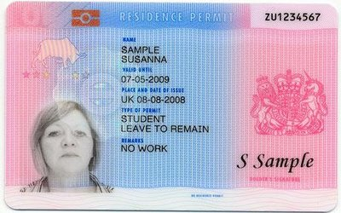
BRP Card Collection
A BRP card is a biometric residence permit which contains a chip with your biometric information along with your other personal details and your visa conditions (name, nationality, date of birth, sponsor licence number, visa expiry date).
A BRP card looks like this:

Slide 39
Dependants
6

Slide 40
Bringing Dependants
A dependant is either:
husband, wife or civil partner
unmarried or same-sex partner, with whom you have been in a relationship similar to marriage for at least 2 years
child who will be under 18 years old on the date you will arrive in the UK
You can apply to bring a dependant to the UK if you are:
on a postgraduate course that lasts 9 months or more
a government-sponsored student on a course that lasts 6 months or longer

Slide 41
Bringing Dependants
If you meet these requirements, your dependants can apply at the same time as you or separately for a “Student Dependant visa”.
Each dependant makes their own application and the process is the same.
They must include all required supporting documents, including financial evidence (e.g. bank statements) and evidence of relationship (e.g. marriage or birth certificate).
Financial requirement is to show £6120 for 28 days, or be included on an official financial sponsor letter.
You must also submit evidence that your relationship is subsisting such as evidence of living together (e.g. utility bills in both your names, letters from each of you confirming the history of your relationship and your intention to live together in the UK, emails/texts between you both).
Guidance and supporting documents are found here:
http://www.studentsupport.manchester.ac.uk/immigration-and-visas/visas-and-applications/

Slide 42
Refusals
7

Slide 43
Visa Refusals
Most common reason for refusal is submission of incorrect financial documents
If your Student visa application is refused you must scan and email all the pages of your refusal notice to visa@manchester.ac.uk.
Most students re-apply with the correct documents and are successful
If an application is refused on financial grounds we will need to see new financial documents before a new CAS number can be issued
You can apply for an administrative review to have your application looked at again but this can take a long time so re-applying is usually the best option

Slide 44
Arriving in the UK
8

Slide 45
International Check-In
You must complete International Check-In before you start your study on-campus course starts.
International Check-in normally takes place in the Student Services Centre (building 57 on the online campus map) but may be completed remotely in some circumstances.
If you will collect your BRP card from the Student Services Centre, we will e-mail you to request that you book a collection appointment. Remember to bring your passport to the appointment.
If you will collect your BRP card from a post office, please e-mail a scan of your passport and the front and back of your BRP card to visa@manchester.ac.uk

Slide 46
Collect your BRP Card
You need to collect your BRP card upon arrival in the UK
The BRP Collection letter you receive with your 90-day visa will state the time and place to collect it
If you collect it from the University you must wait for us to email you first to confirm your BRP card is ready.
BRP collection will be in the Student Services Centre where you will also complete International Check-In (building 57 on the online campus map)
If collecting your BRP card from a post office you must have done this before attending International Check-In

Slide 47
Police Registration
If you are coming to the UK for more than 6 months you may have to register with the police.
Check on the UKVI website if you need to register with the police: https://www.gov.uk/register-with-the-police.
If so you need to make an appointment to register with the police after you have completed steps 1 – 9 of academic registration and have collected your BRP card.
Book an appointment with the police through the MyManchester online system or contact Student Services Centre if you have dependants (ssc@manchester.ac.uk). They may be a delay in obtaining an appointment during periods of lockdown but this will not adversely affect your status.
You must update your certificate every time you obtain a new passport, new visa or you change your address.

Slide 48
How to Contact Us
Email: visa@manchester.ac.uk
Website: www.studentsupport.manchester.ac.uk/immigration-and-visas/
Queries about the creation of your CAS should be directed to your school or department admissions team in the first instance
If you have received your CAS and you require tuition or accommodation fees that you have paid to the University to be added, e-mail CAStuitionfees@manchester.ac.uk who will update your CAS and send you an updated CAS statement

