Slide 1
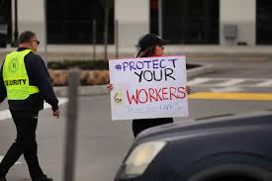
Bogus self-employment and COVID-19: An added layer of insecurity
Martí López-Andreu
Newcastle University Business School
Work and Equalities Institute

Slide 2
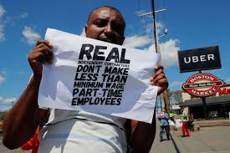
A shift in the characteristics of the self-employed?
Percentage of women increased from 27.1% to 35.2% (2007-2018.
BAME increased from 10.5% to 12% and white non-British from 8.9% to 11.1% (2011-2018).
Part-time increased from 23.5% to 29.7% in (2007-2018).
The solo self-employed increased from 67.5 to 76.5% between (2007 to 2018).
(Source: Understanding Society and Annual Population Survey)
Decrease in self-reported job satisfaction (Maumberg and Meager, 2015).
Since 2000s increase on public administration and education, and from 2008 on the financial sector, information and communication, and ‘other services’ (Meager, 2019).

Slide 3
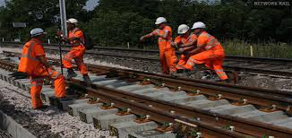
The ‘bogus’ or ‘false’ self-employed
‘Subordinate employment disguised as autonomous work’ (Frade and Darmon 2005).
‘Persons who declare themselves (or were declared) as self-employed simply to reduce tax liabilities or employers’ responsibilities’ (OECD, 2000).
My research focused on:
Couriers | Foster carers
Construction workers | Social care interim managers
Railway maintenance workers | Social care interim managers (subcontracted by local council)

Slide 4
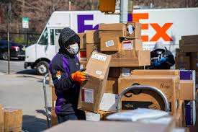
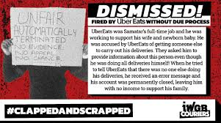
The risks of ‘bogus’ self-employment
No access to key employment and social protection benefits such as: sick pay, minimum wage, holiday pay, ‘redundancy’ pay…
… and to other employer’s responsibilities (eg health and safety, skills development and reproduction, etc.).
Access to work and to continuous work dependent on their ability to sustain their links, contact and reputation with specific physical or virtual contacts.
This includes:
Key individuals in organisations that manage outsourced tasks (eg in PA);
Agencies that manage specific labour markets (eg in construction or railway maintenance);
Online platforms based on algorithms (eg couriers) – the risk of being ‘logged out’ of the system or not getting enough work after not logging in for a while.

Slide 5
COVID-19 An added layer of vulnerability
Income access:
As the Self-Employment Income Support Scheme is based on the annual tax returns of previous years it penalises workers in sectors with high turnover (for instance, app-based courier services).
Penalises low incomes - difficult to survive with the 70-80% of an already low salary.
Exclusion of those with a profit of less than £1,000 – affects those with low profits or those affected by tax release schemes that do no report profits (for example, foster care workers).
Reported delay in payments strongly penalize those with low income/no savings.
Health and Safety
Reported negligence of employers/agencies/platforms in failing to provide protection measures and lack of clear protocols – especially affecting, couriers, construction and railway maintenance workers.
The dependence on key contacts, agencies and platforms to keep their jobs - main barrier preventing these workers requesting more secure working conditions.
Legal mobilisation by union (IWGB) - Recent High Court decision (13/11/2020) stated that the UK failed to grant workers in the gig economy the rights they are entitled to under European directives on safety and health at work (provision of PPE and the right to stop work in response to serious and imminent danger).

Slide 6
Final remarks
COVID-19 shows the weaknesses of social protection mechanisms in the UK when dealing with the event of illness, job or income loss.
The unclear status of many bogus self-employed, their short tenure and low pay makes them extremely vulnerable in accessing the extraordinary grant for the self-employed.
Urgent need to recognise their dependence on clients and platforms as their employers – need to reinforce employers’ responsibilities towards these workers.
Voluntarism is not working! A stronger regulatory role of the state is required to enforce safe working conditions and to guarantee safe spaces for workers’ claims.

