Slide 1
Conflicting Covid narratives: The value of supermarket work and implications for the future
Abbie Winton
Debra Howcroft

Slide 2
Framing
COVID-19 has opened up debate on what is considered ‘key work’
While there is symbolic recognition of the contribution of key workers, this is not reflected in their salary, employment rights, or social perception
Key workers are confronted with a disproportionate risk/reward equation
Supermarket sector is one of the most advanced in terms of their use of labour flexibility, employing part-time employees, with far less favourable employment conditions

Slide 3
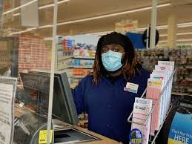
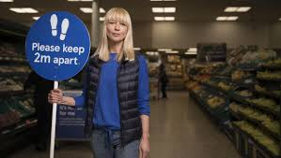
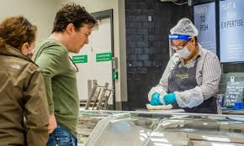
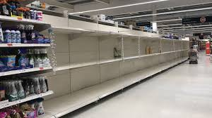
Focus: supermarket workers

Slide 4
The General public & Notions of ‘value’
Clap for ‘key workers’ prompted a shift in perceived social value
“…that made me quite cross as well, and I’ll be honest, I never stood out and did the applause. It made me so mad because it wasn’t just your NHS. They forget that we’ve actually kept the nation with food.” (Union Rep and Store HR)
But...
Customer complaints and sensationalism in the press
Spike in instances of employee abuse
Prompting ‘Abuse is not part of the job’ campaign
“…one of the till operators had said to someone that there was a restriction on how many chickens you can buy, and it was restricted to two chickens per person… When she was told this, she lifted the three chickens and threw them at her. Also people were being spat on and the person who was doing the spitting saying, ‘I have Covid take that!’.” (Area Official)
Refusal to adhere to the rules
Customer assistants in marshalling roles bearing brunt

Slide 5
Employer responses & Notions of ‘value'
Covid Safety measures
‘Race to the top’
Customer is not always right
But…
Some have committed to long-term pay rise for employees
But concerns remain surrounding hours
Bare minimum staff and the impact on social distancing
Extension of temporary roles and bogus self-employment
Expansion of use of third-party delivery services (e.g. Deliveroo, UberEATs and Amazon)
No support when children are self-isolating
Open the floodgates – ‘never paid for it, so why should we now’
‘Punishment’ for self-isolating
Reports that future shifts withheld/poor treatment for staff who need to self-isolate

Slide 6
Newspaper CEO Narrative
“’Our highly valued colleagues have stood tall amidst the coronavirus pandemic, playing their full part in feeding the nation. We want to thank every single one of them for their continued hard work during these unprecedented times by paying a much higher guaranteed bonus for the whole year in recognition of their effort.’”
(The Mirror, April 2020)
Interview Customer Assistant Narrative
“…you can do all the other piecemeal things to make yourself look good but if you don’t wanna pay for staff then… and also when people talk about ‘response to Covid’ they think of it in terms of the community and the shoppers, but what about us? How have they responded to their staff? Have they given us any security? No, they are just hiring and firing and taking people on really dodgy contracts… If you were working there you would feel like the company was skint. But I’m sure with Corona they’ve made loads of money. ”
(Customer Assistant)

Slide 7
Concluding remarks
Poor government responses
“… they phrased it that we were ‘feeding the nation’ keeping everybody alive… ‘feeding the nation’. However, you want us to stay open, you want us to feed the nation but then you’re sending all the kids back to school and you are not putting anything in place if, pardon my terminology, shit hits the fan.” (Union Rep and Store HR)
Future of retail and the implications this may have for the value of labour?
Shift towards logistics and distribution (gendered notions of value)
Optimism surrounding union working relationship and strength of certain collective agreements
“…what I don’t want is that once things go back to a bit of normality that this view changes again and retail workers go back to being devalued as such… Some of the things we can push the employers on, in wage negotiations and things like that. We can now say that these people are key workers and they have kept your business going through the pandemic.” (Area Official)

