Slide 1
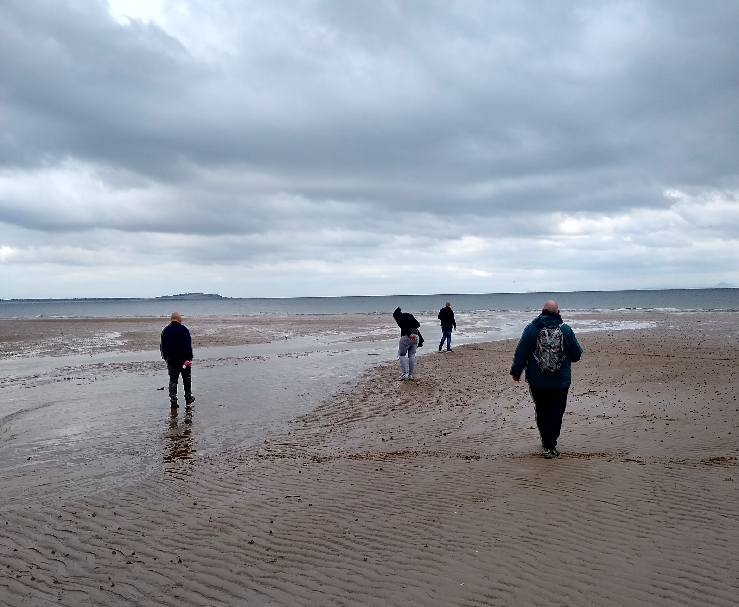
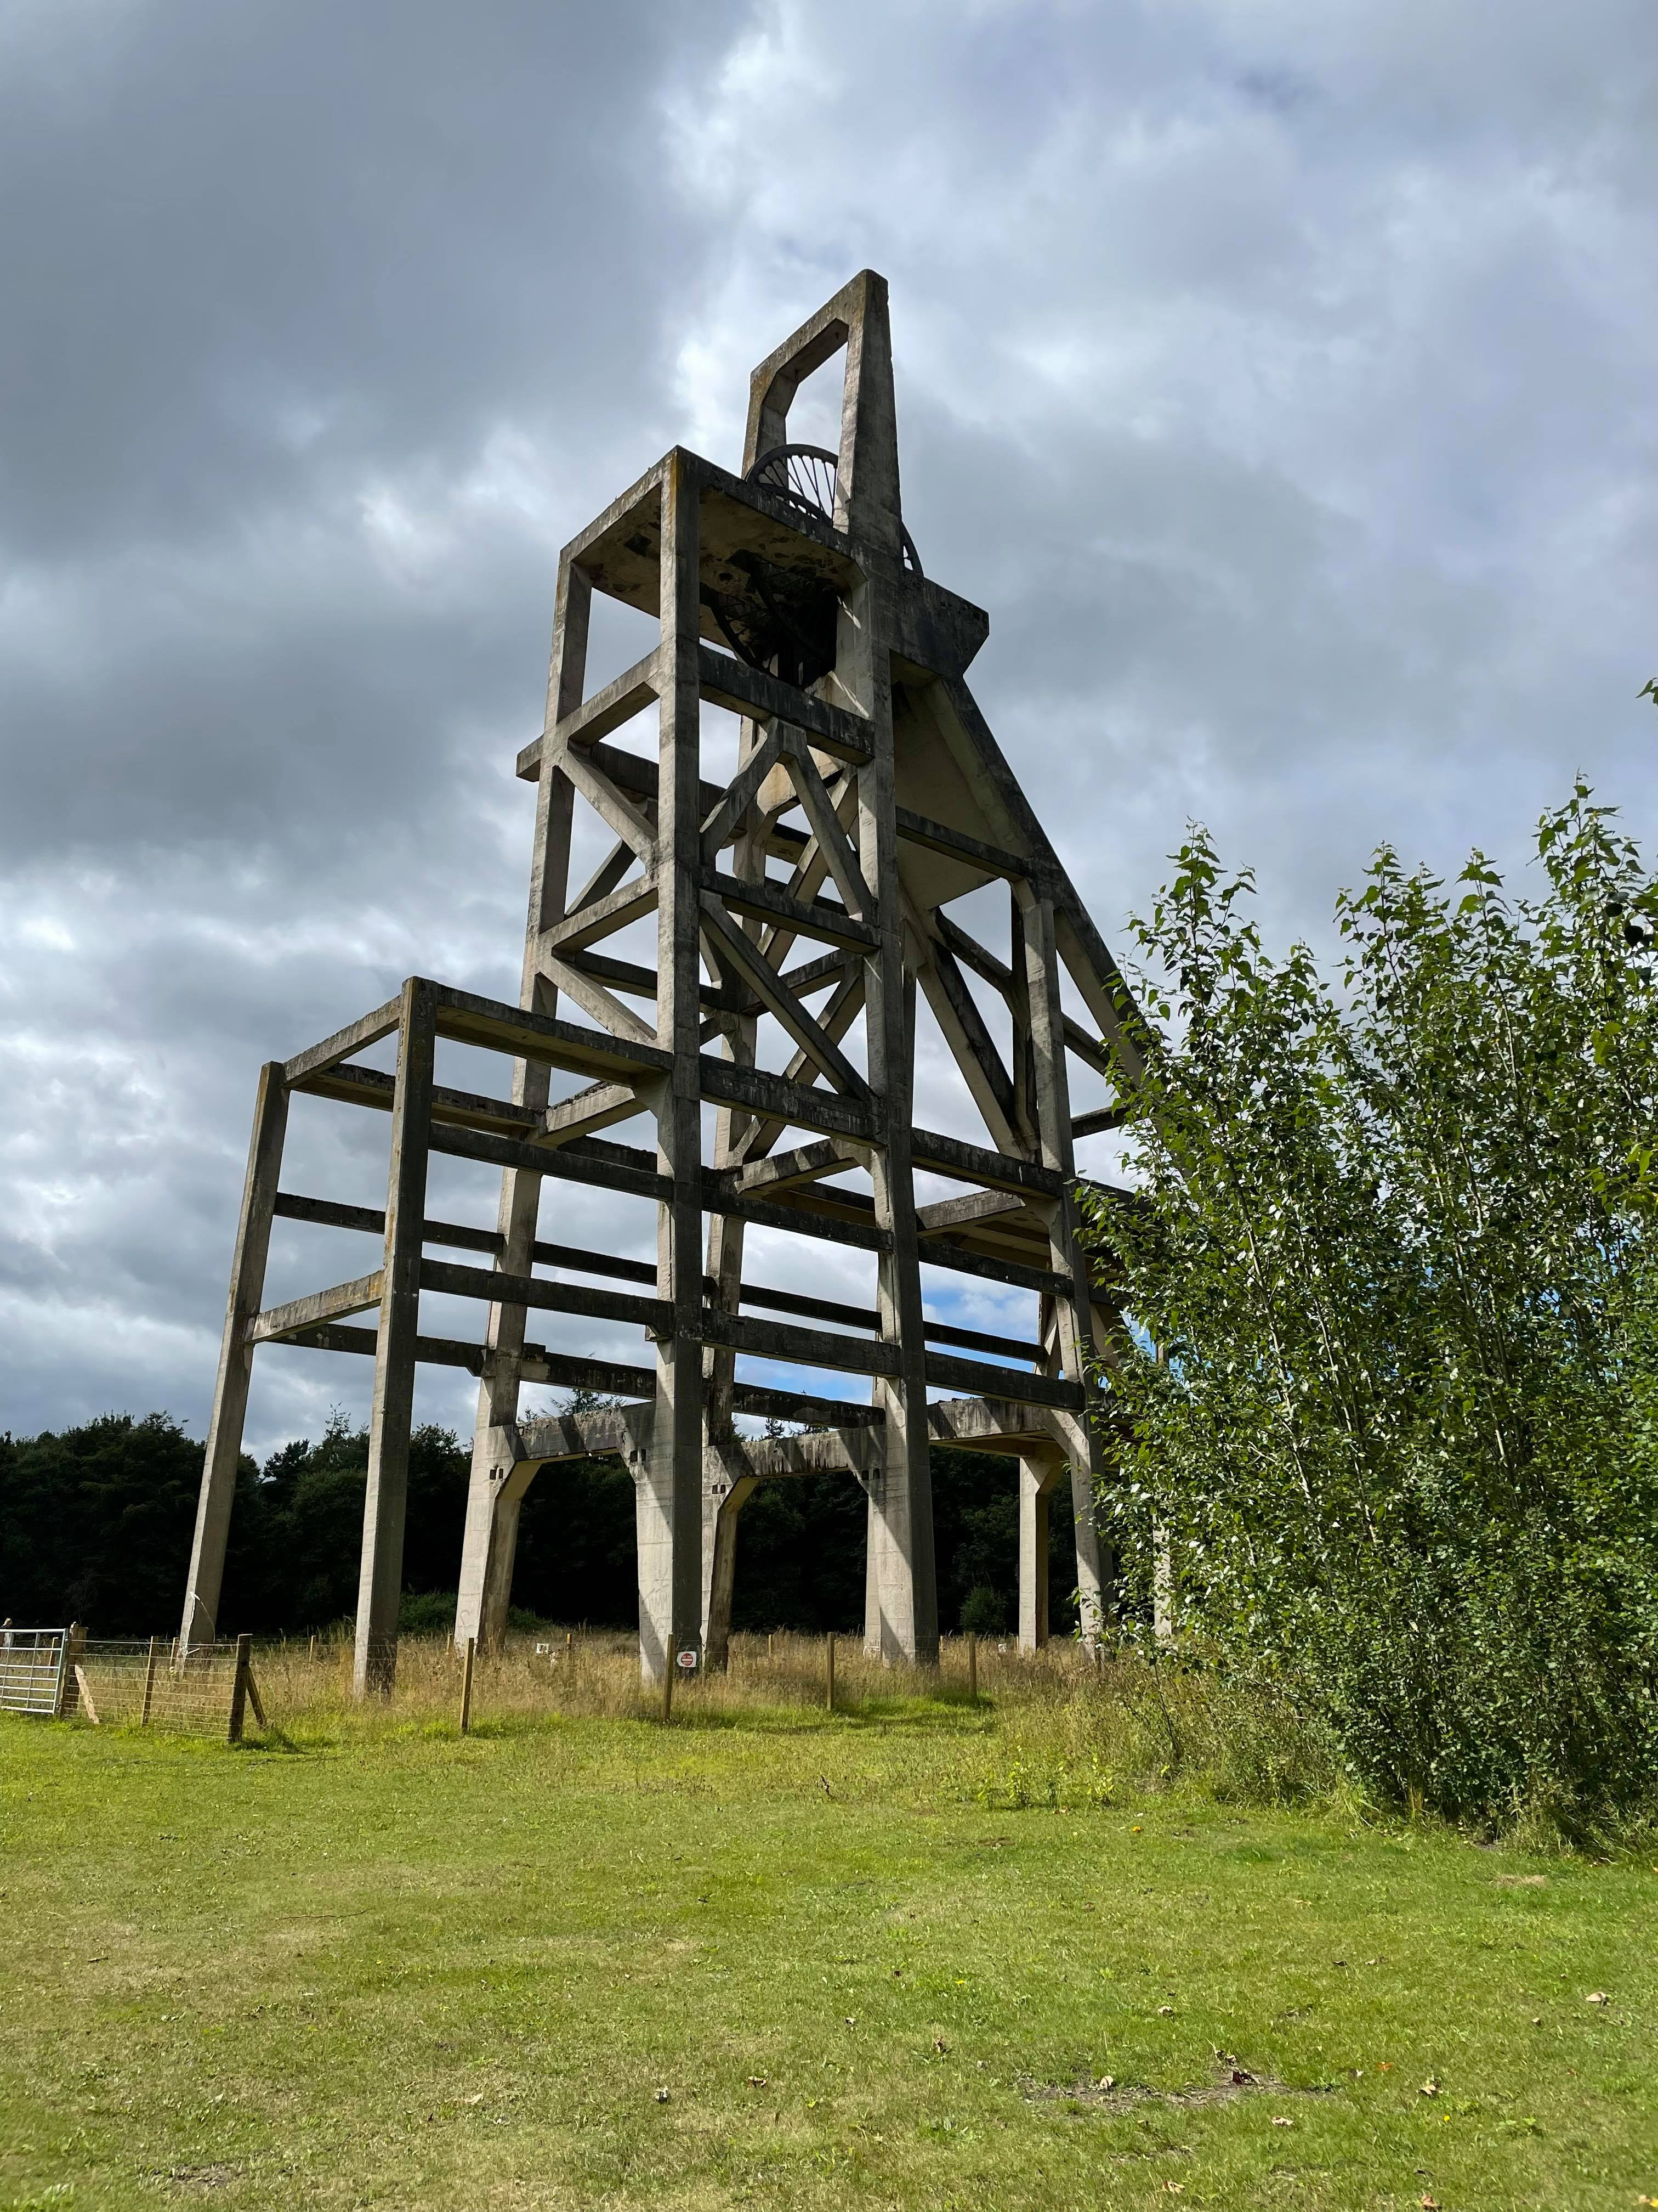
Social Anthropology Seminar Presented by the Department of Social Anthropology
A3 POSTER
TEMPLATE
Laura Roe
University of the West of Scotland
A Memory of Dust: Heroin Addiction and Polydrug use in Post-industrial Scotland
The end of coalmining in Scotland wrought profound changes to landscape, social life, and substance use. The gradual loss of coal livelihoods disrupted longstanding forms of community heritage, social memory, and relations to place and time, the impacts of which continue to shape contemporary experiences of addiction and drug use. Drawing on sustained ethnographic research with people who use drugs in Southeast Scotland, this paper asks how such experiences are composed, in part, in relation to collective imaginaries of coal, industrial nostalgia, and the material consequences of deindustrialisation. It also asks how attention to shifts in industry can illuminate Scotland’s unique and complex patterns of polydrug use, and contextualise the exponential expansion of domestically manufactured drugs. Deindustrialisation, overall, makes manifest a host of urgent ethical and social concerns, which are brought to the fore in the intimate experiences and perceptions of people who use drugs.
Dr Laura Roe is a postdoctoral research fellow at the University of the West of Scotland. She recently finished an ESRC-funded fellowship at the University of St Andrews that explored experiences of time, memory and landscape in the context of substance use, which culminated in an exhibition titled 'The Pit and the Kit: Addiction, Heroin, and the End of Coalmining in Scotland.' In addition to her current project, she is currently working on a STAIRS-funded research project that explores the relationship between drug use, industrial history, and energy transition.
When
Monday 10 October, 2022
4.00pm – 6.00pm
Where
2.016/017 2nd floor
Boardroom
Arthur Lewis Building
University of Manchester
More information
https://www.socialsciences.manchester.ac.uk/social-anthropology/connect/events/

