Slide 1
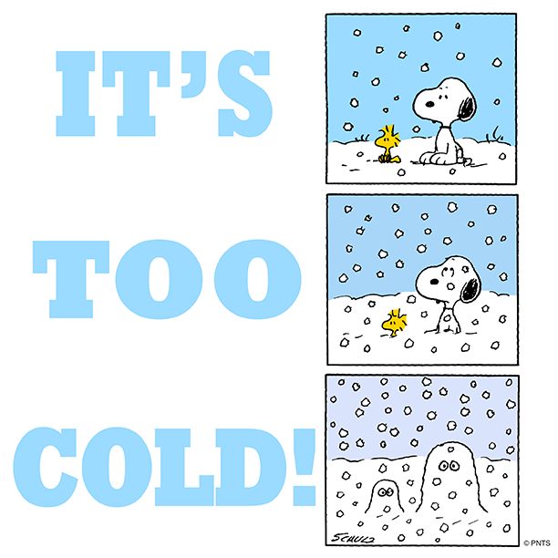
ULT Freezers Why -70°C isn’t as scary as it seems…
Jessica Forsyth
Research Technician
Jessica.Forsyth@manchester.ac.uk

Slide 2
Energy consumption
Operating a ULT freezer at -70 consumes 28% less energy than those run at -80.
At colder temperatures, freezer compressor efficiency is reduced exponentially so operating freezers at suitable warmer temperatures (like at 70) could increase operational lifespan whilst reducing costs and heat output.
Farley et al. (2015) An investigation of ULT freezer energy and temperature dynamics.

Slide 3
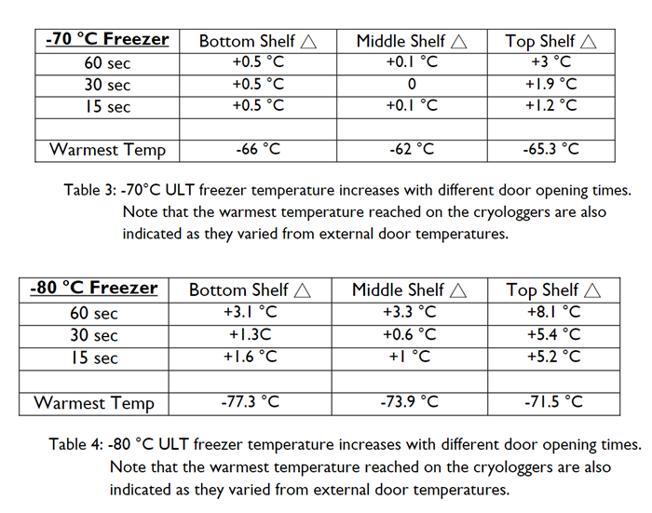
How much does the temperature increase when the door is open?
The longer the door is open, the more significant the temperature change that samples are exposed too, particularly if unprotected by boxes/racking.
Colder operating temperatures lead to greater temperature variation when freezer doors are open. For example, -80 showed increases in temperature as high as 5-8 degrees.
Top-shelves experience greater temperature variation
Farley et al. (2015) An investigation of ULT freezer energy and temperature dynamics.
Notes:
Colder operating temperatures lead to greater temperature variation when freezer doors are open - this is likely because colder temperatures lead to stronger mixing with ambient air resulting in greater temperatures changes.

Slide 4
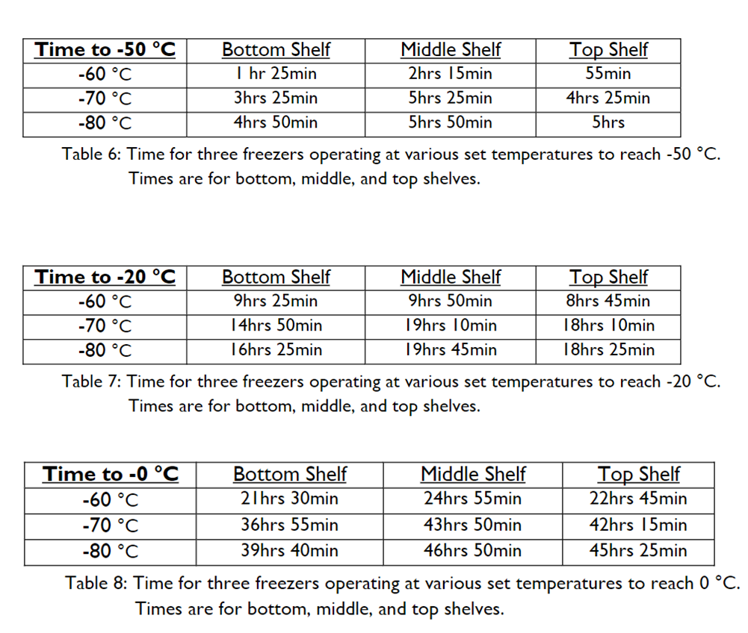
How quickly does the temperature rise if the power is cut?
Colder freezers take longer to warm up but not by much.
Took -70 and -80 around 3-5 hours to warm to 50.
Took -70 41 hours to reach 0 and -80 44 hours.
Racking can significantly improve temperature stability in the event of a power cut. Can provide an approximate 1-4 extra hours of reaction time.
If warm up time in the event of a power failure is a concern, racking, alarm systems and response methods should be assessed as opposed to relying on colder storage temperatures.
Farley et al. (2015) An investigation of ULT freezer energy and temperature dynamics.

Slide 5
Is it safe for samples?
In the majority of cases, the answer is YES!
AstraZeneca, Genentech, the CDC, Imperial College London and Marie Curie in Paris are just a few of hundreds of places where at least some, if not all, ULT freezers are now set to -70. The Salford Biorepository facility working with MHRA and HTA standards switched their 12 ULTs to -75C more than 10 years ago.
Unless you have specific evidence that your samples need to be stored at -80, you should be storing them at -70 (fifteen years ago all ultra-low freezers were set to -65C or -70C)
You can find a list of samples successfully stored at -70 at the link below;
https://docs.google.com/spreadsheets/d/13UvBeoXAhwSHshSYoUDHwcxWiW7qYLnUb-eLwxJbCYs/edit#gid=0
You can also find publications providing evidence for the safe storage of a range of samples here;
https://www.mygreenlab.org/-70-is-the-new--80.html

Slide 6
Overall benefits
Way to make your ULT more sustainable (reduced greenhouse gasses)
A freezer running at higher temperatures doesn’t have to work as hard and thus lasts longer and is less likely to break down!
Less heat generated in the laboratories/corridors where freezers are stored meaning temperature of lab is more stable or one can reduce the energy spent on air conditioning in freezer farms.

Slide 7
Freezer tips…it’s not all about chilling up
Dust Clogged filters make it difficult for air flow to cool the freezer coils and for the freezer to effectively dissipate heat meaning the freezer has to work harder. Clean freezer filters regularly!
Frost Frost accumulation inside or around the door creates gaps in the seal allowing cold air to leak out and warm air to get in. Defrost freezers fully once a year (spare freezers available in the department for this purpose – contact your ToM) and regularly scrape off excess frost using plastic blue scrapers (don’t use sharp objects!)
Storage Avoid large empty spaces in freezers – if there are large areas empty, use polystyrene boxes filled with ice to fill them. Also, don’t store things on top of freezers. This chokes off rising heat and forces it back into freezer intake leading to a fire hazard!
Location Store ULT’s in a well-ventilated space away from sources of heat or in warm rooms. A freezer located in a warm room can use as much as 24% more energy and increase risk of freezer failure, putting samples at risk. Freezers require 6-8” (15-20cm) of space on the sides/top/rear of the unit for heat dissipation.
Sample inventory Every minute a ULT freezer door is open it takes approximately 10 minutes for it to recover back to set point. Inventories reduce time needed to search for samples. Clearly label samples to aid future clear outs.

Slide 8
How to clean freezer filter
Can be done using a vacuum (available to collect from Steve Fawkes office behind reception) or simply remove and rinse with water (choosing direction carefully so lint is pushed off filter). It’s ok to place wet filter back on the freezer. To clean coils, gently vacuum or brush in the direction of the lines n the coil.
Then grates that cover the filter on most freezers will just lift off or can be unscrewed.
Keep an eye on dust and definitely clean filters every 3 months minimum
See the video below for guidance;
https://www.youtube.com/watch?v=G2tE5ZlOUpQ

Slide 9
Places to go for more information
Farley et al. (2015) An investigation of ULT freezer energy and temperature dynamics. University of Edinburgh (a project started by Martin Farley originally), in collaboration with VWR and Eppendorf.
https://www.freezerchallenge.org/uploads/2/1/9/4/21945752/minus-70-is-the-new-minus-80_3.pdf
https://www.nature.com/articles/d42473-018-00223-9
google doc from Institutions who have moved to -70C for a while and detailing the samples they have chilled up. https://docs.google.com/spreadsheets/d/13UvBeoXAhwSHshSYoUDHwcxWiW7qYLnUb-eLwxJbCYs/edit#gid=0
LEAF champions can also access our Teams site where we curate evidence from literature as they emerge in our dedicated ULT folder, along with guidance for efficient usage.

Slide 10
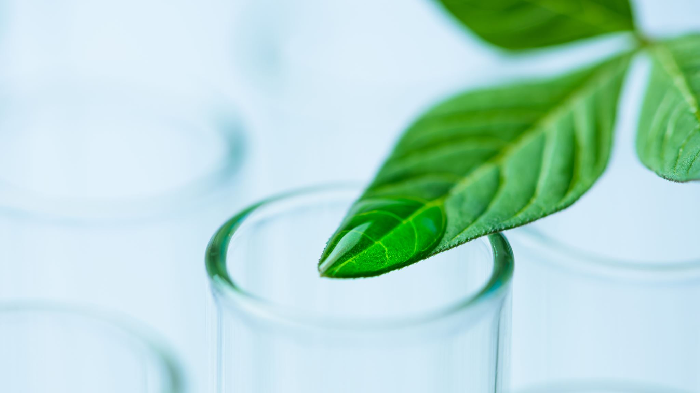
LEAF green tip slides
Print or share at lab meetings to start conversation

Slide 11
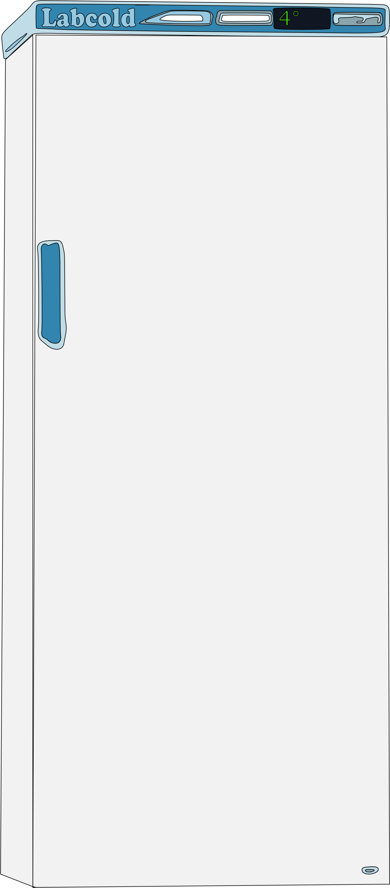
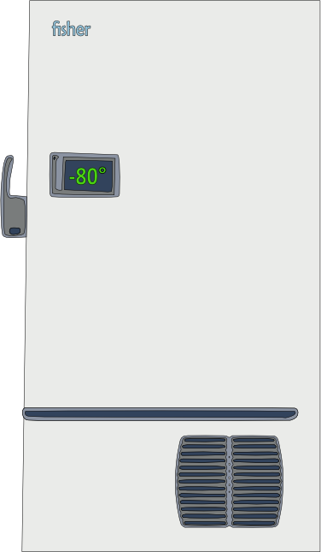
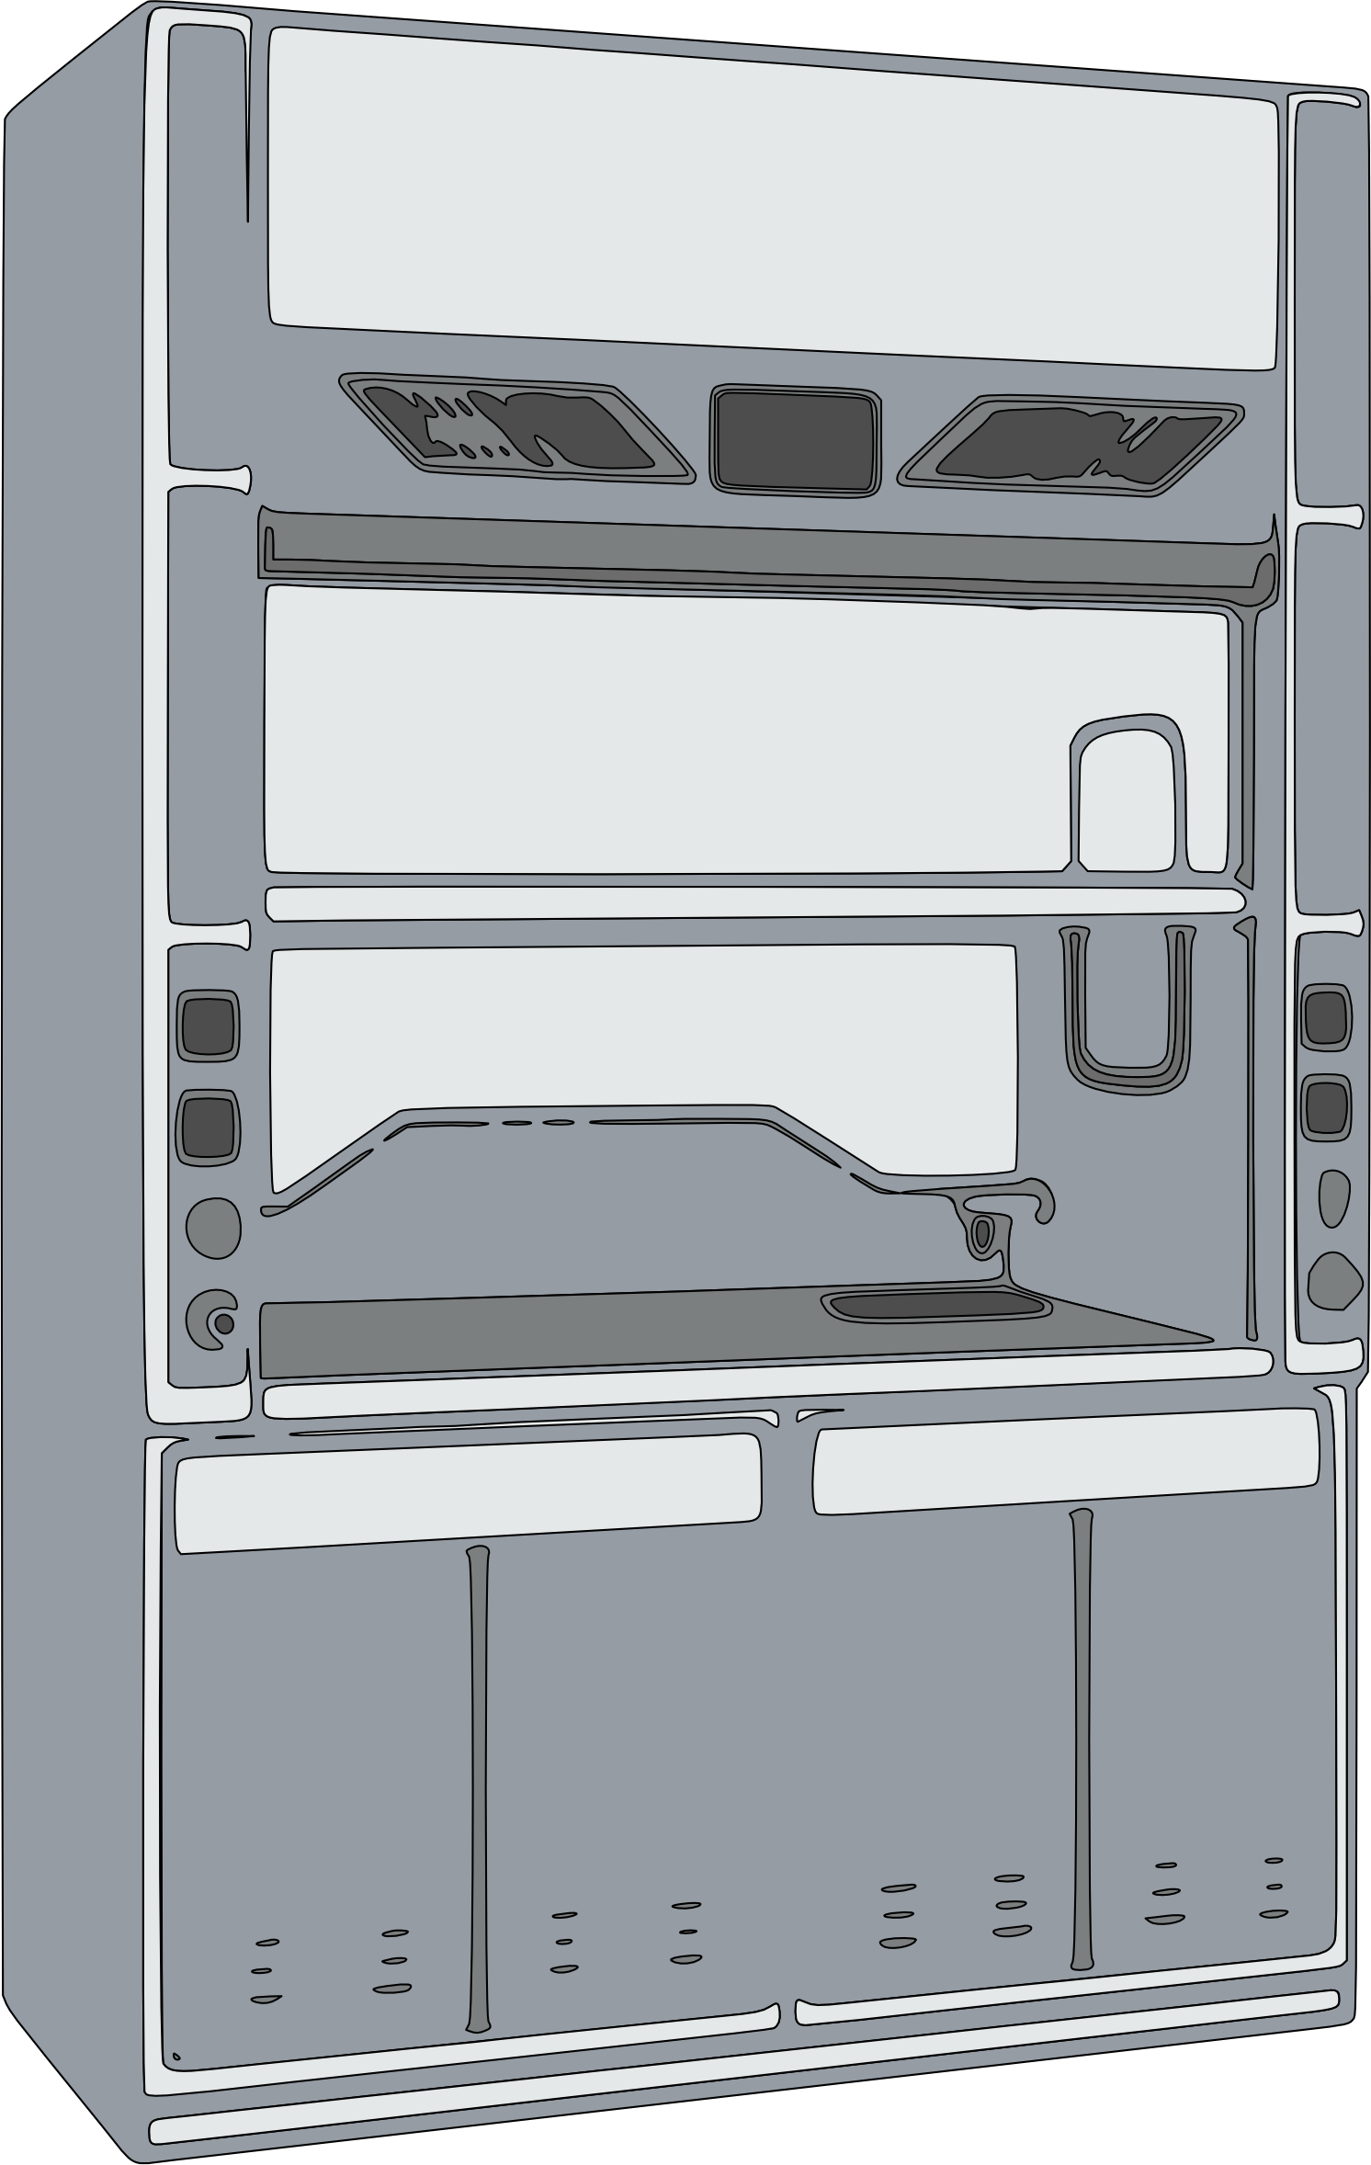
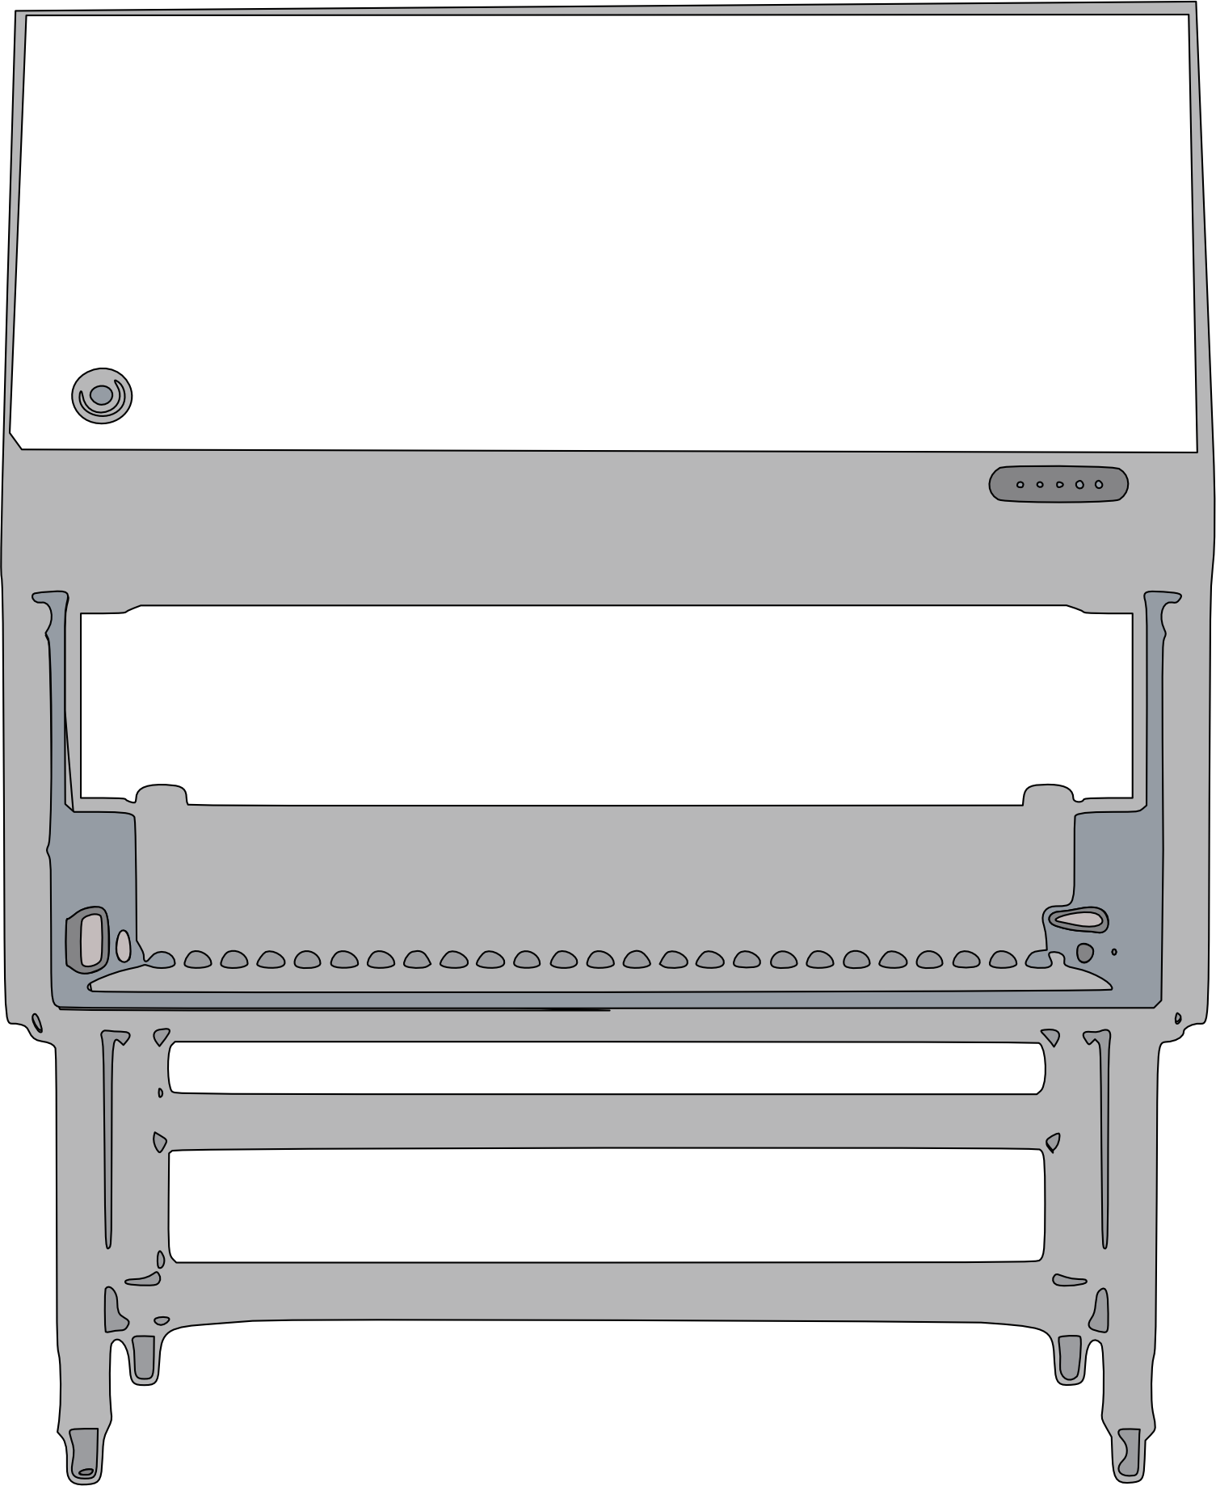
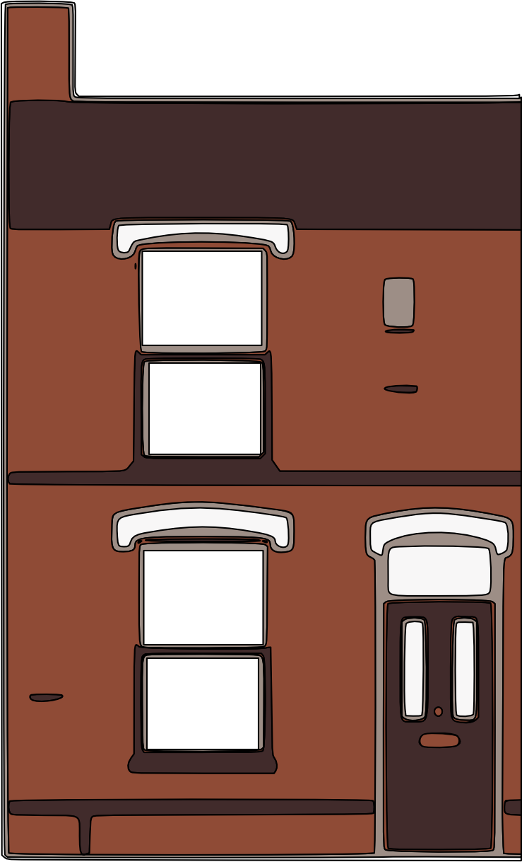
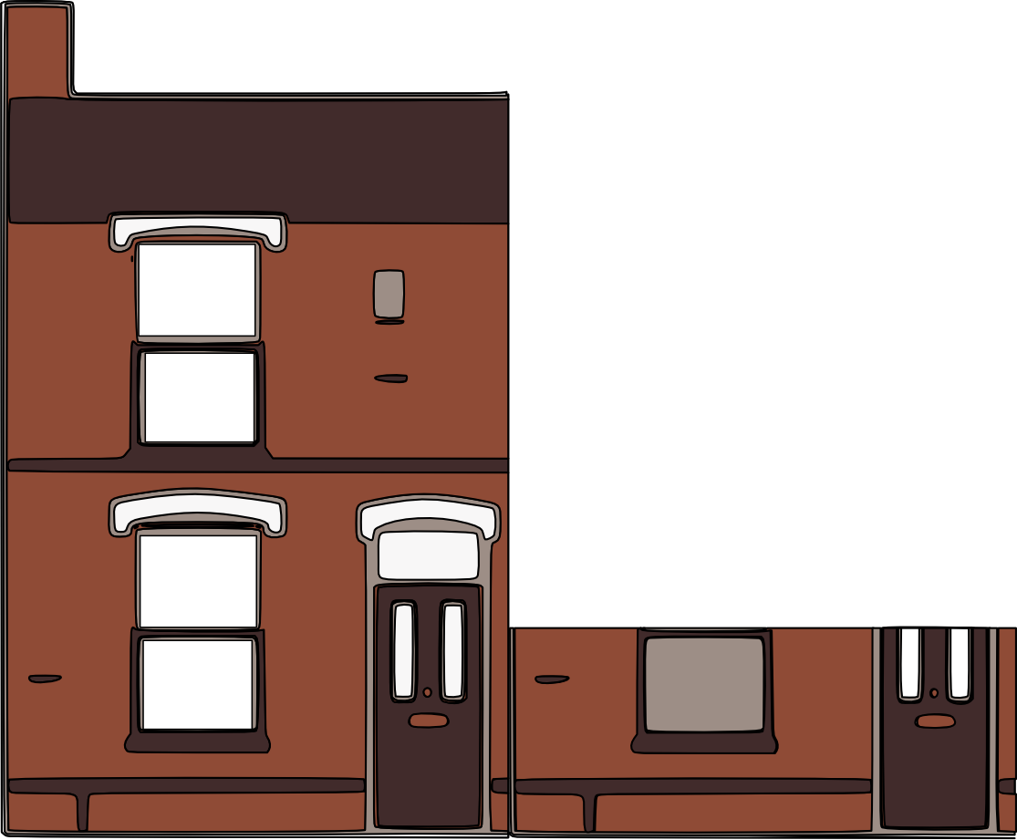
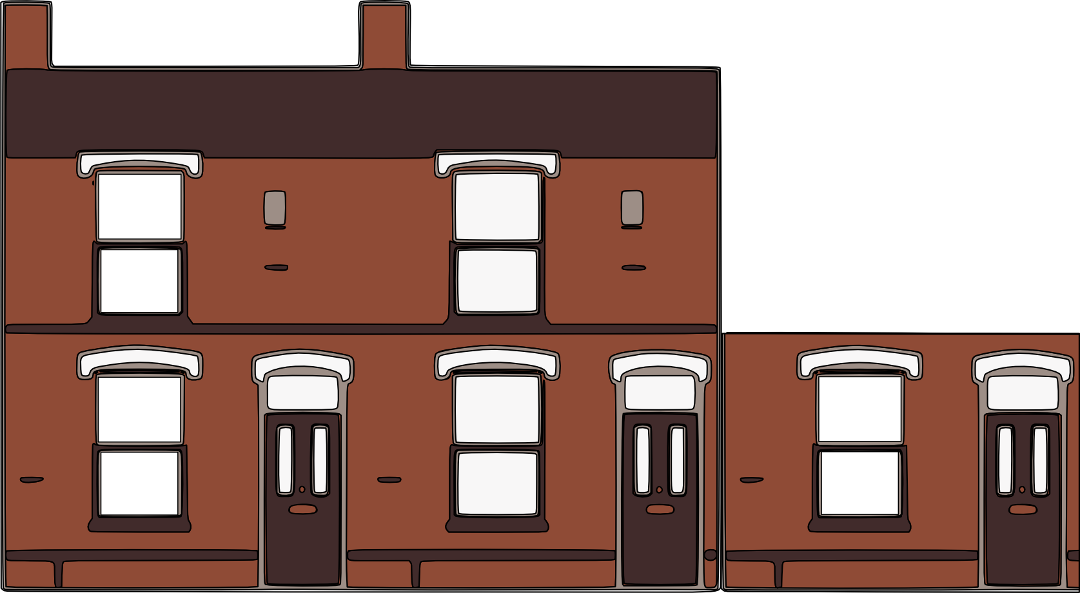
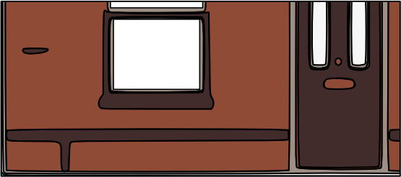
Equipment | Daily Energy Usage (kWh)
-80°C Eppendorf freezer | 12.9kWh
-70°C Eppendorf freezer | 9.6kWh
Incubator | 0.34KWh
4°C 439L Labcold fridge | 2.55kWh
4°C 150L Labcold fridge | 1.1kWh
Biosafety cabinet | 2.34-18.8kWh
-20°C 124L Labcold freezer | 0.8kWh
-20°C 406L Labcold freezer | 3.16kWh
How many homes in our labs?
Upright freezer set at -20°C
Cell culture hood
Biosafety cabinet
ULT set at -70°C
ULT set at -80°C
Maintain
Declutter + consolidate
Rack to minimise retrieval times
Use empty boxes to avoid frost
Store at correct T
Use smaller tubes to minimise space use
Fume cupboard
Switch OFF when not in use
Switch lights off
Do you need UV light? 15 min suffice
-70C
-80C
Declutter
Shut the sash (can cut by 50%)
Increasing Energy Use
Equivalent average UK 4 bed house electricity consumption (11.2 kWh/day)
0.3 UK Homes
0.2-1.7 homes –
Average 0.9 UK Homes
0.9 UK Homes
1 .2 UK Homes
2.5 UK Homes
Notes:
Energy use UK homes: https://www.ofgem.gov.uk/information-consumers/energy-advice-households/average-gas-and-electricity-use-explained
4 bed house: 4,100/365 = 11.2 kWh/day (just Electricity).
Safety cabinet: https://nems.nih.gov/Documents/Newsletter/2021/10_October_2021/Biosafety_Cabinets.pdf
Incubator: https://www.thermofisher.com/document-connect/document-connect.html?url=https://assets.thermofisher.com/TFS-Assets%2FLED%2Fbrochures%2FBRCTHTINCEU-012320%20Final.pdf

Slide 12
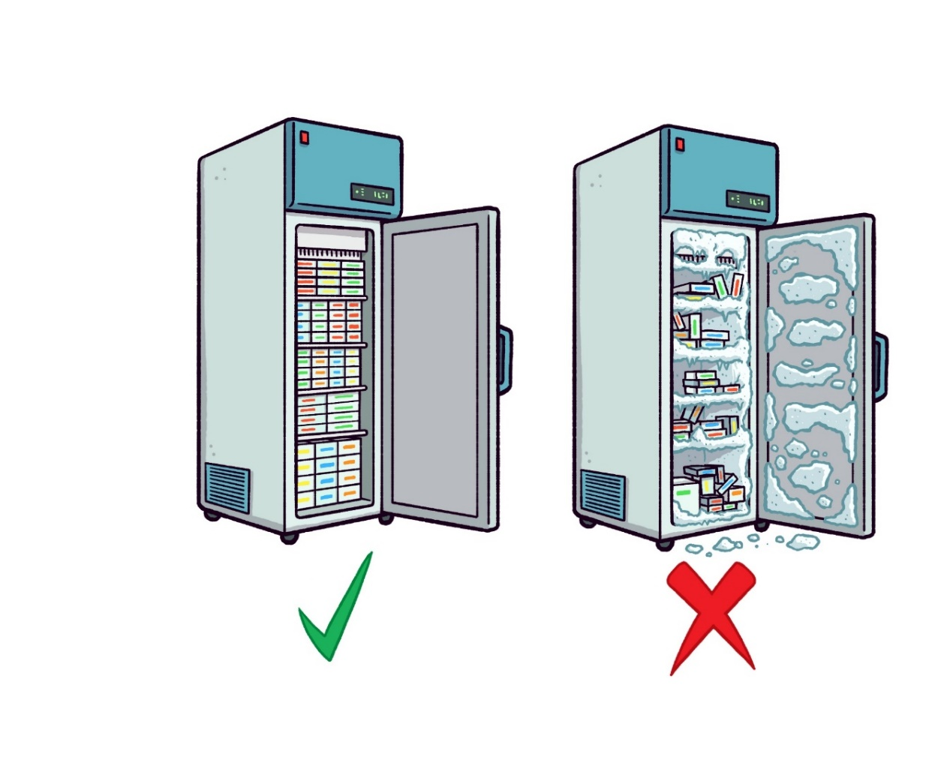
Cold storage
MAKING SCIENCE
Ensure your freezers are defrosted and filters+ seals cleaned.
Ensure samples are labelled consistently in your lab and managed regularly (clear up once a year).
Use appropriate boxes and racking: Keep an up-to-date inventory/map (incl. expiry dates)
Do not leave the door open longer than necessary → T rises very quickly - can damage sample and uses more energy.
What temperature is your freezer running at?
Check you are storing samples and chemicals at correct temperatures.
SUSTAINABLE
An ULT freezer set at -80°C uses as much energy as an average UK household, but increasing the temperature by 10°C can reduce energy consumption by 30%.
Across the world, labs are setting their ULTs at -70 or -75°C, saving energy and extending the ULT life (ULT freezers also use a lot of E for room temperature control.
Notes:
Farley, M. Efficient ULT freezer storage. 2015. https://www.ed.ac.uk/files/atoms/files/efficient_ult_freezer_storage.pdf
2. Leak LB et al. 2023. Forging a path toward a more sustainable laboratory. Trends Biochem Sci. 48(1):5-8. https://doi.org/10.1016/j.tibs.2022.09.001
3. -70 is the new -80. https://www.radboudumc.nl/getmedia/7834fa78-dd66-49b6-87b2-d73ee8c59597/Minus-70-is-the-new-minus-80_3.aspx
4. The SBF (Salford Biorepository Facility) operates within Medicines and Healthcare products Regulatory Agency (MHRA) and Human Tissue Authority (HTA) standards. It runs more than 12 ultra-low temperature freezers that operate at -75°C to ensure they are optimally preserved for future biomedical research. Personal communication. They switched 10 years ago, have 12 ULTs, 50% opened daily and 50% closed most of the time.
https://www.ncaresearch.org.uk/support-research/biomedical-biorepository/salford-biorepository-facility/#:~:text=The%20SBF%20operates%20within%20Medicines,preserved%20for%20future%20biomedical%20research.
Sources for sample and chemical storage temperature
https://www.freezerchallenge.org/sample-storage-temp-info.html (use google forms)
Possible: https://www.lasec.com/blog/post/what-cold-storage-is-best-for-your-biological-samples (being checked)

Slide 13
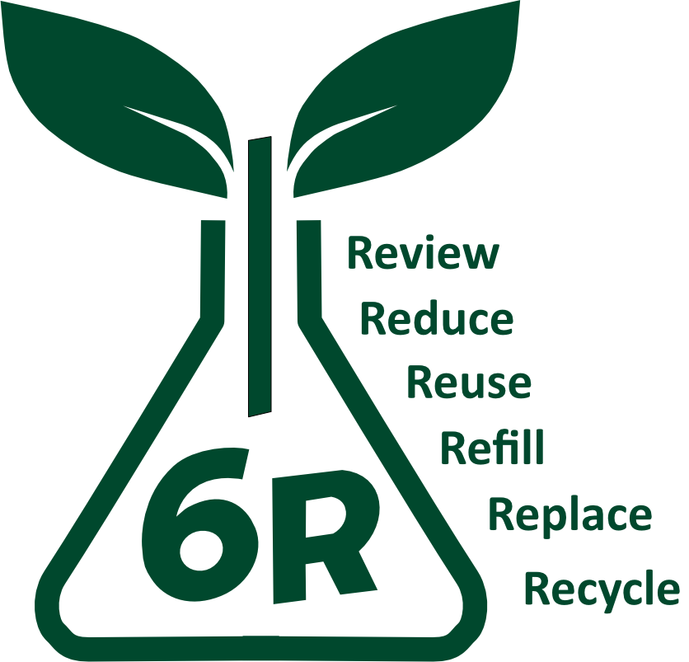
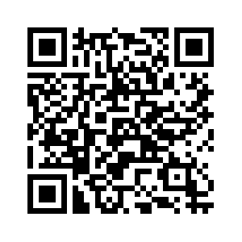
LEAF AND 6R:
ULT
MAKING SCIENCE
Equipment
SUSTAINABLE
DID YOU KNOW?
ULT freezers used to be set at -65°C or - 70°C. In the 1980s, producers started to advertise lower temperature freezers. Despite the increased energy cost, no evidence was provided that lower temperatures improved sample stability or recovery (1).
MY CHALLENGE TO YOU
The Freezer Challenge is a global challenge in which thousands of scientists around the world compete and learn how to be more energy efficient with their lab’s cold storage, improve sample accessibility and save costs for their institutions. Sign up at https://www.mygreenlab.org/freezer-challenge.html
An ULT freezer set at -80°C uses as much energy as an average UK household, but increasing the temperature by 10°C can reduce energy consumption by 30% (1,2).
Across the world, labs are setting their ULTs at -70 or -75°C, saving energy and extending the ULT life (3-4).
ULT freezers also use a lot of E for room temperature control.
Consumables available to take or share can be found at tiny.cc/chemshare.
GET INVOLVED!
Scan to become a LEAF champion
We are conducting our own studies through final year project students on sample viability in ULT freezers set at - 70°C. Please contact May Tassabehji m.tassabehji@manchester.ac.uk if you would like your samples to be part of her study.
Notes:
Farley, M. Efficient ULT freezer storage. 2015. https://www.ed.ac.uk/files/atoms/files/efficient_ult_freezer_storage.pdf
2. Leak LB et al. 2023. Forging a path toward a more sustainable laboratory. Trends Biochem Sci. 48(1):5-8. https://doi.org/10.1016/j.tibs.2022.09.001
3. -70 is the new -80. https://www.radboudumc.nl/getmedia/7834fa78-dd66-49b6-87b2-d73ee8c59597/Minus-70-is-the-new-minus-80_3.aspx
4. The SBF operates within Medicines and Healthcare products Regulatory Agency (MHRA) and Human Tissue Authority (HTA) standards. It runs more than 10 ultra-low temperature freezers that operate at -75°C to ensure they are optimally preserved for future biomedical research. Personal communication. They switched 10 years ago, have 12 ULTs, 50% opened daily and 50% closed most of the time.
https://www.ncaresearch.org.uk/support-research/biomedical-biorepository/salford-biorepository-facility/#:~:text=The%20SBF%20operates%20within%20Medicines,preserved%20for%20future%20biomedical%20research.

Slide 14
ULT
LEAF AND 6R:
MAKING SCIENCE
Equipment
SUSTAINABLE
GOOD PRACTICE
Minimise volume of material stored in the ULT freezer
Clear out: Get rid of samples which are no longer needed and avoid further purchases!
GOOD PRACTICE
Consider raising temperature in a lab meeting after reviewing evidence
Organise:
Use appropriate boxes and racking: Keep an up-to-date inventory/map
Label all freezer contents clearly: Your name, materials, expiry date. Use labels that will last!
Consider using smaller tubes to reduce storage space
Contact May Tassabehji m.tassabehji@manchester.ac.uk to discuss if your samples could be part of her study.
Maintenance:
Defrost: Ice build-up poses a risk to samples by stopping the door from closing properly, and increasing energy demand
Clean up: Defrost and clean filters and seals to limit E loss, avoid issues and prolong life

