Slide 1
Module 2: Evaluating the Service Landscape.
Describing services from two national surveys in England.

Slide 2
Module 2: Evaluating the Service Landscape.
This module presents evidence from two national surveys of NHS and local authority services that were undertaken in 2015. They provide a snapshot of the home support provided to respond to health and social care needs across England.
Sixteen indicators of services were drawn from the national survey data. These focused on: organisational and service characteristics; services provided by the NHS and local authorities (Social Care).
From data on these indicators we calculated a ‘service mix score’. Local authority areas can be scored according to this. The score shows the potential for an area to have a range of dementia support services available. This can be used to judge capacity and assist service development.

Slide 3
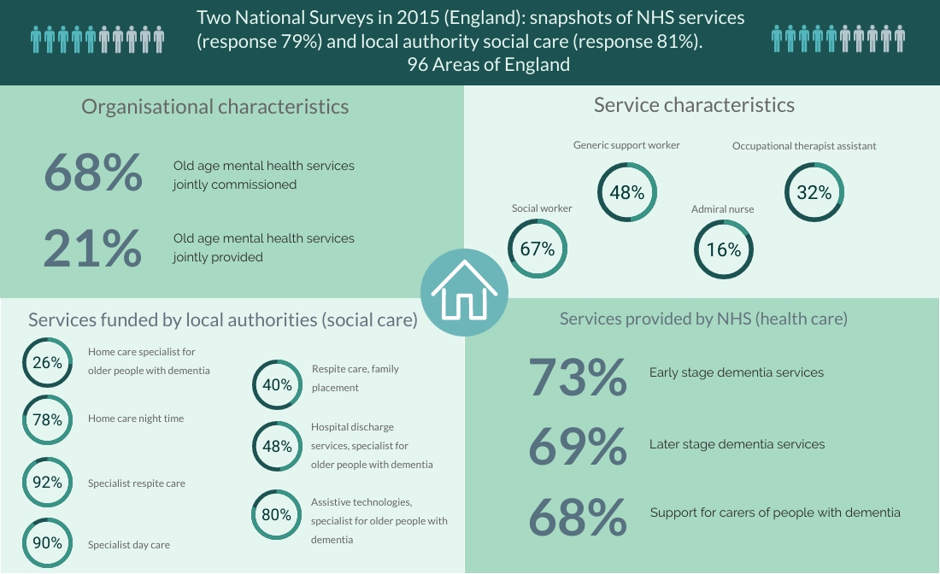

Slide 4
