Slide 1
Module 1: Scoping the evidence for home support
Findings from a systematic literature review

Slide 2
What is a systematic review?
A systematic review summarises the results of available carefully designed research studies (controlled trials) and provides a high level of evidence on the effectiveness of interventions. This permits judgments to be made about the evidence.
The findings below are from the systematic review of effectiveness of home support for older people with dementia and their carers published in 2017. Nine potential approaches were identified. Within each of these approaches, there are multiple components (e.g. 1. education and advice, emotional support and social support). The approaches are summarised below to facilitate use by commissioners and providers in service redesign.
For each approach the papers from which the evidence has been derived have been given a quality rating (from 1 to 5 stars) using a recognised tool. This permits you to judge the quality of the evidence presented.
As well as the summaries, each approach is accompanied by an example. These examples are published studies form the literature review that give a specific example of the approach in practice with an indicative cost. Where possible, these example are embedded in routine practice.

Slide 3
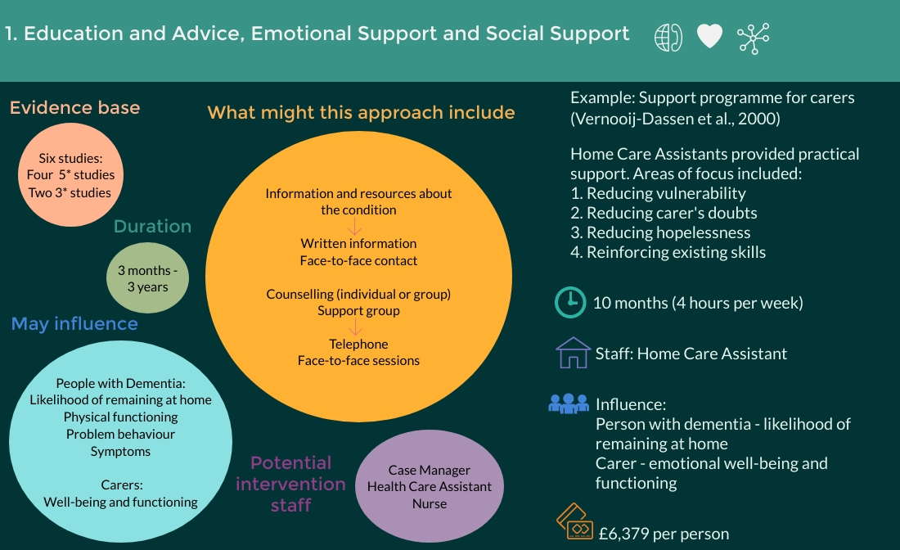

Slide 5
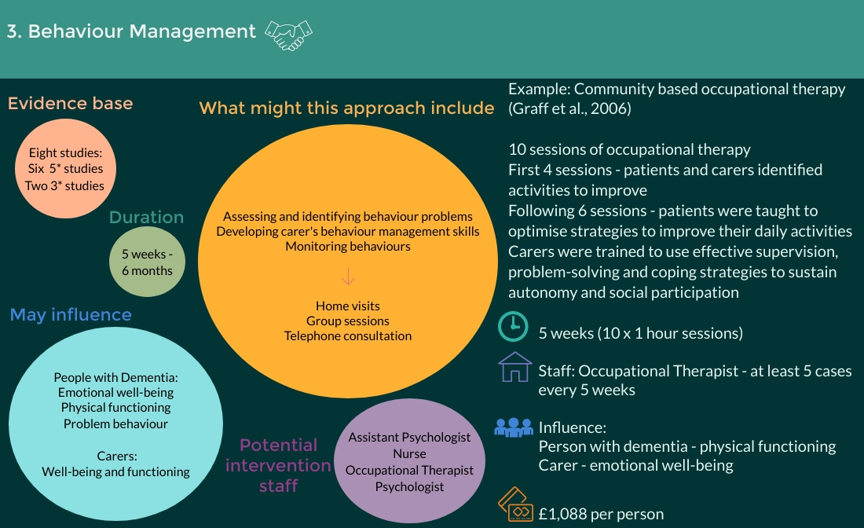

Slide 6
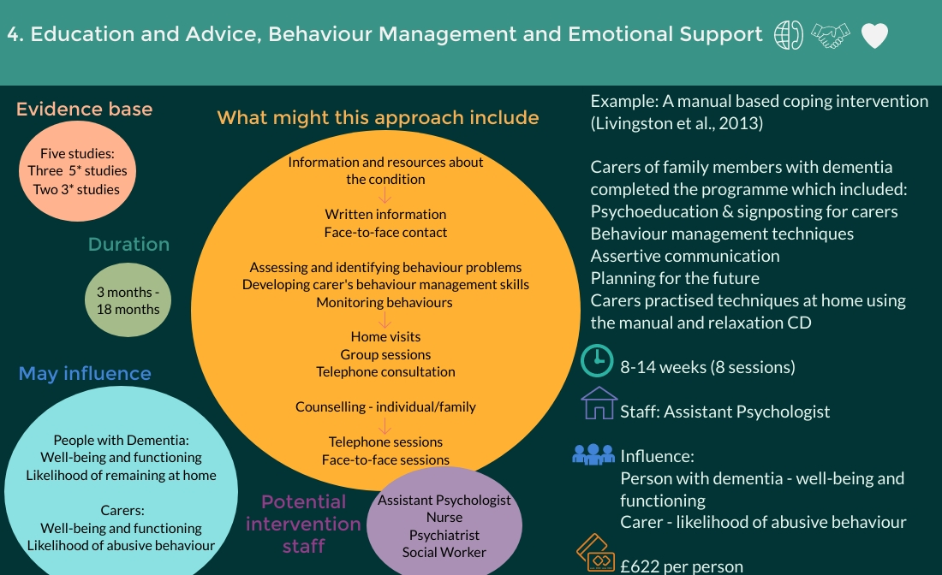

Slide 7
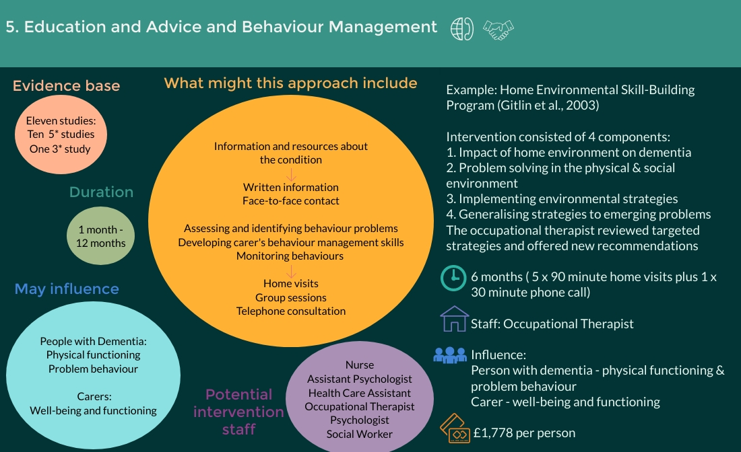

Slide 8
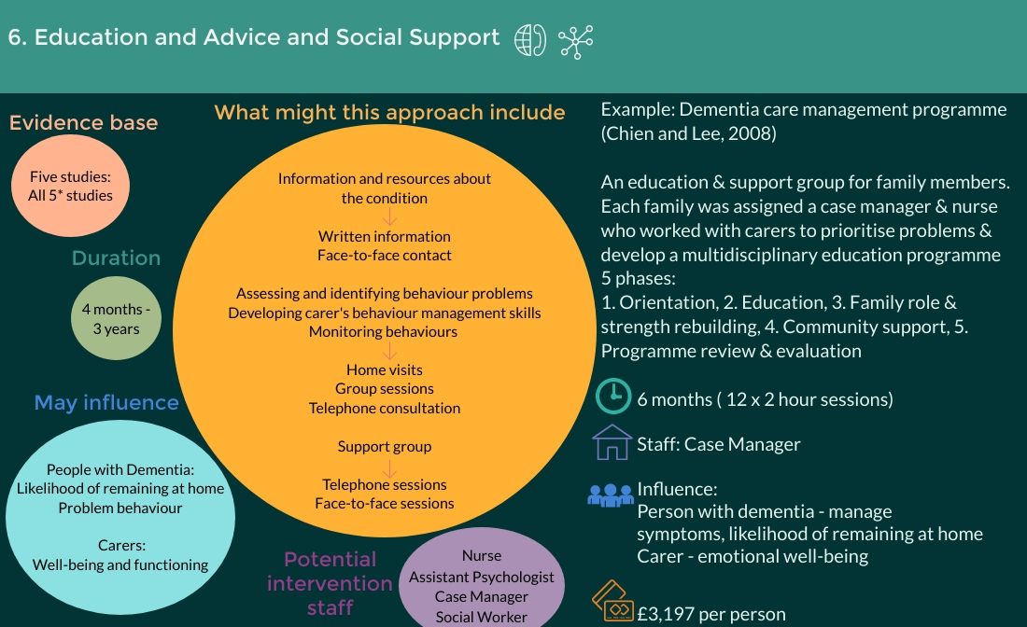

Slide 9
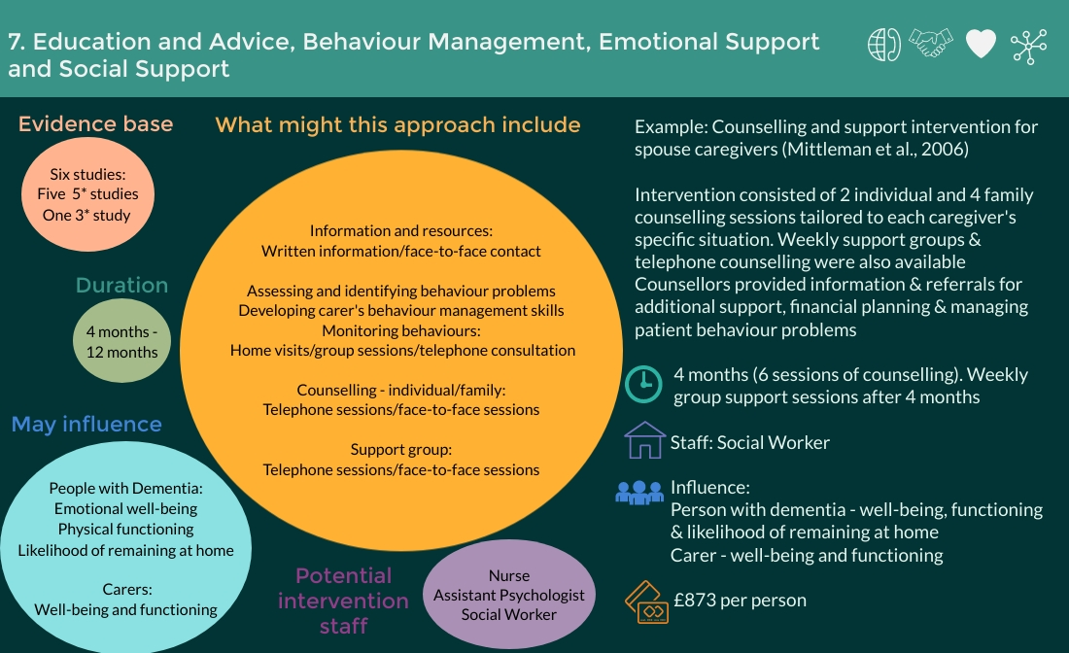

Slide 10
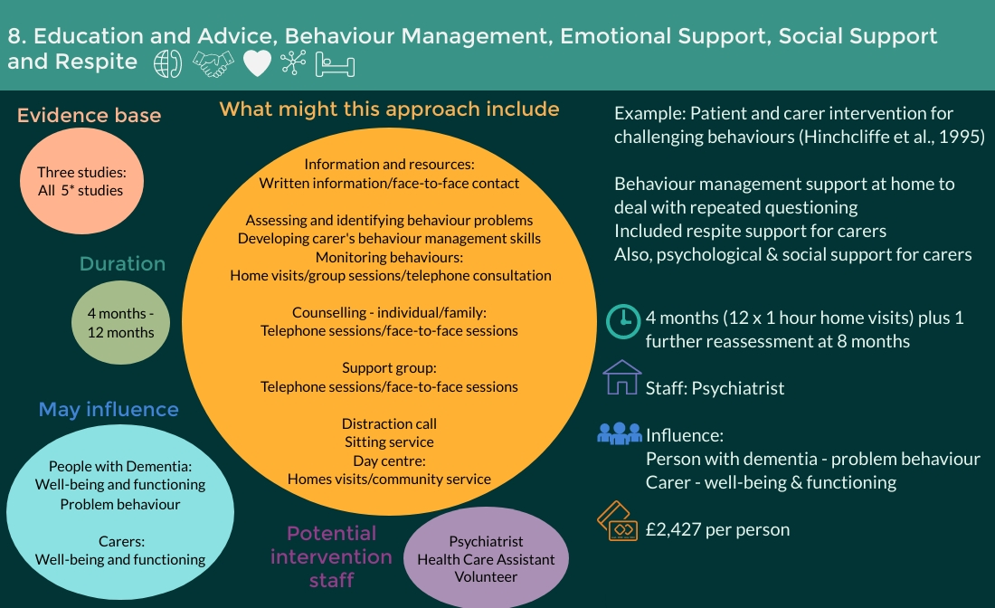

Slide 12
References to the literature
Challis, D., Sutcliffe, C., Hughes, J., von Abendorff, R., Brown, P., & Chesterman, J. (2009). Supporting people with dementia at home. Farnham: Ashgate.
Chien, W. T., & Lee, Y. M. (2008). A Disease management program for families of persons in Hong Kong with dementia. Psychiatric Services, 59(4), 433–436.
Gitlin, L. N., Winter, L., Corcoran, M., Dennis, M. P., Schinfeld, S., & Hauck, W. W. (2003). Effects of the home environmental skill-building program on the caregiver-care recipient dyad: 6-month outcomes from the Philadelphia REACH Initiative. Gerontologist, 43(4), 532–546.
Gitlin, L. N., Winter, L., Dennis, M. P., Hodgson, N., & Hauck, W. W. (2010a). A biobehavioral home-based intervention and the well-being of patients with dementia and their caregivers: The COPE randomized trial. Journal of the American Medical Association, 304, 983–991.
Gitlin, L. N., Winter, L., Dennis, M. P., Hodgson, N., & Hauck, W. W. (2010b). Targeting and managing behavioral symptoms in individuals with dementia: A randomized trial of a nonpharmacological intervention. Journal of the American Geriatrics Society, 58(8), 1465–1474.

Slide 13
References to the literature
Graff, M. J., Vernooij-Dassen, M. J., Thijssen, M., Dekker, J., Hoefnagels, W. H., & Rikkert, M. G. (2006). Community based occupational therapy for patients with dementia and their caregivers: Randomised controlled trial. British Medical Journal, 333, 1196–1201.
Hinchliffe, A. C., Hyman, I. L., Blizard, B., & Livingston, G. (1995). Behavioral complications of dementia – Can they be treated. International Journal of Geriatric Psychiatry, 10(10), 839–847.
Livingston, G., Barber, J., Rapaport, P., Knapp, M., Griffin, M., King, D., Livingston, D., Mummery, C., Walker, Z., Hoe, J., Sampson, E. L., & Cooper, C. (2013). Clinical effectiveness of a manual based coping strategy programme (START, STrAtegies for RelaTives) in promoting the mental health of family carers of people with dementia: Pragmatic randomised controlled trial. British Medical Journal, 347, f6276.
Mittelman, M. S., Haley, W. E., Clay, O. J., & Roth, D. L. (2006). Improving caregiver well-being delays nursing home placement of patients with Alzheimer disease. Neurology, 67(9), 1592–1599.
Vernooij-Dassen, M., Lamers, C., Bor, J., Felling, A., & Grol, R. (2000). Prognostic factors of effectiveness of a support program for caregivers of dementia patients. International Journal of Aging and Human Development, 51(4), 259–274.

