Slide 1
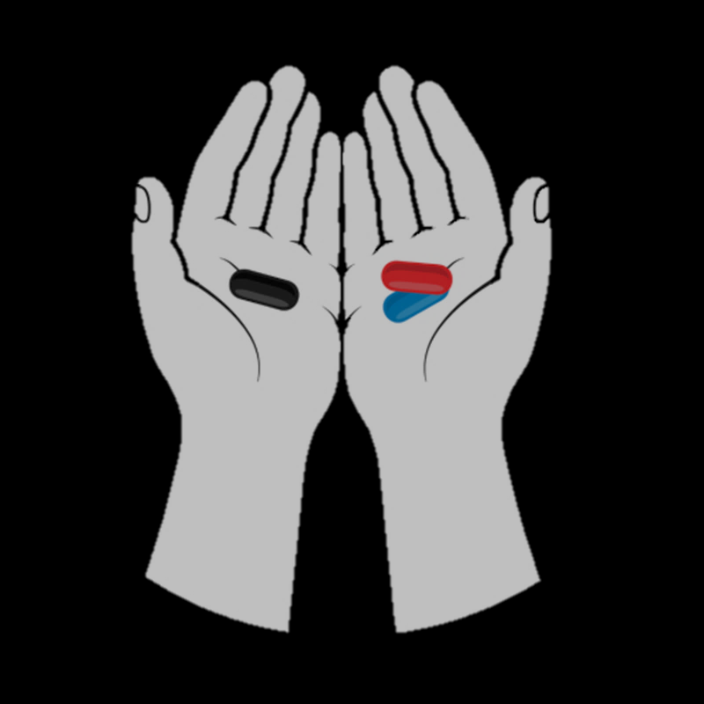
Who are Incels? Ideology, Community of Practice and Persona
Mihaela Popa-Wyatt and Justina Berškytė

Slide 2
Overview
Language plays a central role in shaping and supporting incel ideology and creates a community
Understand Incel ideology, identity and persona.
Understand power dynamics in that ideology.
Mechanisms that reinforce the ideology and create personas
Community of practice
Interpellation and self-directed interpellation
Adoption of a linguistic style

Slide 3
Who are Incels?
Incel = Involuntarily Celibate; someone who desires but is unable to obtain a romantic and sexual relationship.
Can be of any gender or sexuality. However, our focus is members from the popular incel forum incels.is, where the membership criteria demand that one is a heterosexual male
Note that being involuntarily celibate does not automatically make one a misogynist!
Motivation for joining the forum?
Notes:
There is no universal definition of what an incel is, and the term is evolving. But on a basic definition the term ‘incel’- is short for involuntary celibate. It’s basically someone who desires but is unable to obtain a romantic and sexual relationship.
The term was initially coined by Alana in the late 90’ who sought to create a community of support for lonely people who struggled to find love. Initially the forum was quite inclusive. It was open to anybody - regardless of their gender, sexual orientation – the purpose of it being to talk about their struggle to achieve a romantic relationship despite trying (whether that’s dating or sexual success).
As initially coined, the term could encompass a lot of social factors, like social anxiety in how they approach people, or feeling socially uncomfortable with initiating an interaction. It could include a mental health aspect like depression, or a physical disability aspect, or physical appearance (e,g, somebody thinking they are not attractive, or have a physical deformation they feel it impedes them for achieving a successful romantic or sexual relationship).
However the community moved on from being inclusive to being a more insular community – e.g. the forum that we looked at incel.is – is restricted to heterosexual men.
In addition, the term incel has acquired recently a pejorative connotation in the mainstream media, it’s almost colloquial to mean a very angry men who is entitled to women and sex. The dominant driver of the community is perceived to be one of misogyny and violence. However, it’s worth highlighting that not everyone on the forum is a misogynist, though the ecology and the culture on the forum is one in which misogyny and violence are promoted and glorified.
Very quickly, it’s also worth highlighting that involuntary is the crucial part here – their celibacy is not a choice but something that is forced upon them – or rather it’s a condition they experience as a fixed feature of their identity, despite them trying to change it. But furthermore, this is why they think they are failing – not just as a men but as a human being!
So what’s their motivation for joining the forum? Obviously, there is a desire to find similar others, share experiences and find a sense of purpose and belonging, fit-in a community that gives them a sense of moral worth. But there is also a desire to redress a sense of injustice they perceive it’s being done to them. That primarily goes – we claim – via a call to reclaim a perceived lack of power.

Slide 4
Masculine Hierarchy
Taboo → Lack of Recognition
Intimate: Sexual & Romantic
Isolation, Frustration, & Anxiety
Sense of entitlement – feeling of being owed sex
Social
Oppressed, low-status, & social exclusion
Perception of being at bottom of hierarchy
Can’t climb social ladder + being socially "stuck”
Recognition can only be given by fellow incels
Notes:
How do they go about this quest? In their real-life/offline world they feel they fail on two accounts.
First, there is a lack of recognition wrt to a dimension of intimacy:
In real-life they feel isolated (they can’t talk about their romantic failures, or they feel further persecuted (virgin-shaming is a common experience). So they experience sexual frustration, anxiety, and shame, for not being like the other successful men who have access to the female goods to which they feel entitled (qua male). So they feel resent and entitlement.
What’s interesting is that with the romantic failure there is a second sense of failure or lack of recognition – which is a more general sense of social subordination and marginalization:
Basically they conflate their failure in terms of masculinity with social standing. Hence, they think that for this reason, society perceives them as of low-status, as the lowest of the low. Thus, they have often have low-esteem, feel socially excluded, feeling oppressed, that they can’t climb social ladder are socially "stuck” > basically the underdog with regards to looks and flourishing life as a men.
There is a perception of victimization – where they feel displaced from the top of (gender) hierarchy (qua MEN) to the bottom position on a hierarchy of masculinity. All this revolves is driven by a sexual hierarchy around physical attractiveness. There is this hierarchy that women uphold and are responsible for creating that puts physically and stereotypically attractive men and women at the top of the hierarchy (often termed Chads and Stacies); then you’re got the slightly less attractive but still up there in terms of looks (Brads and Beckies), then below that you’ve got regular people (normies) who are average looking, and at the very bottom of the hierarchy you’ve got incels. Incels will often say that they are genetically inferior, there is something about their looks that makes them an incel, and that is not amenable to change.
So this cements their low-tier status for them, and it also justifies that women are responsible for maintaining this hierarchy.

Slide 5
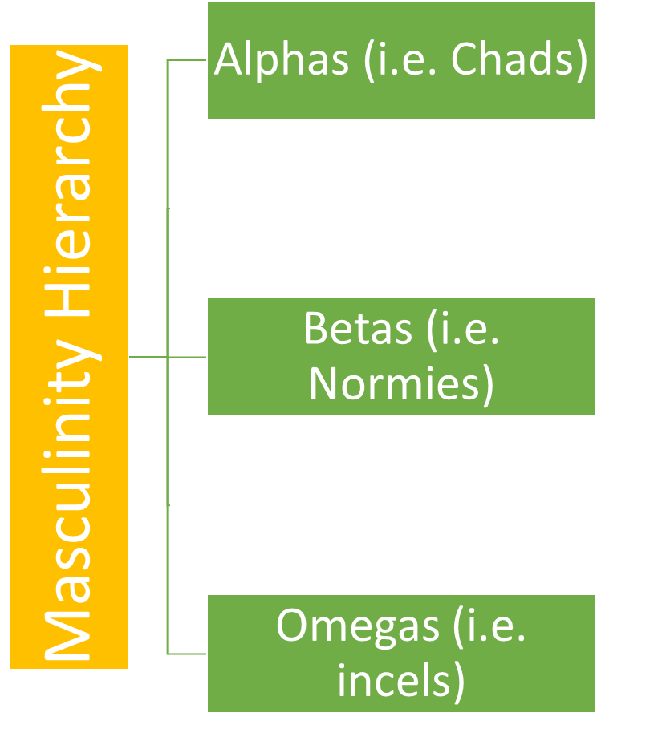
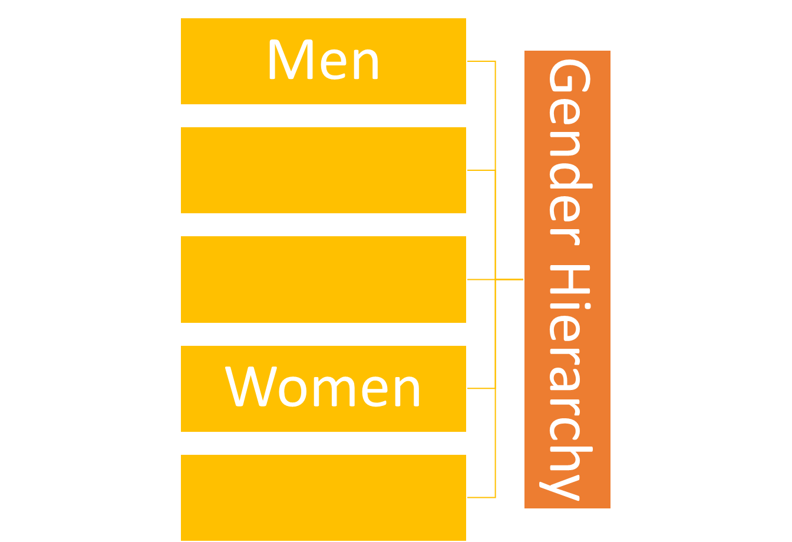
Entitled Hierarchy
DESIRED
Notes:
Whilst incels seem to accept to some extent that they are positioned lower than most men on the masculinity hierarchy, they still wish to be placed above women on the gender hierarchy. It’s a position they feel they are owed (qua men). In fact, we might think that their demand for ‘female goods/services’ (love, sex, attention, admiration, emotional nurturing, reproductive labor’ is mere instrumental. It’s a means to an end: to help restore their relative status (to other men) and reclaim respect from women.

Slide 6
Restored Hierarchy
DESIRED
PERCEIVED
Notes:
Incels therefore perceive a clash between a perceived and ideal masculinity: they feel lower than other men on the masculinity hierarchy, but desire to be at least higher than women on the gender hierarchy.
How do they go about this restoration of status?​

Slide 7
Community of Practice
What unites the community is a “community of speech and practice” (Eckert)
Community of practice = a collection of people engaged in a common goal; defined by its membership and the construction of an ideology, the relationships to each other, and to other communities
develop common ways of talking and doing things, expressing beliefs and displaying values, establishing power relations among themselves and relative to others – “stylistic practice”
performing a persona driven by misogyny and violence
Notes:
Well, here’s where coming together as a part of a community is important in establishing a sense of identity and purpose.
Eckert’s notion is very useful here…

Slide 8
Incentives of Incel Forum
Common goal is a community shaping of a narrative/ideology that supports restoration of status
Narrative of Aggrieved Entitlement and Reversed victimhood: one type of an underdog ideology
Actors: incels are “underdog”, “oppressed”, “victims” of of women and society at large; while women are the “oppressor”
A quest for an ideal: restore masculinity, status, and respect
Rationalises behaviour: justify violence towards women
Appealing to a group undergoing an actual or perceived loss of power
Create and negotiate an online identity and understanding what it means to be an incel
Notes:
So what is it that keeps them hooked on these incel forums? It's an underdog narrative that supports the restoration of their social status
To that end, they co-create a Narrative of Aggrieved Entitlement and Reversed victimhood, and self-declare as victims of a wrongful gender hierarchy, attempting to recruit other men who have experienced a similar loss of power – sending out a message of hope
Narratives are simple and compelling stories: create meaningful connections between events, actors, and behaviour
Actors: incels are victims of women and society at large; women are the “oppressor”
A quest for an ideal: restore masculinity, status, and respect
Rationalises behaviour: justify violence towards women
Because of this, they need to assign the role of aggressor and oppressor to women
So through hateful, misogynistic, and extremist posts, new incel forum members are in this way conditioned to see themselves as oppressed and women as oppressors, and are kept interested to engage with this narrative.

Slide 9
Incel Ideology:
Red, Black & Blue

Slide 10
What are ideologies?
Ideology: a system of normative and factual beliefs, implicit judgments shared in a group, community, or society, that shapes people’s understanding and guides their behaviour.
Ideological beliefs can be held with varying degrees of commitment; weaker degrees of conviction can be sufficient to generate participation.
Notes:
Highlight the anonymous nature of the forum.
Ideological beliefs can be held with varying degrees of commitment: partially or fully internalising ideology (spectrum of devotees to mere)
Even weaker degrees of conviction can be sufficient to generate participation
provides cognitive resources for interpreting, decision-making, shaping people’s behaviour

Slide 11
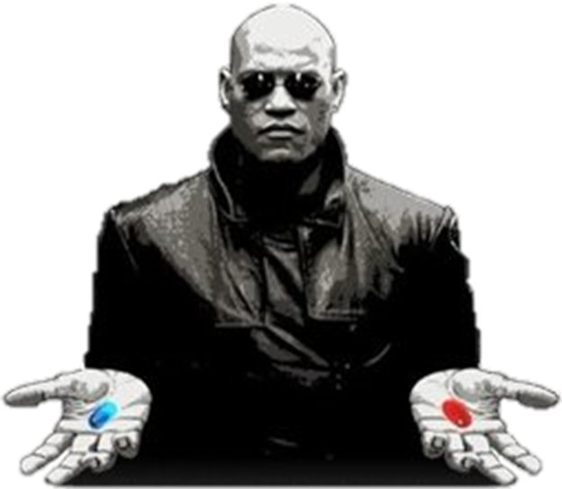
Incel Ideology: Pills
Borrows from The Matrix.
Society is split into (at least) three pills, blue pill, red pill and black pill.
Incels hold that most of society (in particular ‘normies’) is blue-pilled, living under an illusion.
Swallowing the red or black pill allows one to see true reality.
Notes:
Incel (and more broadly manosphere) communities have distinctions between different types of pills. The idea is borrowed from The Matrix where Neo is given a choice between a blue and red pill. Taking the blue pill would leave him as he is, living in a fake reality, taking the red pill would allow him to see the reality.
Illusion: feminism is good, women are an oppressed group, etc.
This idea carries over to incel, but another pill – the black pill – is introduced.

Slide 12
Society is lookist; Anti-feminist;
Women are systematically advantaged;
Women are shallow,
deceptive, manipulators
who lack personality and humanity;
80/20 rule;
Hypergamy.
Rejects solutions on an individual basis;
calls for a systemic change; adopts a fatalistic stance.
Champions
self- improvement; one can ascend out of inceldom.
Refs: incels.wiki articles Red Pill; Black Pill; Feminism
Notes:
If the world was fair there would be no incels – what they see as fair is going back to a time when women did not have power/rights

Slide 13
Functions of Incel Ideology
Out-group Attack
In-group Boosting
Creates a strong group identity
Message of HOPE – promise of status and respect (appealing to recruits)
Explains aggrieved entitlement
Justifies/rationalises sexism and misogyny
Message of THREAT against the perceived ‘oppressor’
Alleviates displacement in the real world
Notes:
We can boil down the main characteristics of the two strands of the ideology into two messages: one for the out-group; one for the in-group.
First, there is a message of threat towards the out-group, including both women and successful men, by perpetuating misogyny and sometimes violence (whether actual violence or detailed discussion of violence online). By putting women down there seems to be an attempt to regain some type of power. This explains away their aggrieved entitlement and justifies why aggression towards the "oppressor" is rational in their eyes.
The second message is one of hope for the incels (and the recruits) in either reclaiming their status or finding a place where there's a clear explanation for their lower status. This is important because it helps boost in-group identity, and create a sense of belonging and community
This dual-message serves as a recruiting strategy to draw in new members.
To maximize the likelihood of uptake they tend to be highly outrageous and inflammatory, and thus contagious, leading to piling-on effect.
This builds emotional contagion as excitement and self-reinforcing within a strongly connected social group.

Slide 14
Ideology and Persona

Slide 15
Incel Persona
Persona relates to how we (re)present ourselves; how we want to be perceived
A particular style of talking and doing things -> “communicative style” (Eckert & McConnell-Ginet)
Posts/linguistic patterns shape a social meaning associated with the construction of an “incel persona”. This contains:
(i) Affective values associated with out-group attacks and in-group loyalty
(ii) Beliefs about the relative social position within a given hierarchy
Notes:
The idea of persona has been developed in sociolinguistics in relation to identity construction. It relates to how we present ourselves and how we want to be perceived. Basically what we do, what we say and how we say it signals to the audience the kind of person we are, the group we belong to and the values we adhere to.
Think of persona as a slice of our identity tailored to particular contexts and which involves some stylisation: so e.g. by the way we dress, we walk, we talk, the accent we use, or the content of our utterances, we adopt what Eckert and McConnell-Ginet call a "communicative style"
In the case of incels, this amounts to using extremist and violent rhetoric, so the social meaning of this kind of language shapes the kind of persona they adopt.
Though the specific content of the persona is determined by the particular strand of the ideology it's embedded in, we can discern two broad dimensions of an incel persona:
An affective dimension: what they approve or disapprove of, e.g. they express negative values towards the outgroup and positive value of the in-group
The second dimension concerns beliefs about how they see their relative position within a given hierarchy, e.g. that they are relegated to a subordinate position on the hierarchy of masculinity and they seek to rebalance the power dynamics in terms of their rightful place within the gender hierarchy

Slide 16
Heterogeneous Personae
Incel persona is embedded in particular strands of the ideology
Prototypical incel persona: the choice of words, topics, style (e.g. misogyny, aggressive, violent) signals one's allegiance to the ideology
Heterogeneous personae (individually tailored styles): dominant, subordinate, marginalized, extremist
Some are loyal/committed members, inciting others to display similar behaviour
This creates a community norm and social pressure to display the ‘incel’ behaviour (e.g. piling up outrage) if they want their peers’ approval
Providing constant reinforcement for shared identity beliefs.
Notes:
Incel persona is embedded in particular strands of the ideology
While there is a particular CORE to the incel persona in that the language used is typically driven by misogyny and violence, there is a certain heterogeneity in the contribution incels make on different threads and thus the kind of persona they present themselves as having... so that some personae can be more pronounced than others. One can present oneself as being dominant or subordinate, marginalised or extremist.
Also, as we mentioned earlier, incels also have varying degrees of commitment to the Ideology.
some are loyal/committed members, and this provides incentives display similar behaviour
there is a sense that users compete for who’s got it worse but also for who is more vocal, active contributor, who posts more (e.g. ranking), and that incentivises others to do the same if they seek their peers’ approval. This cements a sense of community-building and provides constant reinforcement for shared identity beliefs
Now We’ll look at some mechanisms that serve to build the incel persona and how that contributes to boosting in-group identity.

Slide 17
Interpellation, Self-Interpellation & Style
The mechanisms of ideology

Slide 18
Interpellation
Interpellations (or hailings) are speech acts addressing their target to recognise themselves as having a particular social identity/persona (Althusser, Kukla).
When a target is hailed, and they recognise that it’s really them who is being hailed they become a subject of the ideology. Ideology constitutes the subject and subject reinforces the ideology.
A police officer hailing ‘Hey you there!’. You turn around because you recognise it is really you (and not someone else) who is being hailed. By doing so you become a subject of the law and order ideology and you reinforce the ideology by doing so. (Althusser)
You go to the bathroom. There are two options; one of the signs address you. You recognise one of them as hailing you. You go through the door becoming a subject of the gender binary ideology and you reinforce the ideology by doing so. (Kukla)
Notes:
Successful interpellation requires the correct authority and contextual features and uptake.

Slide 19
Incels and Interpellation
Interpellation starts when one signs up for the forum.
The forum issues a hail in the form of membership criteria
you recognise the call; you fit the criteria
you become a subject (at least in the minimal sense)/ begin a persona
Reinforces the ideology that the only ‘proper’ incel is heterosexual & male.
“Welcome! This is a forum for involuntary celibates: people who lack a significant other. Are you lonely and wish you had someone in your life? You're not alone! Join our forum and talk to people just like you.”
Notes:
- You begin the persona as you’re given a template to work with and a space to represent yourself to others.

Slide 20
Incels and Interpellation; suffix -cel
Incels use suffix -cel to perpetuate incel ideology and create their persona. Broadly it’s used in a self-identificatory manner, e.g.:
Incels use the suffix -cel to position themselves within incel forums, e.g. uglycel, heightcel, ethnicel, mentalcel to signal one’s inceldom as resulting from their looks, height, ethnicity or mental condition
Or in a policing/boundary setting manner, e.g.:
Fakecel and volcel are used to indicate someone is not a proper incel. Graycel is used to police new members.

Slide 21
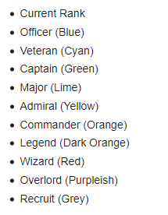
Incels and Interpellation; graycel
When new members join their username appears in grey; indicating to others that they are a new member, this can warrant being addressed as a graycel, e.g.:
a user asking why so many users on the forum insult one another (i.e. questioning the style of discourse between the members) instead of focusing the hatred on women might get a response of something dismissive like ‘Ok GrAYcel’/’Typical GrAYcel thread’.
The hail forces one to recognise themselves as a new member. To gain respect and a good standing they must contribute more to the forum. This forces the individual to contribute more and become a more entrenched member of the ideology.
Perpetuates the idea that it’s only those who have spent sufficient time on the forum should be taken seriously.
Notes:
Of course, simply becoming a member of the forum merely provides one with a template for a persona and not the full persona. To establish yourself in the forum one must actively participate by posting threads or comments.
Here capitalised letters serve as an extra insult, i.e. that they’re also gay.

Slide 22
Self-Interpellation
Whilst second-person interpellation works by hailing the target and making them recognise that it really is them who is being called, self-interpellation, we argue, functions by calling upon the hearers to recognise the speaker’s social position.
Walking into a classroom you utter, ‘I will be your lecturer for this module’. In doing so you call upon the hearers to recognise your social position. Upon sufficient uptake you successfully interpellate yourself in the classroom ideology; this becomes part of your identity (or reinforces it) and establishes the relevant student-teacher norms.

Slide 23
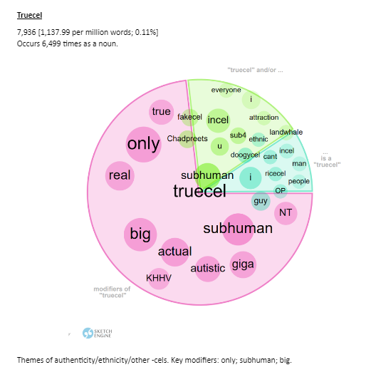
Truecel
Incels hail themselves as uglycel, heightcel, ethnicel, mentalcel, this forces others to recognise them as a particular kind of incel. Contributes to a unique persona.
The persona of a truecel provides a model for what a ‘true’ loyal group member is: how one is expected to behave to receive esteem from their peers
Hailing yourself as a truecel demands recognition from others that they have it the worst. If there’s sufficient uptake, this gives some authority to the individual on incel matters.
Notes:
- From the visualization you see subhuman and truecel occur very close, meaning that people use those words frequently together. This is not surprising since incels use subhuman to refer to themselves. What this tells you about one’s identity is that to be a truecel one must see themselves as subhuman. Thus those accepted as truecel will have had to prove themselves to be in some sense subhuman.

Slide 24
Self-Interpellation
Self-interpellation: uglycel
heightcel,
subhuman,
truecel, etc.
Contribute to the common goal of understanding incel identity.
Understand incels’ relationship to different communities of practice.
Play a part in the negotiation of identity.
Call upon the members to recognise their unique incel persona in the forum.
Reinforce the ideology that their incel status is not their fault but women and society are to blame.
Group signal their belonging in the community; committed to the ideology
Notes:
Contribute to the common goal of understanding incel identity – there’s a specific (largely biological) feature that makes them an incel.
Help one to understand incels’ relationship to different communities of practice. For example, they will not succeed in the community of practice of dating because of these specific features that make them incels.
Reinforce the ideology that their incel status is not their fault but women and society are to blame, e.g. it is women who reject shorter men.
Play a part in the negotiation of identity, acceptance/rejection of a self-hailing informs what the appropriate candidates for the incel identity are.

Slide 25
Adoption of a Style
The style of language that the members of the forum adopt is largely derogative towards themselves (e.g., subhuman) and out-groups and particularly towards women.
Foid = Shortened version of femoid which is a contraction of the word "female" and "android" (incels.wiki).
Foid is used in two common ways in a derogatory manner and in (an almost) a descriptive manner as a placeholder for woman.
Derogatory use: 'should not have expected more from her, she's a fucking foid’
Referential use: 'I went to the shop and a foid held the door open for me'
Notes:
Incels use a lot derogatory terms towards women, these include metaphorical and objectifying terms such as toilet, it, hole, roastie, femoid, foid. For now our focus is on foid.
Note that 'foid' is still dehumanising, but the main aim of the post is not simply to dehumanise.

Slide 26
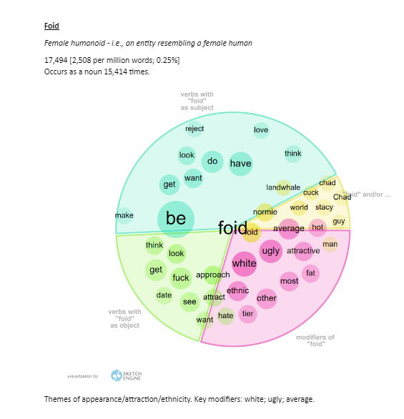
Adoption of a Style
In using foid one sends out a THREAT message towards the out-group AND in doing so one adopts a derogatory style, which:
Distances themselves from women by dehumanising them.
Shows affiliation to the ideology and commitment to the incel persona. It says, ‘I am the type of person that uses the correct language, I belong here’.
Adopting a derogatory style establishes certain norms, the correct way to talk about women is one that involves derogation.
Credit: Lily Calloway, Aston University
Notes:
Incels use a lot derogatory terms towards women, these include metaphorical and objectifying terms such as toilet, it, hole, roastie, femoid, foid. For now our focus is on foid.
Note that 'foid' is still dehumanising, but the main aim of the post is not simply to dehumanise.

Slide 27
Underdog Ideologies
Notes:
To recap so far, we’ve seen that the primary take-away is that the reason why ideology is seductive for incels is that it's crafted through a narrative around betrayal and loss of status
What drives this narrative is the promise to recover a lost sense of power or status. We saw this with the red-pill and black-pill ideologies. But this is common to other ideologies that we recently saw flourish in both American and UK politics.

Slide 28
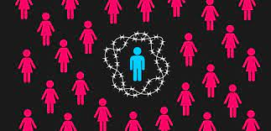
Incel ideology and Male Supremacism
Recruits: males who feel low status sexually
Resentment of women
Promise of power: regain some status by either red pill or violence

Slide 29
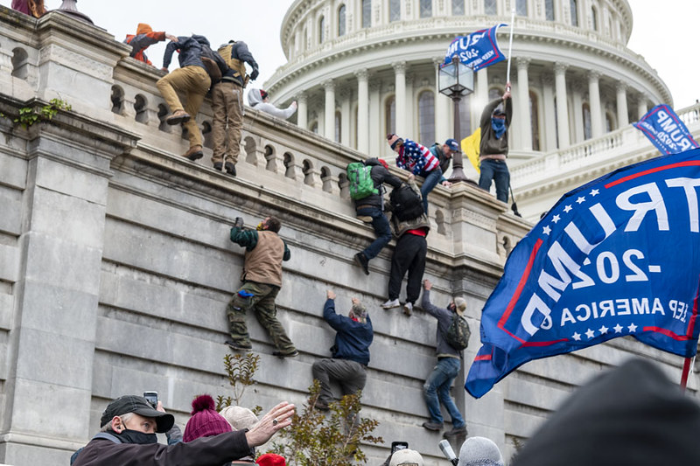
Make America Great Again
Recruits: feeling displaced by communities of colour, feminists and immigrants
Racial resentment
Nostalgia for the Past
Promise of racial power

Slide 30
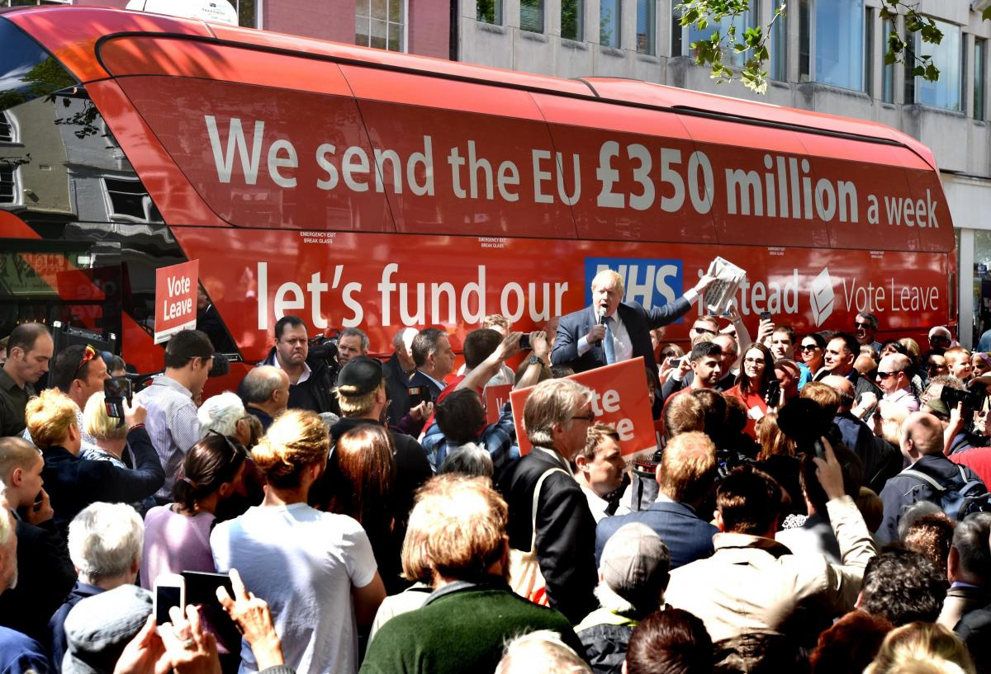
Brexit
Recruits: loss of familiarity and status
Resentment of EU and immigrants
Nostalgia for the Past
Promise of power: take back control

Slide 31
What’s Common to Underdog Ideologies
Targets: groups undergoing an actual or perceived loss of power, identity, culture, country
Perception of being unjustly displaced from entitled position of some status
Resentment: a need to take back what they perceive they are owed
Message of hope to in-group: creating a social role whose status is redeemed
Language of hate against the ‘oppressor’
Path to regain power/status
Willing to use extra-legal means if and as necessary but not first resort
Notes:
What they have in common is an attempt to regain back a position of power or control. This is appealing to recruits who feel displaced.

Slide 32
Ideology through the lens of Underdog Narrative
A: the Aggrieved | previously in a position of power/status/privilege
B: the Falsely Elevated | situated below A in the social hierarchy, but climbed on the social ladder
C: the Powerful Collaborators of the Falsely Elevated | are of higher status. Betrayed A by promoting B to a position of undeserved status above A
A has to take retribution on B, by pushing them back down on the social hierarchy below A, where B belongs, or by removing them altogether
Notes:
in incels' view, a rightful recovery of status through whatever means necessary to cast down those who climbed up the social ladder - here women and in particular feminists who made it possible for women to acquire more rights.
The ideology provides a narrative within which each actor is assigned a certain social role, specifying how these social roles are related to one another, how they changed in the past, and how they should change in the future to reverse the loss of status. Typically the roles are duals or triples:
To regain a high-power social role relative to men (‘normies’) and respect from women, incels have to take retribution on women.
Their interest in having sex with Staceys is at least a means to an end, the end being to beat the Chads at their own game.

Slide 33
Conclusion
Incel ideology seeks to explain a perceived lack of power
They create social roles and personas for themselves and women (interpellation, adoption of style, community of practice)
These support, for black pillers, hope for redemption of status by violence
There are common elements with other ideologies
All message a group that sees itself as the underdog

