Slide 1
Talking about suicide and psychosis: what is the evidence for implementing psychological interventions?
Professor Gillian Haddock
University of Manchester

Slide 2
A few acknowledgements…
Not all my own work!
Large team of people working on suicide and psychosis research
Key partnerships with our service user groups (the INSURG, CARMers, SSRURG) – couldn’t do it without them

Slide 3
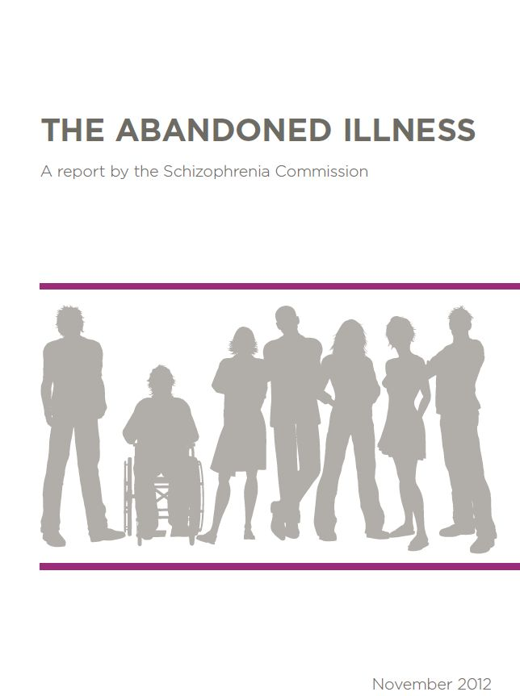
Schizophrenia Commission report 2012
Imagine suddenly developing an illness in which you are bombarded with voices from forces you cannot see, and stripped of your ability to understand what is real and what is not. You discover that you cannot trust your senses, your mind plays tricks on you, and your family or friends seem part of a conspiracy to harm you. Unless properly treated, these psychotic experiences may destroy your hopes and ambitions, make other people recoil from you, and ultimately cut your life short. Some 220,000 people in England have such psychotic experiences – we probably all know a family who is affected……..
http://www.rethink.org/media/514093/TSC_main_report_14_nov.pdf

Slide 4
NICE Guidance (2014)
Cognitive Behaviour Therapy (CBT) is a recommended treatment for schizophrenia/psychosis
NICE recommends:
CBT should be offered to all people with diagnosis of schizophrenia
Start in the acute phase, or later, including inpatient settings
Family interventions should be offered
Do not routinely offer counselling, supportive psychotherapy, social skills training or adherence therapy

Slide 5
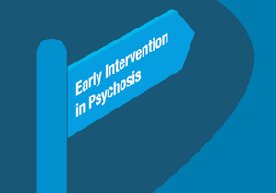
The early psychosis standard
The access and waiting time standard for early intervention in psychosis (EIP) services requires that, from 1 April 2016 more than 50% of people experiencing first episode psychosis will be treated with a NICE-approved care package within two weeks of referral.

Slide 6
But, despite recommendations….
National implementation historically has been poor
“No voice, no choice”: a review of community mental health services in England (2007) suggested 46% service users offered CBT (update 2009 – no real change)
Rethink survey of symptomatic service users
29% offered CBT (2012), 45% (2014)
10% offered FI (2012), 23% (2014)
Recent Manchester survey - implementation still poor

Slide 7
So what is the problem…….

Slide 8
Key issues
Services not well geared up for delivery – lots of trained staff but emphasis on case management – therapy not prioritised
CBT not a panacea - may not be suitable for everyone
People with psychosis – heterogenous population - different populations may need different interventions
Complexity and challenging clients i.e. suicide, self harm, aggression, substance misuse…..workforce not well geared up to deal with these issues and evidence base less developed?

Slide 9
So, what now?….
We know CBT for psychosis works
Getting it into services as routine treatments from the first episode or earlier is crucial
Specialist therapists and supervision is required
Close attention needs to be paid to implementation and service user choice about the way they receive treatments
Needs of complex clients need to be incorporated……

Slide 10
Suicidality* and psychosis
*thoughts, images, plans, intent and actions

Slide 11
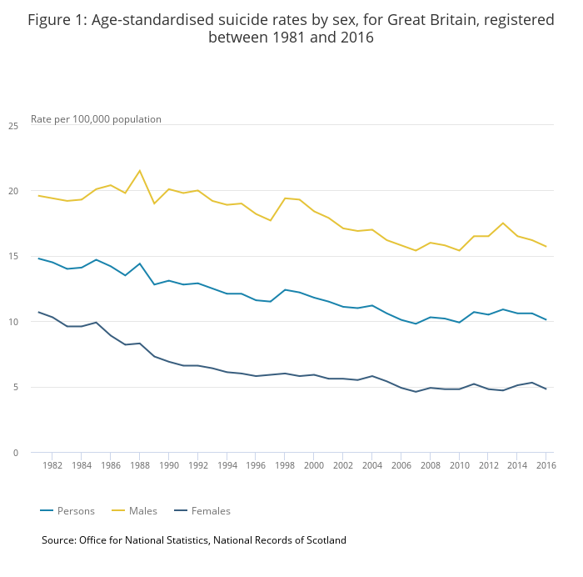
Suicide in the UK
There is one death from suicide every 90 minutes
Each year about 6,000 people die by suicide
…and about 140,000 suicide attempts (one attempt every 4 minutes)
These figures have only slightly reduced over the last 30 years

Slide 12
Psychosis and suicide
20-40% of people with psychosis will attempt suicide in their lifetime (Sanchez-Gistau et al, 2013)
8-10% will die by suicide
And, many experience ongoing thoughts of suicide and self harm
The risk may higher among those with first episode psychosis (FEP)
Substance use exacerbates the risk and SU is more common in people with psychosis

Slide 13
Why should we prioritise suicide in people with SMI?
Suicidality is common in this group
During 2008 and 2018, there were 18,029 deaths identified as patient suicides (i.e. in contact with mental health services 12 months prior to death)
Suicide and suicidal behaviour present huge personal, social and financial costs for the individual, families, carers and services…..

Slide 14
Risk factors for Suicide – epidemiological data
Demographics:
Gender, age, education, employment, marital status, familial status, income/social & economic status
History of suicidality:
Previous attempts, family history of death from suicide
Mental Health Problems – 28% of suicide deaths are in people with known mental health problems:
Increased risk associated with:
Psychiatric hospitalisation / imprisonment
Depression, Psychosis, Trauma, diagnosis of personality disorder
Substance and/or alcohol misuse
Adverse life events

Slide 15
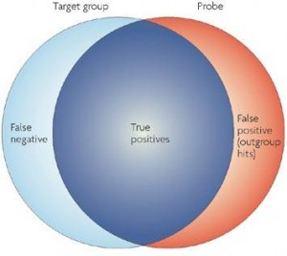
Limitations of epidemiological research…
Many individuals who fall into high risk groups do not kill themselves (false positives) and many who kill themselves do not fall into high risk groups (false negatives)

Slide 16
Knowing the risk factors alone is not helpful to help develop interventions
No accurate method of predicting who will die by suicide
Static risk factors cannot be reduced (e.g. gender)
Current practices are flawed – many people in services who die from suicide are considered at no or low risk
Suicide risk assessment scales have limited clinical utility and may waste valuable resources and are no longer recommended (NICE, 2011; Quinlivan et al, 2017)
But, psychological factors can be changed…….

Slide 17
Understanding Suicidal Behaviour
Thoughts about death
Suicidal ideation
Self harm
Suicide attempt
Suicide
Suicide lies at the extreme end of a continuum
All aspects of this continuum can be important treatment targets
Understanding the psychological mechanisms helps to better understand the individual and enable formulation of an individualized - specific treatment approach

Slide 18
Models of suicide (e.g. Cry of Pain, Williams, 1997; IMV model, O’Connor; IPT, Joiner, Schematic Appraisals Model (Pratt et al, 2014; Johnson, Gooding & Tarrier, 2008)
Models differ but identify key psychological features, which include defeat, hopelessness and entrapment
Risk Factors
Mediating factors
Suicide
Notes:
Clear need to understand factors that lead a person to suicidal behaviour.
A model that has been proposed to explain this is the cry of pain model.
This suggests that the key processes that lead a person to suicidal behaviour are defeat and entrapment.
These states are thought to arise when a person is in an intolerable situation, they believe they cannot cope with and it wont end.
Suicide here then is seen as a way of escaping from this situation.

Slide 19
Understanding pathways to suicide in psychosis (Harris et al, 2019)
Negative life events are central to experience of suicidal thoughts.
Low mood, perceived loneliness, and hopelessness precipitated suicidal thoughts, with hopelessness featuring primarily in the transition to suicidal plans.
Psychotic symptoms, such as hallucinations and delusions, were present at each stage of the pathway to suicidal thoughts, plans, and attempts.
Certain types of delusions, such as grandiose delusions, were sometimes perceived to reduce the intensity of suicidal experiences and the associated psychological distress i.e. protective.

Slide 20
Key issues for therapy…..
A sense of feeling defeated and believing that there are no options for escape (entrapment) are strongly implicated in suicidal behaviour
Suicide can be considered to be escape from an intolerable emotion/situation
Suicide beliefs and cognitions (schema) drive the urges, are strengthened over time, and can be activated at any point in time, by a large range of (maybe seemingly unrelated) stimuli
Psychotic symptoms, substance misuse and environmental factors feed in at all stages
Notes:
Blocks: shame? Difficultly articulating feelings? Rules about coping? Positive beliefs around suicidal behaviour? Needing to be punished?

Slide 21
Role of psychotic symptoms…

Slide 22
Is the severity of psychotic symptoms linked with self harm and other violence?
Not clear cut, methodological problems in research
Some evidence that psychotic symptoms are linked to increased rates of self harm/violence (e.g. Meehan et al, 2006)
Findings are inconsistent, but, content or type of symptom seems more important than severity of symptoms i.e. not related to how ‘ill’ a person seems

Slide 23
What type of psychotic symptoms most implicated?
Paranoia
Delusions of misinterpretation
Command hallucinations
Sometimes called ‘threat/control over-ride symptoms’

Slide 24
Threat/control over-ride symptoms (TCOS)
Threat
‘My neighbours are plotting to kill me and attack me’
‘MI5 are following my movements and want me dead’
Control over-ride
‘Outside forces are in control of my mind’
‘Invisible men put thoughts into my head and guide me’

Slide 25
Command hallucinations and self harm
Studies shows type of command (harm other/harm self etc) not really linked to compliance
But beliefs about the entity giving the commands are linked to compliance (Beck-Sander et al, 1997; Barrowcliff and Haddock, 2010)
e.g. belief in the commander being benign associated with self harm
e.g. belief that the commander was justified in making the command influenced harm other compliance

Slide 26
Interpersonal environment and psychosis
Interpersonal environment has long been demonstrated to contribute to outcome in Sz (e.g. expressed emotion)
Environment has been clearly related to relapse of symptoms, aggression/violence (e.g. Barrowclough et al, 2001)
This has been highlighted in family environments but also in staff and inpatient environments
Psychiatric services often under-resourced, low staff morale and high staff turnover……

Slide 27
The Observer, April 8, 2007 (quote taken from mental health nurse, anonymous)
'Those working on acute psychiatric wards live in parallel worlds filled with horrors that no one on the outside could ever try to imagine. We see atrocities every day and take them for normal. ‘
‘Every morning, we brace ourselves for mayhem: I could start my day witnessing an attack on another member of staff or a patient, or even be attacked myself. The only thing I can be sure of is that the risk of such violence is increasing.'

Slide 28
Resilience to suicide: a systematic review (Harris et al, 2019)
Reviewed 27 studies (21 quantitative)
Key findings which conveyed psychological resilience:
Perceived social support
Religious or spiritual support
Having reasons for living
Perceived positive personal skills and attributes

Slide 29
What is the evidence for working with suicide and psychosis?
Three trials (and two in progress)

Slide 30
Overview of UoM/GMMH/Pennine treatments to prevent suicide research
Recovery in Psychosis Programme (NIHR programme)
Community based, Psychosis and Suicidality (Greater Manchester West Mental Health Trust)
Prosper trial (RfPB)
Prisoners at risk of suicide (HMP Manchester)
INSITE trial (RfPB)
Acute psychiatric inpatients at risk of suicide (GMMH)
CARMS trial (MRC-EME)
Community based, Psychosis and Suicidality – large scale study (3 Mental Health Trusts in North-West England) - ongoing
PROSPECT trial (NIHR): Prisoners at risk of suicide - ongoing

Slide 31
Cognitive Behavioural Suicide Prevention in Psychosis: The RECOVERY trial
Tarrier et al., 2014; Schizophrenia Research, 156; 204-210.
Funded by the NIHR - Research for Patient Benefit Programme

Slide 32
RECOVERY trial: small two arm feasibility trial
Treatment (24 sessions, twice a week, plus TAU)
Control (TAU alone)
Aged 18 – 65 years
Diagnosis - schizophrenia spectrum.
Previous suicide attempt and/or current suicidal ideation.
Recruited from community mental health services
Notes:
Simple design.
Aimed for 30 ppts per group.
Therapy – 2x a week for 12 weeks which allows for a months grace between baseline and being seen by therapist.
Three therapists.

Slide 33
Outcomes
CBSPp group improved more than TAU group..
On two out of three primary outcome measures of suicidal ideation and suicide probability
Secondary outcomes of hopelessness related to suicide probability, depression, some psychotic symptoms and self-esteem.

Slide 34
Effects of therapy
Notes:
Both significant – (Beck ideation Scale was not, if asked in questions.)
Hopelessness sub-scale was the driver of the SPS measure – Ideation, Hopelessness, negative Evaluations, hostility.
Stats: Random effects regression models for repeated measures data were fitted.
Be prepared for a question about why Suicidal ideation and probability improve in both groups.

Slide 35
PREVENTION OF SUICIDE IN PRISONERS (PROSPeR)
Funded by the National Institute for Health Research. (Research for Patient Benefit Programme)

Slide 36
PROSPeR trial
Aim to demonstrate the feasibility of conducting an RCT of CBT for suicide prevention in a prison setting
Eligibility criteria:
Adult male prisoners (aged over 21 years)
Identified by staff to be at risk of suicide or self-injury
Participants randomly allocated to two groups:
Therapy group: CBT + ACCT (prison suicide prevention system)
Control group: TAU (inc ACCT)

Slide 37
Effects of treatment
Frequency of self injurious behaviour
Large effect=-0.72
se=0.47
95%CI= -1.71 to 0.09
p=0.162

Slide 38
THE INSITE study
A randomised controlled trial of CBT for suicide prevention in inpatient settings
Haddock et al (2016) Trials., Feb 11;17:79
Haddock et al (2019), British Journal of Psychiatry Open (trial results)

Slide 39
What is INSITE?
A pilot study to investigate the feasibility and acceptability of a Cognitive Behavioural Suicide prevention therapy for people in acute psychiatric wards.

Slide 40
Why focus on in-patient suicides?

Slide 41
Because…..
Suicidal In-patients have continuous 24 hour direct contact with staff.
Therefore in-patient suicides should be the most preventable of all suicides
Notes:
Most suicides occur in the community,
Most suicides have not had contact with services in the previous year,
Most suicides of those in contact with services were assessed by staff as ‘No’ or ‘Low’ risk

Slide 42
In-patient suicide
Suicidal behaviour is still highly prevalent in psychiatric wards
Re-admission for repetition of suicidal behaviour is common
In 2018 there were 74 inpatient suicides (4% of all patient suicides), 179 in the 3 months post discharge
Treating suicidal in-patients is expensive financially, personally……

Slide 43
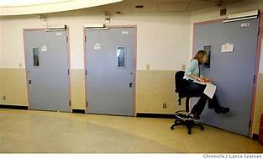
Usual NHS treatment for suicidal psychiatric inpatients
Frequent risk assessments
Observation
Medication
‘Containment’
1:1 time with ‘named nurse’
Ward activities / groups
Psychological therapies sparse or absent

Slide 44
Environmental challenges in inpatient settings
Security factors over-ride aesthetics
Risk management is paramount
Staff often have dual role - security vs therapy

Slide 45
Psychiatric wards – some challenges……
Unpredictable chaotic environments
No precedents for psychological therapy
Very little individual autonomy or privacy
Low ward staff morale – high staff turnover
High bed occupancy
Excessive use of agency staff
Highly acute complex risky patients
High patient dissatisfaction

Slide 46
Key questions?
Can it be successfully implemented?
Is it feasible and acceptable to staff and patients?
What impact does it have on key outcomes (length of stay, suicidality*, mental health problems, functioning etc
*Suicidality includes suicidal thoughts, feelings & behaviours
Notes:
Pre-study informal national survey of clinical psychologists to identify provision of in-patient psychological therapy carried out by YA in 2012– results: nothing other that ad-hoc psycho-education / brief intervention groups in existence
Few precedents of psychological therapy trials in psychiatric ward settings

Slide 47
The intervention
Delivered over 6 months, up to 20 sessions
Delivered weekly, depending on needs of patient
A collaborative, one to one intervention based on cognitive behavioural treatment for suicide
Targets key factors which underpin suicide e.g. hopelessness, entrapment and defeat
CBT principles to address suicidal thoughts and feelings
Incorporates a focus on staying well and maintenance of recovery

Slide 48
Outcomes
Suicidality
Length of stay
Risky behaviours
Symptoms
Psychological factors
Quality of life
Is it cost effective?

Slide 49
Suicide severity
SPS Suicide scale
Mild n = 3 (5.9%)
Moderate n = 7 (13.7%)
Severe n = 40 (78.4%)

Slide 50
So, is it feasible?

Slide 51
Findings suggest it is…
70 people consented, 51 people randomised
Mean no. of sessions = 12
However, the range was wide: 0-20

Slide 52
Sessions

Slide 53
Is it acceptable?
For service users:
Qualitative work indicated service users want it and value it
Data on take up of sessions good
Engagement in therapy good (therapeutic alliance similar to other CBT studies)
For staff:
Generally well received
And not too disruptive!

Slide 54
Serious, adverse events
They were common!
We recorded 255 serious adverse events during INSITE i.e. serious self harm
Ranged from 0-105 events per person
Highlights the stressful environment staff are working in
None were research related
And, they were no more frequent in the therapy group suggesting engagement in the intervention did not increase risk

Slide 55
What have we learned?
Suicidality is a key problem with people with psychosis
CBSP approaches are feasible, acceptable and welcomed
There is evidence of effectiveness
But, there are challenges……..
Next results, 2022, large multi-site CARMS trial of CBSP in the community, n= 253 (see protocol, Gooding et al, 2020, BMC Psychiatry)

Slide 56
Thank you

