Slide 1
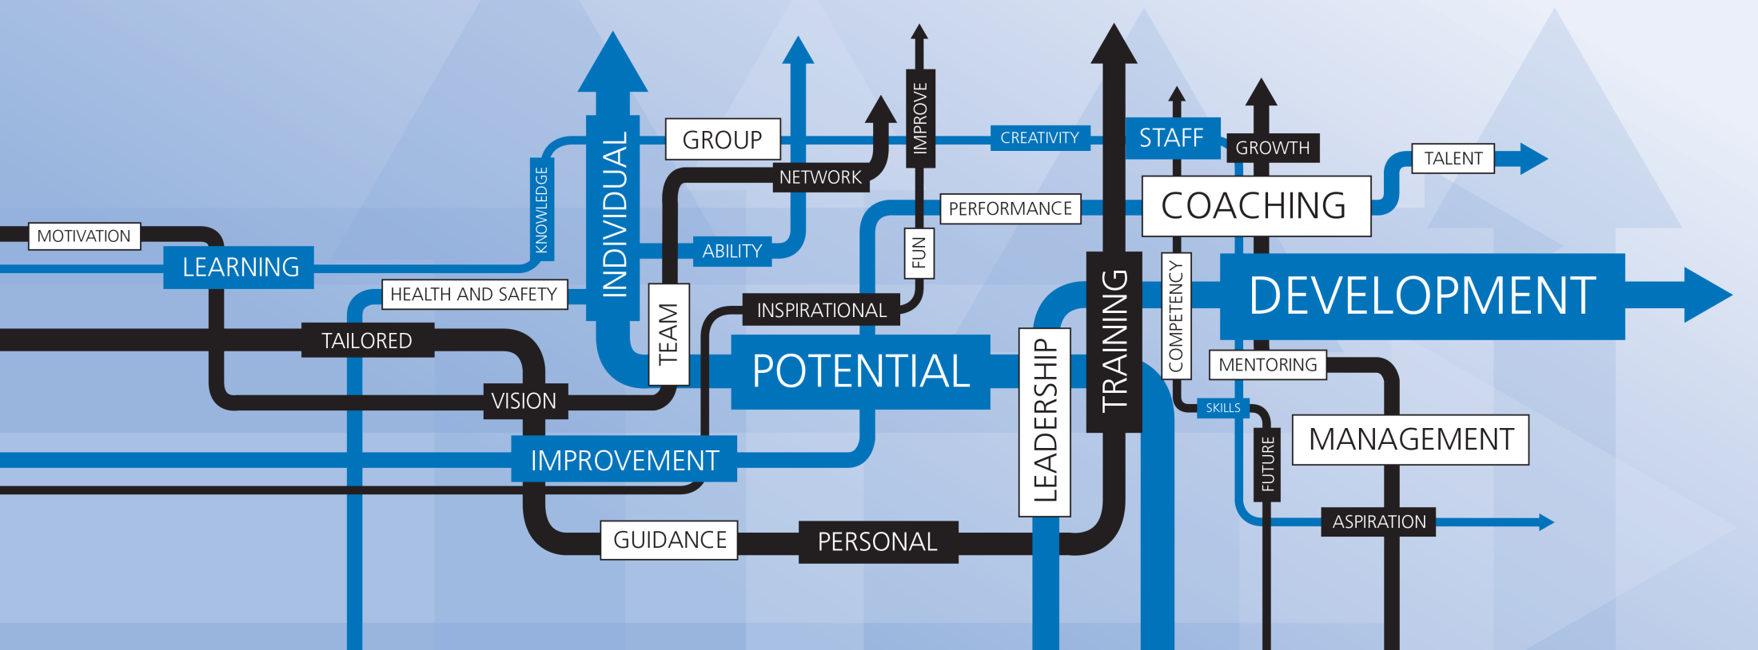
Staff Training and Development Unit The Importance of PDR and making it work

Slide 2
Aims of Session:
Revisit the benefits of an effective Performance and Development Review
Identify the critical factors in making PDR work
Commit to at least one action to make the process more valuable this time round
Consider the respective roles of reviewer and reviewee
Staff Training and Development Unit

Slide 3
Firstly – feedback in response to core brief item Will initiated
More structured and focussed for different staff groups – one size fits all not work?
Paperwork complicated, electronic process?
Links to training provision – how?
Need for clear timescales, link with planning cycle?
Follow up as an issue, mini reviews
The voluntary/mandatory issue still confuses
Links with other HR processes promotion, re-grading, reward?
Refresher training/briefing for reviewers
Some staff question the value
Feedback from others in process – how and role of it
Staff Training and Development Unit

Slide 4
Why – what should be the benefits
Recognition, feedback and valuing of staff/achievements
Clarity of future focus – objectives, standards, alignment with bigger picture and enhanced performance
Supportingthe reviewee to be successful in their job and career
Feedback and support in developing less successful aspects of work
Clearer communications and quality of relationship reviewer/reviewee
Actions to support being successful – training, wider experience, facilities, space – anything
Consideration of future contribution and support in developing career
Staff Training and Development Unit

Slide 5
How was your last PDR - Pairs:
What worked?
What didn't work?
How effective was it?
Summarise in one word?
What were the critical factors resulting in it being effective or ineffective?
Summarise in one word?
Staff Training and Development Unit

Slide 6
Critical factors for Effective PDR
Something happens as a result – its seen to do something
Organised and systematic in the process and follow up – its well managed
Style, approach and commitment of reviewer – its taken seriously
Balance of meeting organisational and individual needs – Its focussed
Reviewees aware of what the process is about, warmed up to it – its desired
Recording and documentation processes followed – Its not forgotten
It is seen as part of a wider process of management and support – it’s not a one off
Senior staff totally engaged and exemplars in process – its role modelled
Staff Training and Development Unit

Slide 7
Role of the Reviewer
Directive Assessment
Reviewee Centred
AIM
One way dialogue,
Tends to ‘what you have done wrong’,
Not engage reviewee,
Telling approach
Cosy chat,
Lacks focus and link to context and University needs.
All about the person,
Laissez faire
Shared responsibility
Performance and Development
University and Individual
Backward and Forward Looking
Balanced and Objective
Staff Training and Development Unit

Slide 8
Role of the Reviewee
Active, involved
AIM
Passive
Let reviewer do majority of talking,
Position self as one down – waiting to be told,
Expect reviewer to know everything about them and their work
Actively prepare – identify achievements and be honest about areas for development,
Ask for recognition and feedback,
Ask for things to support in job,
Tell reviewer what is going on for them.
Take an interest, take some control
Staff Training and Development Unit

