Slide 1
Your Money and Banking
Patrick Ryan
Student Funding Team Leader
Alex Gaskill
Scholarships and Bursaries Officer

Slide 2
Your Money and Banking
This session will:
Examine the costs of living in Manchester
Discuss budgeting and offer tips on managing your finances
Provide information on banking
Notes:
Given your roles as teachers and advisors, you’ll know a lot about student finance and funding!
What we are about to deliver will covers some of the common myths surrounding student finance and will provide you with some TOP TIPS to pass on to your students and their parents.
We won’t go in to the detail of amounts and what students are eligible to receive, as this an vary from student to student and we have included in your conference packs information a useful handout with the 2012 figures for maintenance loan, maintenance grant and how they are assessed etc…
Given that you will know a lot already we thought we would incorporate the opportunity for us to test your expert knowledge as well as expand on some of the facts and information that will be relevant to students starting an undergraduate degree form course in 2012 onwards.
So we are going to do this, Who wants to be a Millionaire style with 13 questions…….

Slide 3
Who Wants to Be a Millionaire
Your Money and Banking

Slide 4
50 : 50
13 £1 MILLION
12 £500,000

11 £250,000
10 £125,000
9 £64,000
8 £32,000
7 £16,000
6 £4000
5 £2000
4 £1000
3 £500
2 £200
1 £100
What is the estimated cost of living as a student in Manchester for a year?
A: £8,300
B: £10,300
C:£12,300
D:£14,300

Slide 5
Estimated living costs 2012/2013 (based on a 52 week postgraduate term)
Accommodation (self catered halls) - £4,900
Meals - £1,965
Books & stationery - £475
Clothes - £475
Transport - £665
Other general expenses - £1,820
Total - £10,300

Slide 6
International Student Calculator
To help you plan, budget and manage your money during your studies in the UK see
www.studentcalculator.org.uk/international

Slide 7
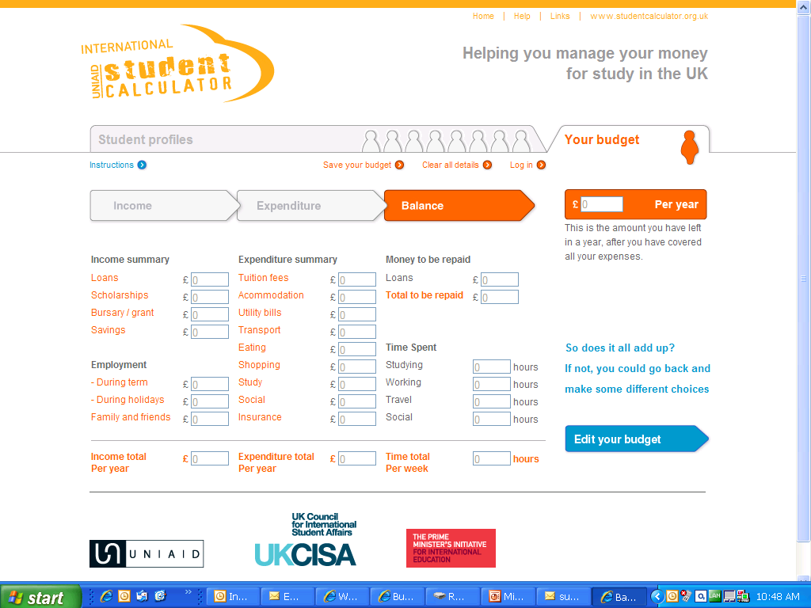

Slide 8
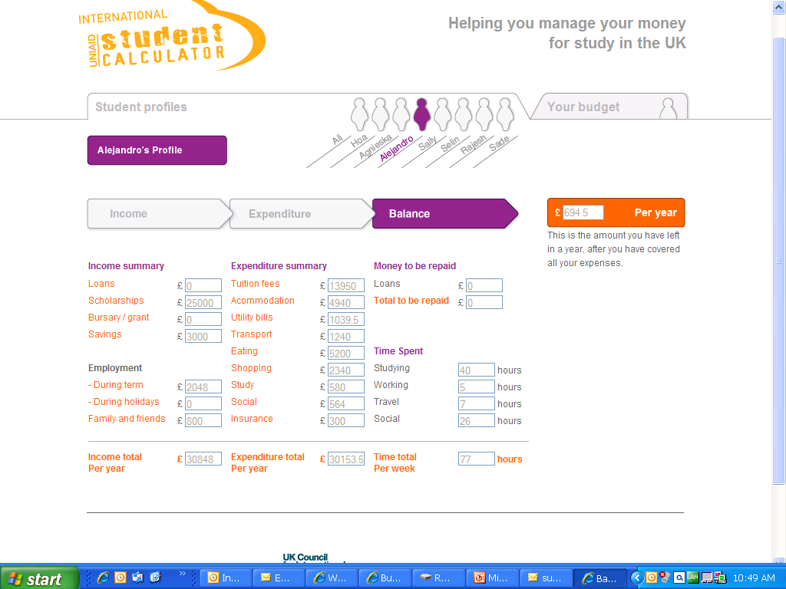

Slide 9
50 : 50
13 £1 MILLION
12 £500,000

11 £250,000
10 £125,000
9 £64,000
8 £32,000
7 £16,000
6 £4000
5 £2000
4 £1000
3 £500
2 £200
1 £100
If you have completed a student budget planner and discover
a shortfall between your income and expenditure what should you do?
A: Consider taking a part time job
B: Do nothing
C: Review your spending
D: Panic !

Slide 10
Balancing your budget
During first few weeks keep receipts and work out exactly how much you are spending. Work out as soon as possible if you need to make cutbacks.
Consider part time work. The University’s Careers Service can offer help and advice on getting part time work, visit www.careers.manchester.ac.uk
Notes:
10
No home/EU student will have to pay for tuition fees up front. Every new home/EU student is entitled to a Tuition Fee Loan that will cover their fees and this won’t have to be paid back until they have completed their studies and they are earning over £21,000 a year.
One of the most important messages when working with home/EU students coming to university under the new fee regime is that there is no cost at the point of entry. All home/EU students are entitled to a tuition fee loan to pay for their fees which goes directly from Student Finance England to the university they are studying at. This money never gets paid to the student.

Slide 11
50 : 50
13 £1 MILLION
12 £500,000

11 £250,000
10 £125,000
9 £64,000
8 £32,000
7 £16,000
6 £4000
5 £2000
4 £1000
3 £500
2 £200
1 £100
Going to a major supermarket is always the cheapest way of shopping?
A:TRUE
B: FALSE

Slide 12
Shopping Tips
Shop around, use budget supermarkets such as Aldi and Lidl or price comparison websites such as www.mysupermarket.co.uk. Also shop locally for food produce such as fruit and vegetables.
Supermarkets use a variety of tactics to try and encourage customers to spend more money. Be aware, special offers may not always be the cheapest option. Also don’t purchase more food then you will actually need.
Notes:
12
Maintenance Loans and Grants are for HOME students only.
Some EU nationals may qualify for a Tuition Fee Loan and additional help, but usually only if all of the following apply:
They are an EU national, or the family member of someone who is
They have lived in the UK for three years or more before their course starts
They will be living in the UK on the first day of the academic year in which their course starts
Their main reason for living in the UK was not to receive full-time education
Their course qualifies (all UG courses at UoM are qualifying)

Slide 13
50 : 50
13 £1 MILLION
12 £500,000

11 £250,000
10 £125,000
9 £64,000
8 £32,000
7 £16,000
6 £4000
5 £2000
4 £1000
3 £500
2 £200
1 £100
Your student ID card can be used to obtain discounts?
A:TRUE
B: FALSE
Notes:
13

Slide 14
Student Discounts
Your student ID card can be used to obtain discounts at shops, restaurants, cinemas etc.
Remember to have your student ID card with you at all times, and don’t be afraid to ask if there are any discounts on offer for students.
Notes:
14
The maximum Maintenance Loan for new home students starting in September 2012 is:
£5,500 for students who live away from home and study at a university or college outside London
65% = £3575, remaining is means assessed
£7,675 for students who live away from home and study at a university or college in London
65% = £4988, remaining is means assessed
£4,375 for students who live at home
65% = £2843, remaining is means assessed
The non means-tested loan is 65% of the total and is available to all eligible students.
The means-tested loan is 35% of the total and is dependent on household income.
Maintenance Loans are paid in 3 instalments (one at the start of each term) directly into a student’s bank account
Of course those students who are millionaires are NOT entitled to any maintenance grant!

Slide 15
Other Budgeting Tips
Use internet call providers like Skype www.skype.com/intl/en-gb
International phone cards available from the Post Office for cheaper calls
If you get a mobile phone, think about how much you will use it and find the best deal. (If you get a contract, you will need a bank account)

Slide 16
Other Budgeting Tips
You can usually get a discount for paying monthly household bills using Direct Debit from a UK account
Save energy costs by: drawing curtains, have heating on a timer
If you are having financial difficulties (eg problems paying your fees) speak to a University representative as soon as possible so they can help you. Ask for help. Don’t struggle on your own.

Slide 17
50 : 50
13 £1 MILLION
12 £500,000

11 £250,000
10 £125,000
9 £64,000
8 £32,000
7 £16,000
6 £4000
5 £2000
4 £1000
3 £500
2 £200
1 £100
What is required to open a UK bank account?
A: Your passport
B: Proof of home address
C: Proof of term time address
D: All of the other options

Slide 18
What is required to open a UK bank account
Need to prove who you are -
your passport
Need to prove where you live
Proof of both of the following addresses may be required
Home address – copy of unconditional offer letter (not a PO box or agent’s address)
Term time address - copy of University accommodation contract

Slide 19
Proof of your address
The University can help you if you have lost or forgotten your proof of address documents.
You can attend a number of our student card issue venues to obtain a bank letter confirming your details.

Slide 20
Why you need a UK bank account
To set up a Direct Debit if you want to pay your fees or accommodation by instalments
Safety and security for your money
Extending your visa
Notes:
SAFETY AND SECURITY – It is not a good idea to carry lots of cash with you. It is best to deposit this in a bank account
• PAYING FOR TUITION FEES – If you need to transfer money from your home country, it is much easier if you have a bank account in the UK. If you cannot pay your tuition fees, you will not be allowed to register. This
means you cannot use the library or computer facilities and begin your studies
• PAYING FOR ACCOMMODATION – When you have set up your bank account it is much easier to pay for your accommodation. This means you have less to worry about.
• EXTENDING YOUR VISA – If you need to extend your student visa you will need to submit three months’ (recent) bank statements to the UK Home Office, in order to show how much money you have for living and studying in the
UK. Having a bank account in the UK helps you to do this quickly and easily.

Slide 21
Direct Debit
A Direct Debit is an instruction that you provide to your bank allowing the University to collect an amount directly from your bank on an agreed date. You may also find that you set up direct debits for other services such as a mobile phone contract

Slide 22
Main banks near the Campus
Barclays www.barclays.com
HSBC www.hsbc.co.uk
Lloyds TSB www.lloydstsbgroup.co.uk
Nat-West www.natwest.com
Royal Bank of Scotland www.rbs.co.uk
Branches of international banks in or around Manchester include:
Bank of China www.bankofchina.com/uk/
State Bank of India www.sbiuk.com

Slide 23
Things to consider
Branches closest to campus will have staff who best understand your needs
Read publicity material carefully (eg ‘student’ accounts may only apply to UK/EU residents)
Most banks open Monday to Friday during business hours. Some may be open on Saturday mornings
Some of the campus banks are represented at the Services Fair for International Students and will have a presence at the Welcome Week fair

Slide 24
50 : 50
13 £1 MILLION
12 £500,000

11 £250,000
10 £125,000
9 £64,000
8 £32,000
7 £16,000
6 £4000
5 £2000
4 £1000
3 £500
2 £200
1 £100
What type of card allows you to both withdraw funds from
cash machines and pay in shops or on-line?
A: Store Card
B: Debit Card
C: Cash Card
D: None of these

Slide 25
Banking Cards
Debit cards can be used to withdraw cash and also pay for goods and services in a store or on-line.
Cash cards can normally only be used to withdraw cash
Store cards are a type of credit card specific to a particular store

Slide 26
50 : 50
13 £1 MILLION
12 £500,000

11 £250,000
10 £125,000
9 £64,000
8 £32,000
7 £16,000
6 £4000
5 £2000
4 £1000
3 £500
2 £200
1 £100
It is free to use the vast majority of banks‘ cash machines
no matter who you bank with?
A:TRUE
B: FALSE

Slide 27
Cash machines
Most cash machines will not charge you for using them. None of the cash machines outside banks will charge.
Some machines inside pubs and convenience stores do have a £1.50 charge. This will be clearly marked on the machine.
Using your debit card will be cheaper than your credit card, which will charge you a fee for making the withdrawal.

Slide 28
Top Tips
Choose paper statements that are issued monthly as you will need these for any visa extension applications. (Internet printouts from online accounts will not be accepted.)
You are the customer so choose the bank that suits YOUR needs
If there are monthly fees for additional services consider whether you really need them
Check carefully what a bank requires to open an account – it will save you time.

Slide 29
Security Tips
Don’t carry large amounts of cash with you
Don’t use cash points (ATMs) late at night
Guard your PIN carefully
Don’t lend your card to anyone
If you use internet banking, be careful when accessing your account in public clusters of PCs

Slide 30
Useful websites
For more information, tips and terminology about banks www.ukstudentlife.com/Life/Money.htm
Exchange rates - to find the current value of pounds in your currency www.xe.com
Compare current account interest rates www.moneyextra.com/compare/current

Slide 31
Useful websites
International Student Calculator
www.studentcalculator.org.uk/international
The UK Council for International Student Affairs
www.ukcisa.org.uk/student/information_sheets.php
National Union of Students – ‘NUS Extra’ discount card
www.nus.org.uk
Skype internet calls
www.skype.com/intl/en-gb
University of Manchester Crucial Guide Live
www.studentnet.manchester.ac.uk/crucial-guide

Slide 32
Thank You!
Any questions?
www.manchester.ac.uk/international/orientation

