Slide 1
MANCHESTER A Global University in a Globalising City-region
ROD COOMBS
DEPUTY PRESIDENT AND DEPUTY VICE CHANCELLOR
UNIVERSITY OF MANCHESTER

Slide 2
The University of Manchester: a ‘Civic-Global’ Institution
Victoria University of Manchester and UMIST were formed as “civic institutions” in the nineteenth century
Deep roots in the industrial and philanthropic underpinnings of Manchester’s civic pride
But - disconnect with civic hinterland occurred in 1980s and 1990s
Resurrected sense of civic engagement coincided with creation of the new University following the dual dissolution of VUM and UMIST in 2004
[Pre-cursor Focussing role of Commonwealth games in 2002]

Slide 3
The Rationale for the Merger of VUM and UMIST: the city region dimension
Two research-intensive Universities immediately adjacent to each other
Neither quite strong enough to break away from the pack
Combined strength gave ability to position Manchester to mount a long term challenge to unique supremacy of golden triangle
At the time, the narrative of ‘rebalancing’ and of a ‘duo-pole UK economy’ was being developed in the North – now it is becoming more widely received wisdom
Manchester as a city was on an upward trajectory and saw the synergies with the ambition of the University
City, Region, and national support for the merger
Unique alignment of national, regional, civic, and educational logics.

Slide 4
A Mutual Relationship- 2004 to 2014
The emergence of the city region as a Combined Authority – pooling sovereignty, demanding more autonomy, reforming services and delivery
Developing a stronger strategic narrative, with knowledge-intensive industry and service activity at the heart of the economy
The University grows its global connections; trebling overseas students and income – and recognises the attractor power of the city and its brand
Growing collaboration on winning ‘bidding’ opportunities for the city
The global University in the ‘original modern’ city….
2012 – Graphene Nobel Prize encapsulates the narrative

Slide 5
Our Importance to the City: 1 The University of Manchester: an Economic Engine
41st ranking Jiao Tong index 2013
40,000 students-of which 12000 post graduate
10,000+ staff
£800m annual budget- more than Manchester City FC, Manchester Airport, and Manchester United FC combined
4th highest earning UK University
A significant real estate with a new £1bn masterplan signed off
£1.15bn contribution to GDP in 2011/12

Slide 6
Our Importance to the city: 2 The University of Manchester: an International Institution
The most globally connected institution in Greater Manchester
10,000 non EU students
University export earnings of £180M
£100m off-campus expenditure of students
24% of revenue comes from international sources
25% of academic staff born outside UK
Strategic research partnerships with many global companies
Major driver of traffic through Manchester Airport
Major contributor to global Manchester brand

Slide 7
The University of Manchester: a Place-Maker
A defining part of the economic offer of the City Region
University estate - quality buildings in a quality landscape
Cultural contribution
Whitworth Art Gallery
Manchester Museum
John Rylands University Library
Contact Theatre
Jodrell Bank
Enterprise
Role of UMI3 – spin outs , venture capital, collaborations
Oxford Road Corridor–extending the CBD southwards

Slide 8
Corridor Manchester
Funding stakeholders
University of Manchester
MMU
Manchester City Council
Hospital Trust
Bruntwood/ msp
Background
55,000 people work on the Corridor, which is 18% of the City’s workforce.
80,000 students study on the Corridor.
43% of the activity is in knowledge-intensive sectors, which is much higher than national (22%) and regional (21%) averages.
generates £2.8bn which is 22% of the City’s GVA.

Slide 10
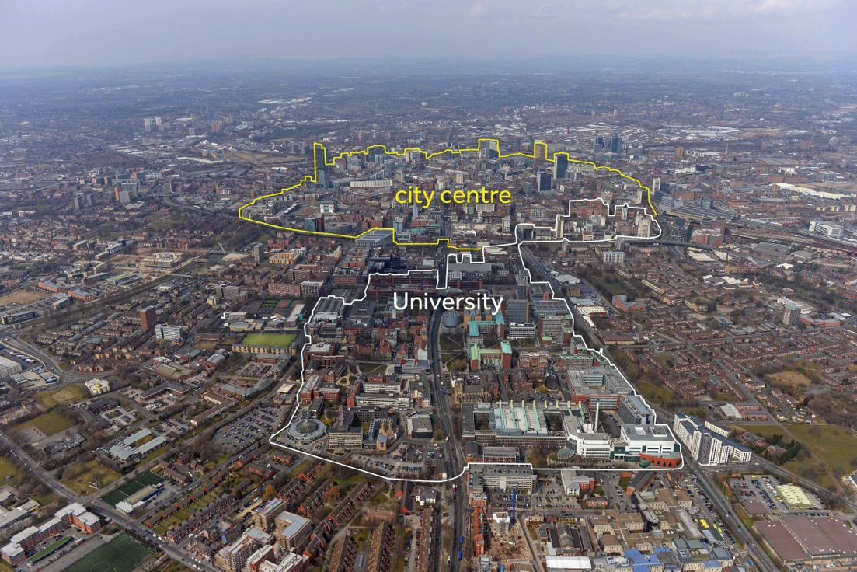

Slide 11
Corridor Investments
Half way through a 10 year, £3 billion development
Over the next five years the investments include;
The University of Manchester Estates Masterplan phase 1 (2012-2018) = £700 million will include the new Manchester Engineering Campus Development, School of Law and Manchester Business School,
Manchester Metropolitan University £160 million, including Birley Fields campus,
Central Manchester University Hospitals NHS Foundation Trust = £50 million in planned investments for Central Manchester site
Manchester Science Park expansion = £50 million
2014 Central Library = £48 million (opening 2014)
Citylabs = £28.5 million (opening 2014)
Creation of HOME Cultural Facility = £25 million (opening Spring 2015)
Cross City Bus (part of a £54 million overall scheme within Greater Manchester of which Oxford Road is one component)

Slide 12
The Tools of Partnership
City Region Governance
University Membership of LEP
Membership of City Region bodies
Informal University/ City Region Partnership Steering Board
City and University shareholders in Manchester Science Park (now owns Alderley Park)
Collaboration on International and inward investment groups and initiatives- eg China
Collaboration on Cultural Strategy for the City
Engagement of University in wider Manchester community:
Employment and Skills initiatives
Working with Schools

Slide 13
Big Picture
Manchester is the only city-region capable of becoming a complementary UK economic driver to the London complex
The University is a key part of that strategy
Creates alignment of interests between us
National policy now recognises this is positive for UK
Many future opportunities

