Slide 1
“Getting to Know Me”
Supporting people with dementia in general hospitals
Part 4: The impact of the hospital environment
© University of Manchester/Greater Manchester West Mental Health NHS Foundation Trust/Royal Bolton Hospital NHS Foundation Trust

Slide 2
Aims
To consider which aspects of the hospital environment can be challenging for people with dementia
To explore ideas on practical ways to improve the physical environment

Slide 3
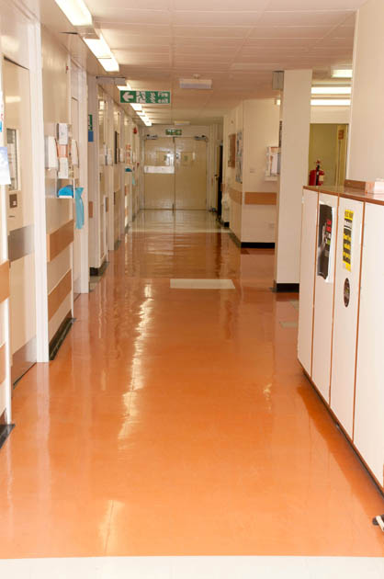
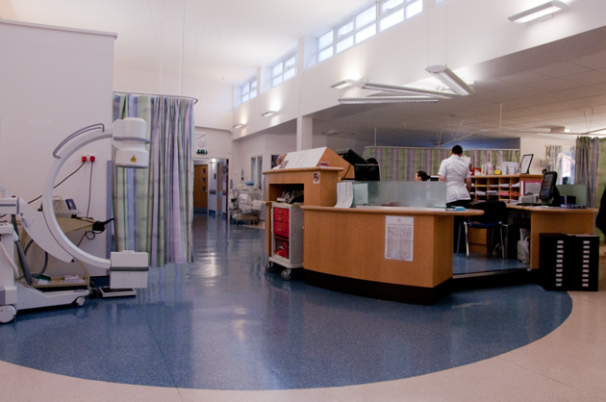
What features of the hospital environment may cause difficulties for people with dementia?

Slide 4
Creating an “accessible” hospital environment for people living with dementia 1
Way-finding – what works?
Noise – what works?
Signage that is clear/at an appropriate level, and uses pictures as well as words
Objects/pictures/themes on walls that distinguish and identify areas
Handrails with strong colour contrast to walls
Walls and floors clearly distinguished by colour contrast
Reduction in noise where possible, particularly at night
Opportunity for patients to access quieter areas

Slide 5
Creating an “accessible” hospital environment for people living with dementia 2
Lighting – what works?
Familiarity –what works?
Avoid unnecessary moves within or between wards
Familiar items from home for the bedside area
Distinguishing features to help patients identify their own bed areas and bays
Pictures of interest in communal areas
Bright but avoiding glare
Natural light where possible

Slide 6
Creating an “accessible” hospital environment for people living with dementia 3
Flooring – what works?
Occupation/relaxation – what works?
Flooring that does not reflect glare, and is of uniform colour e.g. avoiding patterns or abrupt changes in contrast
Social areas that are homely, restful, and interesting
Access to outdoor spaces and other facilities in the hospital e.g. shops/cafes
Things of interest to look at e.g. pictures/murals/views from windows
Books and interesting items

Slide 7
Creating an “accessible” hospital environment for people living with dementia 4
Mealtimes – what works?
Toilets and bathrooms
– what works?
A calm and quiet environment
The opportunity to eat with others if this is preferred (and possible)
Contrasting colours for plates and cups against table surfaces
Warm, light and offering privacy
Clearly signed
As “non-clinical” as possible
Adapted from Dementia Service Development Centre (2009)

Slide 8
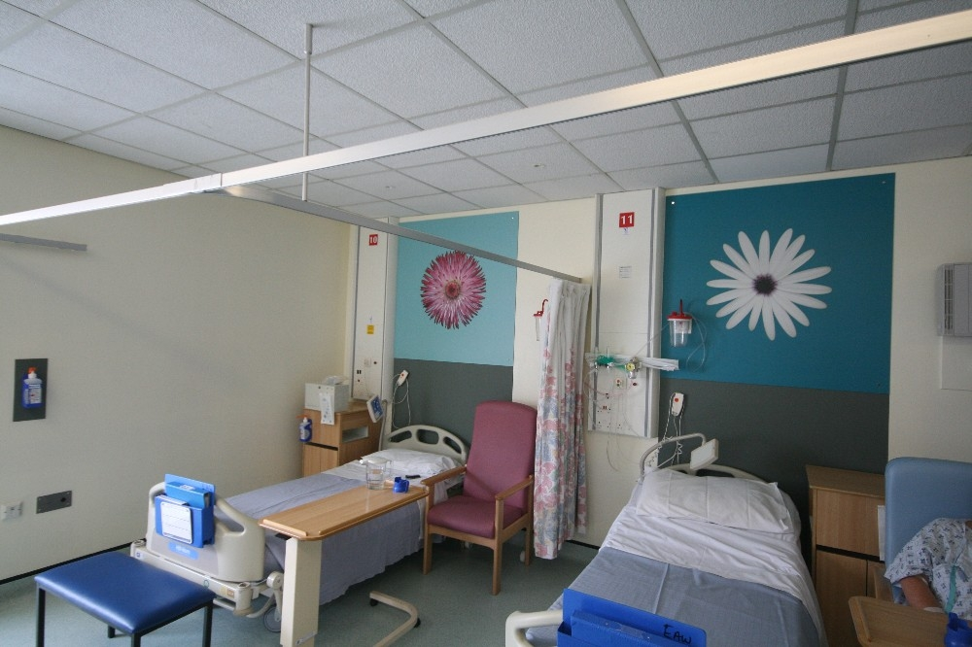
The King’s Fund Enhancing the Healing Environment Photo Library

Slide 9
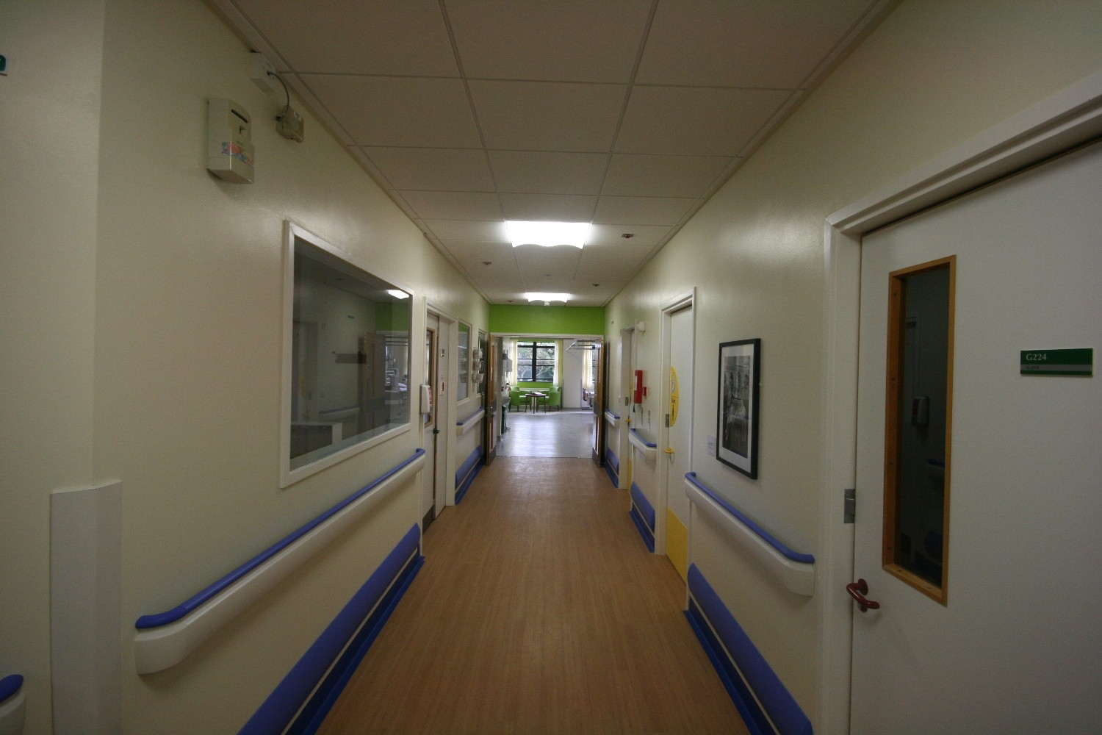
The King’s Fund Enhancing the Healing Environment Photo Library

Slide 10
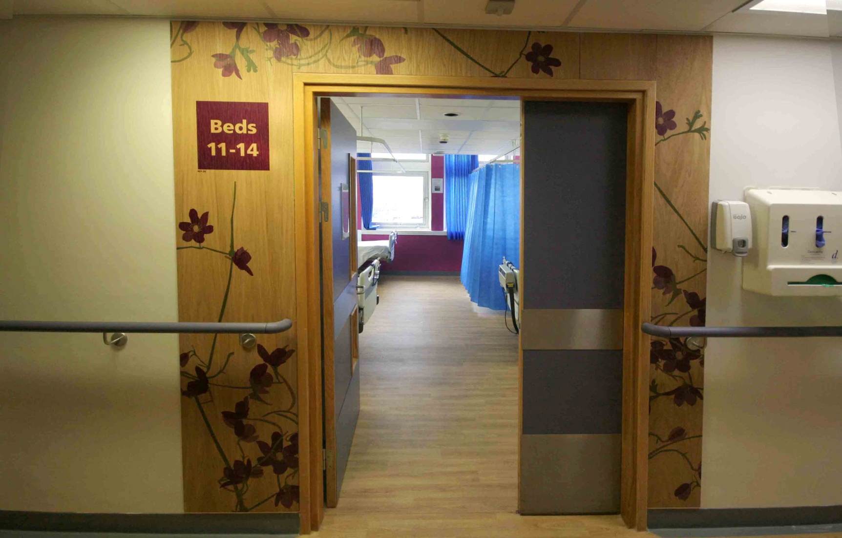
The King’s Fund Enhancing the Healing Environment Photo Library

Slide 11
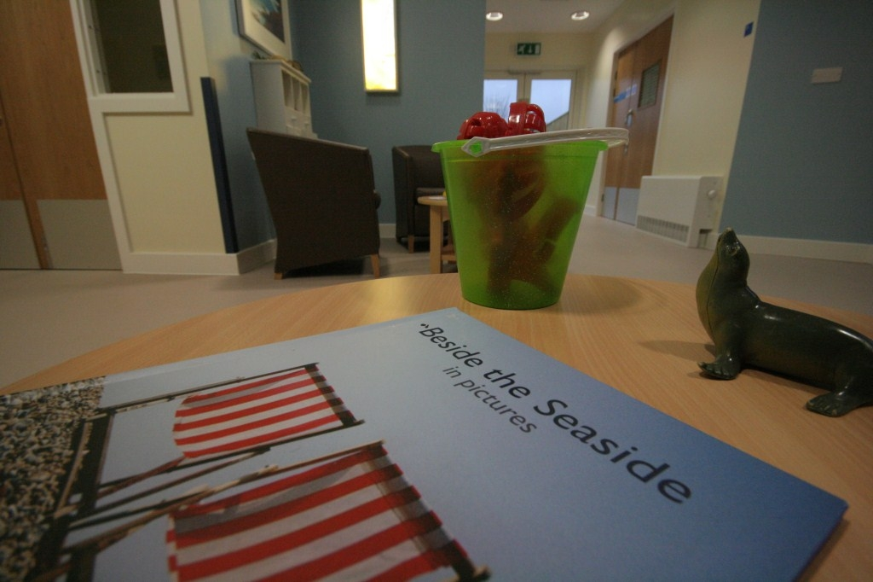
The King’s Fund Enhancing the Healing Environment Photo Library

Slide 12
Any Questions?

