Slide 1
Extracellular environment (Outside)
Cytoplasm (Inside)

Slide 2
Cut out the membrane proteins using the dotted lines

Slide 3
Channel
Spans the membrane and allows molecules to pass through a central channel or pore. Can squeeze shut to stop things leaking out or getting in when they’re not supposed to.
Cholesterol
A structural protein that gives the membrane strength and rigidity.
Integral Membrane protein
A protein which is embedded in the membrane between the lipids. The thick parts that dislike water hide in the membrane and the thin parts that like it poke out. These can create channels or receptors.
Receptor
Molecules can bind to the receptor on one side of the membrane. The receptor then transduces the signal across the membrane to cause a change on the other side.
Peripheral membrane protein
The protein is associated with other proteins or lipids in the membrane but not in between them. These can be cleaved to float away from the membrane and act as signalling molecules.
Lipid membrane
Made of a double layer (bilayer) of phospholipids. The red heads like water, the yellow tails hide from it. This is why they arrange themselves in this way

Slide 4
Questions
Can you make a membrane that is good for:
Signalling?
Transport?
structural strength?
What other things might membranes do in the cell?

Slide 5
Cell Border force – Instructions
Assign the following roles to the indicated number of students (approx)
Lipid x10
Water x2
Protein x2 – soluble/membrane (passports)
Signalling molecule x1
Intracellular Messenger x1
Virus x1 (Fake passport)
Ions x3 (sodium and potassium ion sheets. Balance - Potassium high in cells, sodium high outside)

Slide 6
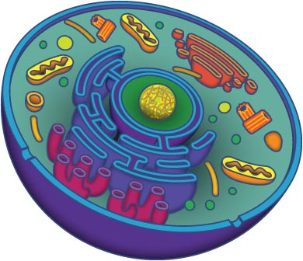
PASSPORT
This document allows the bearer into the cell:
CYTOPLASM
EU
Eukaryotic Union
Official EU hologram

Slide 7
PASSPORT
This document allows the bearer into the cell:
MEMBRANE
EU
Eukaryotic Union
Official EU hologram

Slide 8
PASSPORT
This document allows the bearer into the cell:
CYTOPLASM
EU
Eukaryotic Union

Slide 9
Na⁺
^{(sodium ion)}

Slide 10
K⁺
^{(potassium ion)}

Slide 11
Other ideas
Build 3D membrane – Playdoh membrane, insert proteins? See http://teach.genetics.utah.edu/content/begin/cells/print/BuildAMembrane.pdf
Model cell – papier mache round balloon with inserted tubes for channels, etc. Can ask students to try and identify types of proteins.
Cell cookies?

