Slide 1
“Getting to Know Me”
Supporting people with dementia in general hospitals
Part 6: A person centred understanding of behaviour that challenges
© University of Manchester/Greater Manchester West Mental Health NHS Foundation Trust/Royal Bolton Hospital NHS Foundation Trust

Slide 2
Aims
To explore meanings behind behaviours that we can find challenging
To draw together all six parts of the training
To consider the changes staff may make to their practice
6.2

Slide 3
What behaviours do you find most challenging
and why?
What factors might influence a person’s behaviour?
Biological
Cognitive damage
Physical health e.g. pain, delirium
Sensory impairment
Physical needs e.g. thirst, hunger, need for the toilet
Psychological
Thoughts, perceptions, and interpretations of what is happening
Feelings e.g. worry, frustration, anger, joy
Social
Interactions with others
Absence of family members
Impact of the hospital environment
Lack of stimulation

Slide 4
What we see...
The behaviour e.g.
shouting /pacing/resisting care…
Feeling lost
What we don’t see…
Side effects of drugs
Differing perception of reality
Visuoperceptual difficulties
Need for emotional comfort
Anxiety
Physical e.g. need for: food, fluid, pain relief, toilet
Cognitive difficulties
Need to be occupied
Fear
Delirium
(Adapted from: James, 2011)

Slide 5
Case study 1
Mrs Williams

Slide 6
Sylvia Williams is a 73 year old lady of Jamaican origin. She has a diagnosis of dementia and was admitted four days ago from a care home with a respiratory infection. Mrs Williams is responding well to antibiotics and oxygen via a nasal cannula, but is constantly “on the go”. Mrs Williams walks around the ward, becoming breathless and disorientated. One day she left the ward and was discovered “lost” in the grounds of the hospital.
Possible biological factors?
Possible psychological factors?
Possible social factors?

Slide 7
Additional information
Health
Wears dentures and spectacles for long distance
Physical health improving after illness
Social
Receives visits in the evening by her daughter Angela, and friends from her church
Psychological
Becomes agitated when she is prevented from walking and escorted back to bed
Often heard asking for Angela or Edna
Getting to Know Me
Angela provides some additional information on her mother’s “Getting to Know Me” card…

Slide 8
Sylvia Williams
Mrs Williams

Slide 9
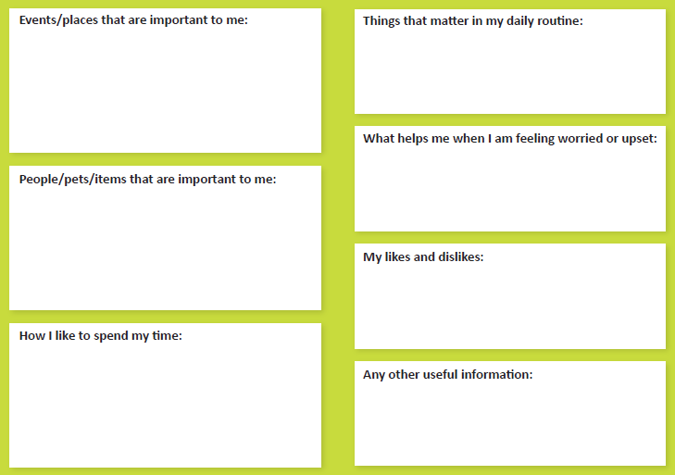
I grew up in Kingston, Jamaica, and emigrated to England in 1962 with my late sister, Edna. I have lived in Manchester ever since. I worked for many years in a textile factory and have two children, Angela and Malcolm, and five wonderful grandchildren.
I eat cornflakes and fresh fruit for breakfast. At my care home “Meadow View”. I get up 6.30 and always have a nap after lunch. Most days I like to spend some time in the garden.
Angela is a great comfort to me, as are my friends. When I am worried and need comfort I sometimes like to pray.
My dear husband, Clifford, died twenty years ago but I treasure fond memories of him. I adore my children and grandchildren but cannot always remember their names. My friends from church are all important to me.
I don’t like too much noise, particularly people shouting and laughing noisily. I feel lost and frightened when there is no one around that I know.
I like the company of children who bring joy to me. I enjoy flowers and gardens and used to arrange the flowers for our church.
I am told I have a lovely voice and I like to sing. Angela takes me to church every Sunday.
I sometimes have problems finding the loo and worry that I might not get there in time.

Slide 10
With the additional information we now have on Mrs Williams:
1. What might be influencing the observed behaviours?
2. What care/interventions could we provide?

Slide 11
Case study 2
Mr Samadi

Slide 12
Mr Samadi has advanced dementia. He has lost the ability to walk and to feed himself. As he sits in his chair or lies in bed he repeatedly calls out. This shouting annoys other patients in his bay. Mr Samadi’s family inform you that the words he repeatedly shouts are not intelligible in English or Persian (his first language).
Possible biological factors?
Possible psychological factors?
Possible social factors?

Slide 13
Additional information
Health
Has an indwelling catheter
Manages a soft diet and thickened fluids
Pressure sore with dry dressing to left heel
Social Factors
Mrs Samadi visits every evening
Psychological
Sometimes seems unsettled
Appears a little calmer with physical contact e.g. holding of hand, particularly by his wife
Getting to Know Me
Mr Samadi’s children have completed a “Getting to Know Me” card…

Slide 14
Ahmad Samadi
Mr Samadi

Slide 15
Father was born in Iran in 1942. His family moved to London in the 1950s. He studied dentistry in Manchester in 1960 where he soon met and fell in love with our mum, Anne. Our father set up a successful dental practice in Sale. He has 4 children and 7grandchildren.
Father no longer has routines but he still seems to like regular drinks of chai (sweetened tea made with condensed milk).
When father is upset we talk to him, and massage his hand when he lets us do so. The sound of mother’s voice often soothes him.
Father is very close to all his family and has always been devoted to his grandchildren.
Father dislikes being alone. He will call out words none of us understand, but he often becomes calmer when we are around.
Our father’s life-long passion has been for flying, he used to own and pilot a light aircraft. In more recent times he has enjoyed the company of his family and spending time in the garden.
Our father used to enjoy jazz and traditional Iranian classical music.
Father can no longer manage solid foods but likes regular sips of thickened chai. He often gets discomfort from the area around his catheter which makes him upset.

Slide 16
1. What might be influencing Mr Samadi’s behaviour?
2. What care/interventions could we provide?

Slide 17
Behaviour that Challenges:
Establishing the Meaning
Consider using a behaviour monitoring chart to identify patterns and triggers
As a team, utilise all your knowledge of the person to consider what might be the cause of their behaviour. Share your ideas and begin to eliminate those that can be discounted
Talk to relatives, they are likely to know the person the best

Slide 18
Any Questions?

Slide 19
“Getting to Know Me” - Key Messages
Focus on feelings and try to put yourself in the person’s shoes
Try to help create a sense of security and familiarity
See all behaviour as having “meaning”
Provide opportunities for meaningful activity
Think about how best to support and involve relatives
See the person not the dementia

Slide 20
Improving care for hospital patients who are living with dementia – next steps…
The 3 changes I will personally make are:
1.
2.
3.

Slide 21
References (Parts 1-6)
Alzheimer’s Society (2007). Dementia UK: A report to the Alzheimer’s Society by King’s
College London and London School of Economics. London: Alzheimer’s Society.
Alzheimer’s Society (2012). Dementia 2012: a national challenge. Retrieved June 17, 2013, from www.alzheimers.org.uk/dementia2012
Bryden, C. (2005). Dancing with Dementia. London: Jessica Kingsley.
Dementia Services Development Centre (2009) . Caring for people with dementia in acute care settings; a resource for staff. Stirling: Dementia Services Development Centre .
Department of Health (2012). Using the commissioning for quality and innovation (CQUIN) payment framework .
Guidance on new national goals for 2012-13. London: Department of Health.
James, I. (2011). Understanding behaviour in dementia that challenges: A guide to assessment and treatment. London: Jessica Kingsley.
Kitwood, T. (1997). Dementia reconsidered. Buckingham: Open University Press.
National Institute for Health and Care Excellence/Social Care Institute for Excellence (2006). Dementia: Supporting people with dementia and their carers in health and social care. NICE clinical practice guideline 42. London: National Institute for Health and Care Excellence.
NHS Confederation (2010). Acute awareness: Improving hospital care for people with dementia. London: NHS Confederation.
Royal College of Psychiatrists (2005). Who cares wins: Improving the outcome for older people admitted to the general hospital. London: The Royal College of Psychiatrists.

Slide 22
Thank You

